Slide 1
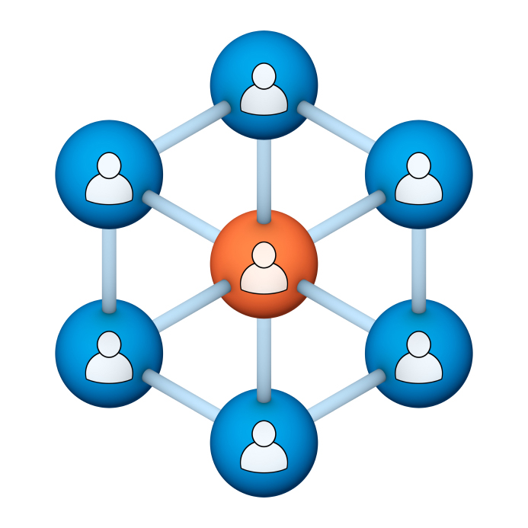
Administrators
Users Group
Meeting

Slide 2
Housekeeping
Right-click on the orange arrow and you’ll see two options: Auto-Hide Control Panel or Show Control Panel.
Clicking on “Show Control Panel” will let you keep the control panel open throughout the presentation.

Slide 3
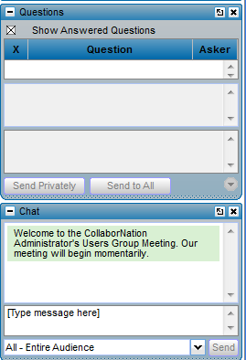
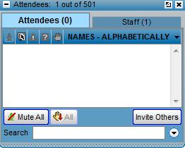
Housekeeping
If you have a question, please type it into the questions area on your “Go To Webinar” control panel. We want to encourage questions, so please feel free to type them in at any time.
You may raise your “hand” if you are asked to respond during the presentation.

Slide 4
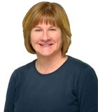
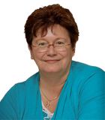
Our Presenters
Chris Glenn, Customer Service Rep, CypherWorx
Debbie DiBacco, Director, Client Services, CypherWorx

Slide 5
Agenda
Login info
Forgot Password
Events
Reporting Review
http://en.wikipedia.org/wiki/Firefighting_in_the_United_States
Notes:
Paul: Introduce who the development partners are – Newroads/Roberta & CypherWorx
The partners agree that all will be involved and be invited to every presentation. We will also agree to communicate in some form prior to each meeting.

Slide 6
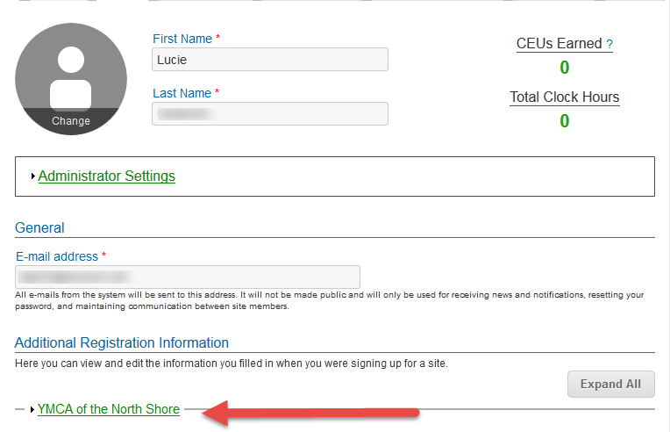
Registration
Importance of the URL:
Specific URLs for each site
Naming convention is: https://collabornation.net/ login/yoursiteinfohere
Without that URL, a customer registers incorrectly (usually into collabornation.net) without the courses they need.
NOTE: NP Training Works is no longer active. Please make sure that URL is not given to out to employees.
EXAMPLE: https://collabornation.net/login/ymcanorthshore

Slide 7
Forgot Password

Slide 8
Forgot Password
The email you will receive will be from CollaborNation.
Below is a sample of the subject line and the email.

Slide 9
Forgot Password
Click the gray Log in button and then create a new password:

Slide 10
Events – how site members can register
and

Slide 11
Reporting Review
How to look up a certificate
What is tracked:
Courses
Additional Training submissions
Resource downloads
Events participation
Common elements and how to use
Questions? What else do you want to see?

Slide 12
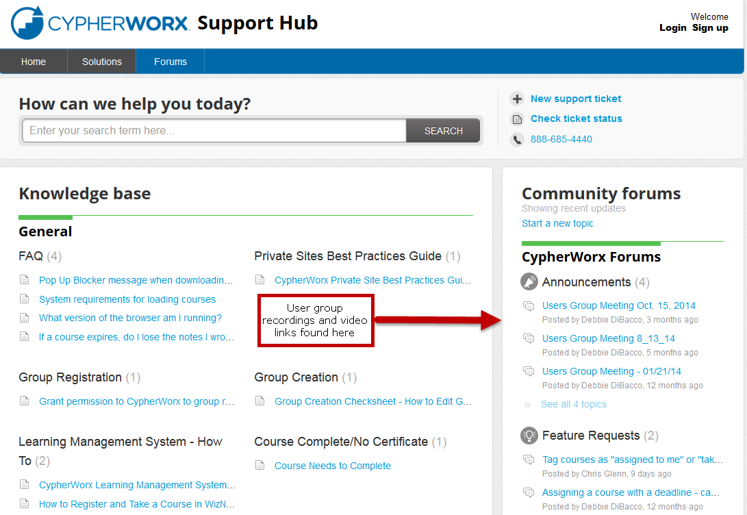
Support Hub

Slide 13
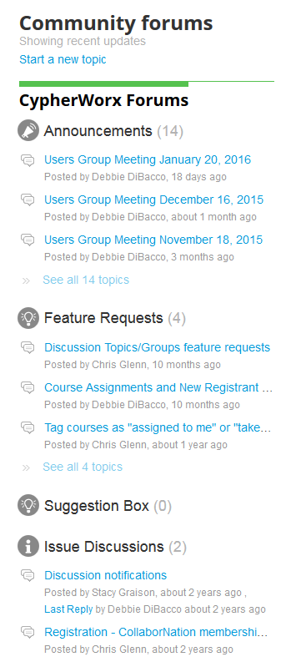
Suggestions
If you have any suggestions, and/or would like to request a new feature that would increase YOUR overall customer experience with our system, then please share them with us.
Any features which are incorporated into our LMS will be announced on next month’s call. By sharing your ideas with us you are assigning us all rights to the features.
In appreciation of your time, submitters whose features are incorporated into our LMS will be sent a $5 Starbucks gift card as a quick “Thank You!”
http://support.cypherworx.com/support/discussions
Click on “Suggestion Box” to add your ideas
in our community forum

Slide 14
Contact Info
Please feel free to reach out to any of us after the webinar if you have more questions.
Debbie DiBacco – ddibacco@cypherworx.com
Chris Glenn – cglenn@cypherworx.com
Al Ryan – aryan@cypherworx.com

