Slide 1
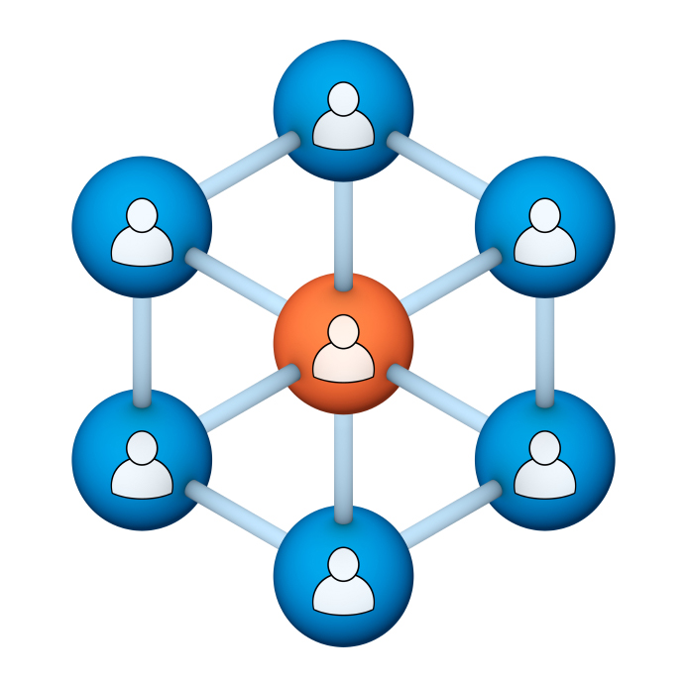
Administrators
Users Group
Meeting
10/19/16

Slide 2
Housekeeping
Right-click on the orange arrow and you’ll see two options: Auto-Hide Control Panel or Show Control Panel.
Clicking on “Show Control Panel” will let you keep the control panel open throughout the presentation.

Slide 3
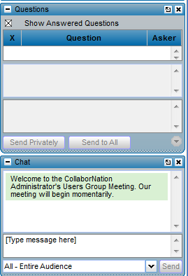
Housekeeping
If you have a question, please type it into the questions area on your “Go To Webinar” control panel.
We want to encourage questions, so please feel free to type them in at any time.

Slide 4
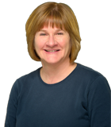
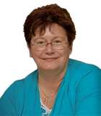
Our Presenters
Chris Glenn, Customer Service Rep CypherWorx, Inc.
Debbie DiBacco, Director, Client Services CypherWorx, Inc.

Slide 5
Agenda
Registration URL
New password request
Discussions
Events in Teams
CalSAC courses
http://en.wikipedia.org/wiki/Firefighting_in_the_United_States
Notes:
Paul: Introduce who the development partners are – Newroads/Roberta & CypherWorx
The partners agree that all will be involved and be invited to every presentation. We will also agree to communicate in some form prior to each meeting.

Slide 6
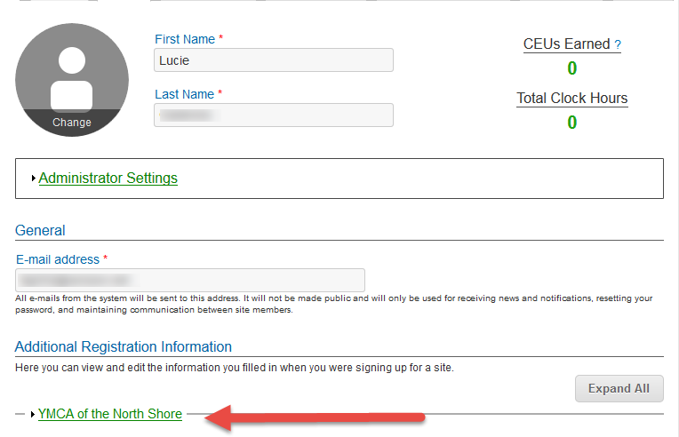
Registration
Importance of the URL:
Specific URLs for each site
Naming convention is: https://collabornation.net/ login/yoursiteinfohere
Without that URL, a customer registers incorrectly (usually into collabornation.net) and without the courses they need.
EXAMPLE: https://collabornation.net/login/ymcanorthshore

Slide 7
To get a new password
NOTE: Think Together employees will still have to call/email for a new password

Slide 8
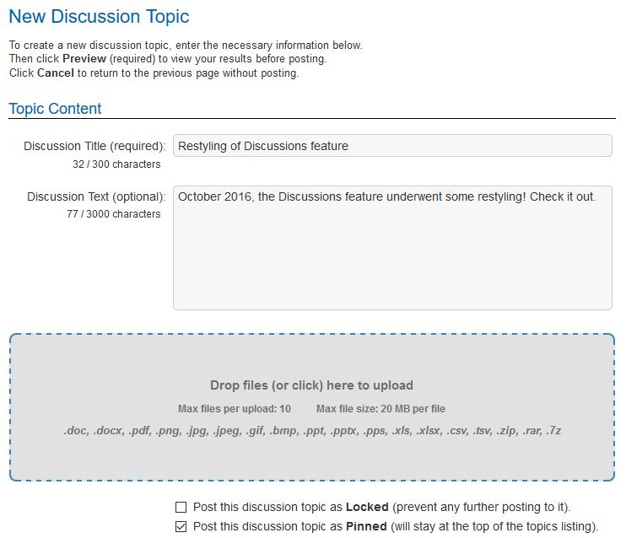
Discussions
The Discussions feature has been restyled.

Slide 9
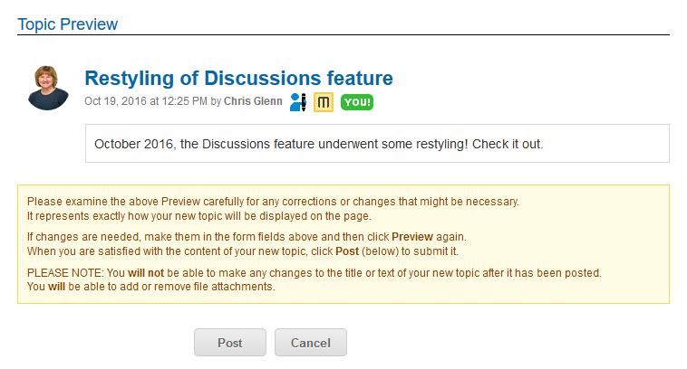
Discussions
Here’s what the Preview section now looks like.
Learner icons/pictures will show
Icon holding pen indicates the Learner is the author
Yellow icon with “M” = Manager of the discussion, in this case, me!

Slide 10
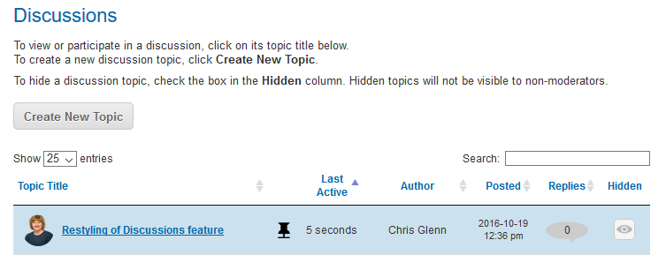
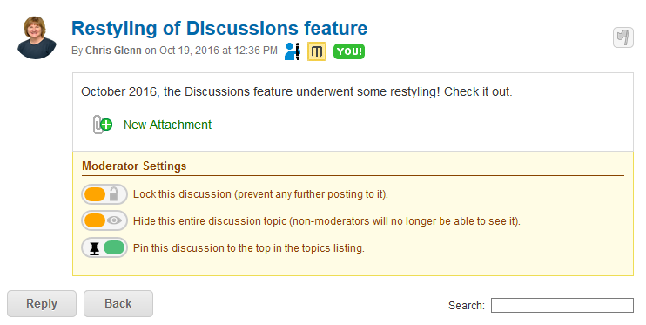
Discussions
Main Discussion board for admins will show the “Hidden” column.
Click on Discussion Topic Title and the settings have a new look, and this is where you go to:
Lock or unlock a discussion
Hide a discussion
Pin or unpin a discussion

Slide 11
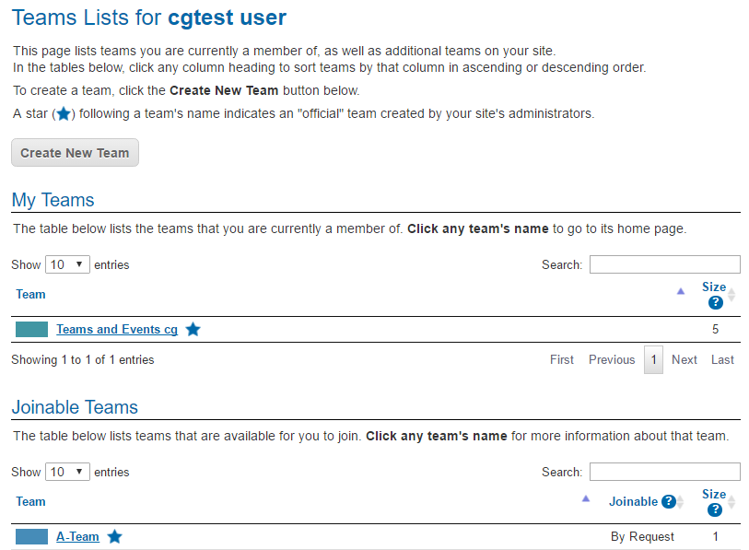
Events in Teams
A Learner can log in and click on the Teams menu option, then click the title of their team to view Events.
This screenshot shows the list of the Learner’s team(s) and then a list of Joinable teams beneath that.

Slide 12
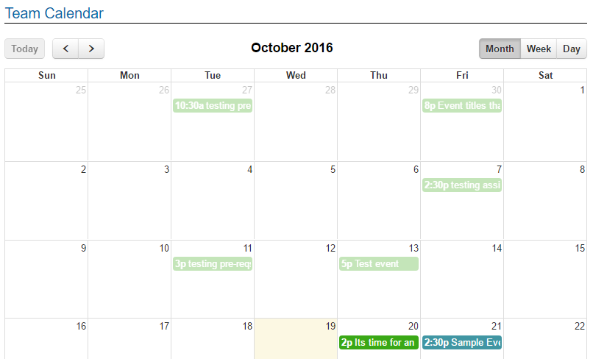
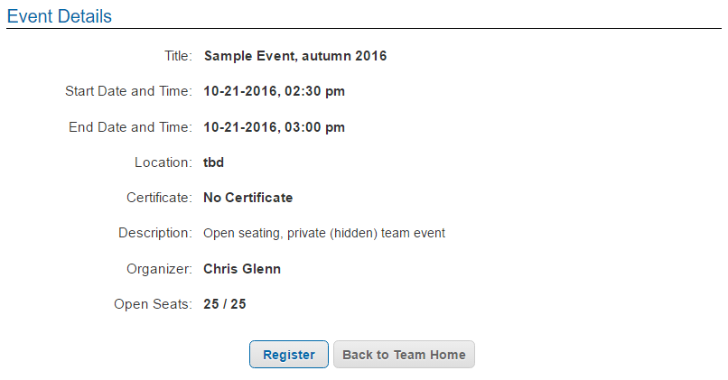
Events in Teams
An event in a team will only show on the Team’s calendar, not the main Events calendar.
Team Members should go to Teams, click to open their team and then click on the Event in their calendar to Register.

Slide 13
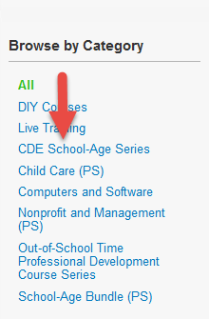
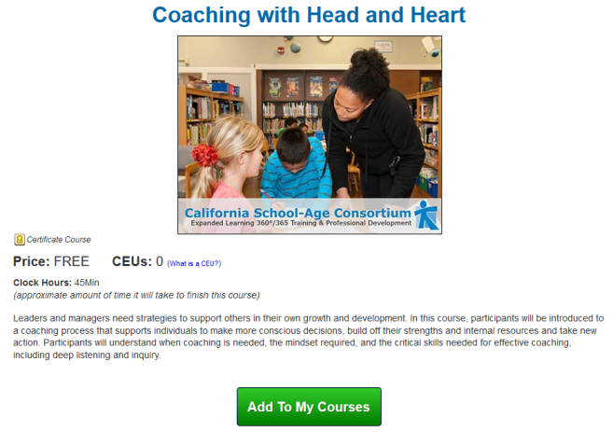
9 New Courses in the CDE School-Age Series Catalog
Coaching with Head and Heart
Going Deeper: Supporting Social-Emotional Learning and Character Development
I Am: Supporting Self-Awareness and Self-Management
I Belong: Supporting Social Awareness and Interpersonal Skills
I Can: Supporting Growth Mindset and Self-Efficacy
Leading Teams and Organizations with Head and Heart
Leading with Head and Heart
Social-Emotional Learning, Character Building and Enhancing Quality Supervising with Head and Heart

Slide 14
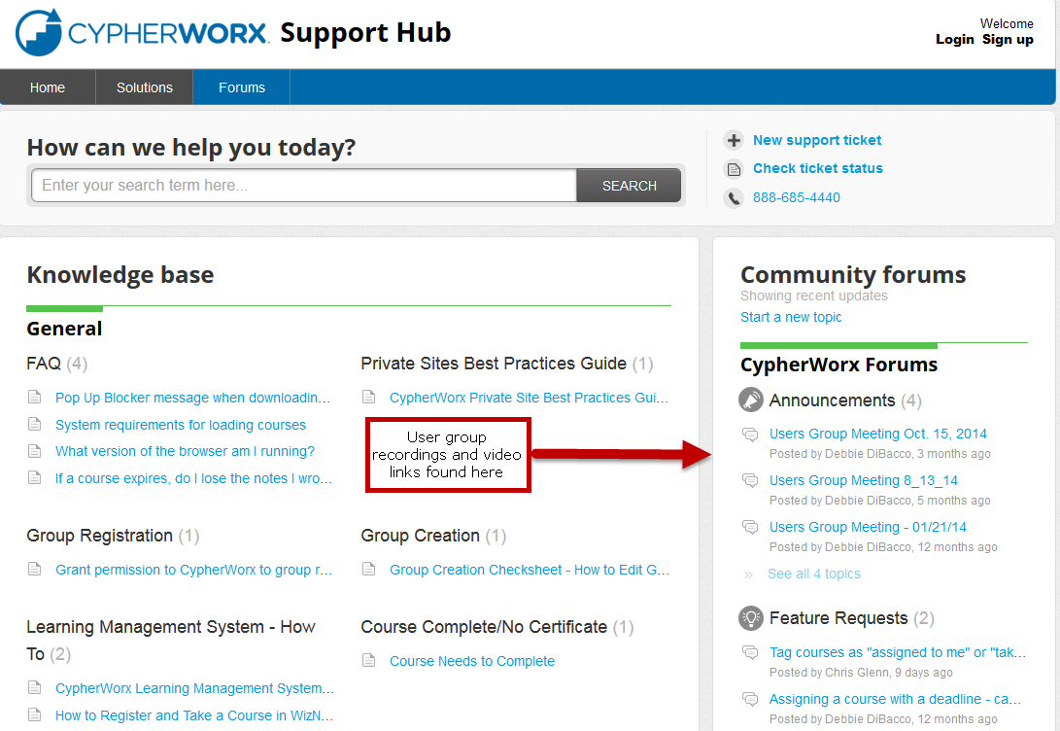
Support Hub

Slide 15
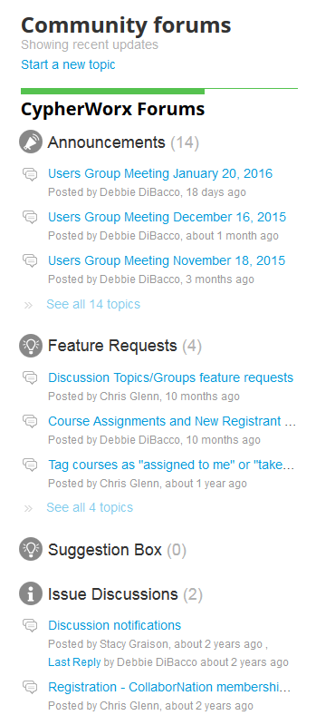
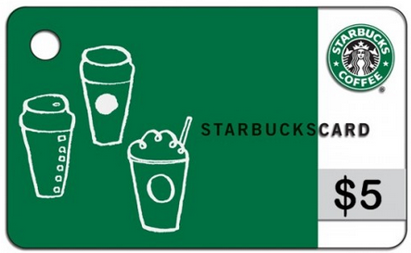
Suggestions
If you have any suggestions, and/or would like to request a new feature that would increase YOUR overall customer experience with our system, then please share them with us.
Any features which are incorporated into our LMS will be announced on next month’s call. By sharing your ideas with us you are assigning us all rights to the features.
In appreciation of your time, submitters whose features are incorporated into our LMS will be sent a $5 Starbucks gift card as a quick “Thank You!”
http://support.cypherworx.com/support/discussions
Click on “Suggestion Box” to add your ideas
in our community forum

Slide 16
Contact Info
Please feel free to reach out to any of us after the webinar if you have more questions.
Debbie DiBacco – ddibacco@cypherworx.com
Chris Glenn – cglenn@cypherworx.com
Al Ryan – aryan@cypherworx.com

