Slide 1
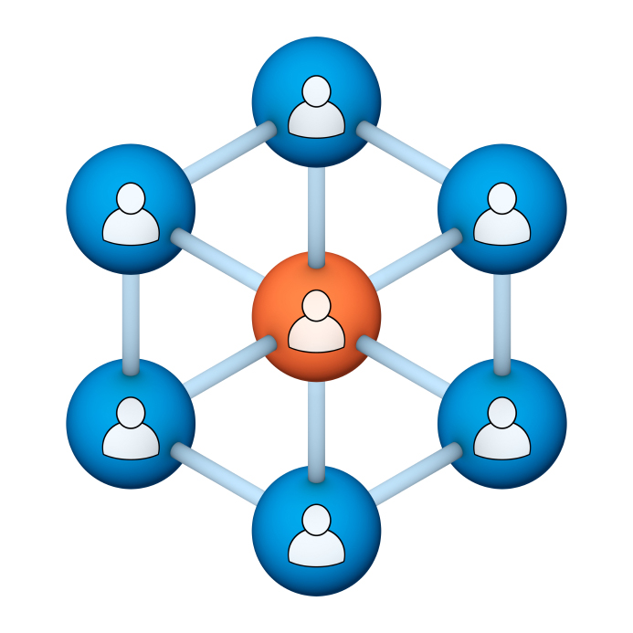
Administrators
Users Group
Meeting
1/18/17

Slide 2
Housekeeping
Right-click on the orange arrow and you’ll see two options: Auto-Hide Control Panel or Show Control Panel.
Clicking on “Show Control Panel” will let you keep the control panel open throughout the presentation.

Slide 3
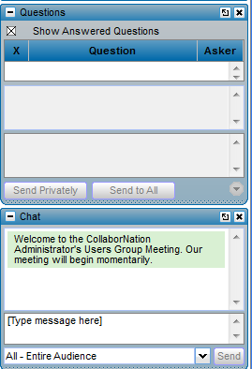
Housekeeping
If you have a question, please type it into the questions area on your “Go To Webinar” control panel.
We want to encourage questions, so please feel free to type them in at any time.

Slide 4
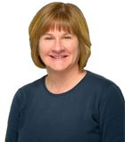
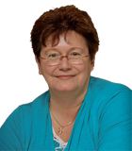
Our Presenters
Chris Glenn, Customer Service Rep CypherWorx, Inc.
Debbie DiBacco, Director, Client Services CypherWorx, Inc.

Slide 5
Agenda
Reporting Changes
Recertification
Site Members List
http://en.wikipedia.org/wiki/Firefighting_in_the_United_States
Notes:
Paul: Introduce who the development partners are – Newroads/Roberta & CypherWorx
The partners agree that all will be involved and be invited to every presentation. We will also agree to communicate in some form prior to each meeting.

Slide 6
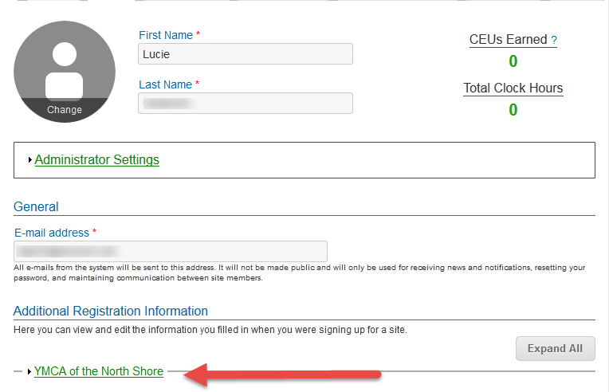
Registration
Importance of the URL:
Specific URLs for each site
Naming convention is: https://collabornation.net/ login/yoursiteinfohere
Without that URL, a customer registers incorrectly (usually into collabornation.net) and without the courses they need.
EXAMPLE: https://collabornation.net/login/ymcanorthshore

Slide 7
Reporting changes
When you click on Reporting, you will see a blue bar at the top which defaults to STANDARD reporting with a button at the right to move over to CUSTOM reporting. Beneath the blue bar is a green one which is where you can select to view one reporting group at a time instead of “All Site Members.”
What you will see when you click on the Reporting feature in your Admin Settings menu:
What you will see after switching to CUSTOM reporting and then clicking the “Create a New Report” button:

Slide 8
Reporting changes
In STANDARD reporting you will now see a column that shows you how a course got into an account when you open a Course (Course Material/click on course title) or open up a Learner’s account record. You will see the name of the person who assigned the course or “Self-Assigned” or whether it was linked to a Reporting Group and assigned as Learners were added to the group.

Slide 9
Recertification
Many of you are using the beginning of the year to have Learners re-certify in certain areas, and that may mean that they need to repeat taking a course they have completed in the past.
It is very important to explain to Learners that once you have completed a course and see the Certificate button on it in the My Courses list, you cannot revise the date on the certificate. So although the system allows you to re-take a course, the intention there is for review or a Learner’s own edification.
Either through Course Assignments or Self-Assignment, a Learner seeking recertification in the current year must obtain a new instance of the same course and complete that.
Sample of a course NOT to re-take:
Sample of a course that will receive a current date on a certificate upon completion:

Slide 10
Site Members list
If for any reason you do not want the Learners in your site to be able to view the Site Members list, disabling it is now possible – just contact Chris! Site admins will still have the same view of the Site Members list, with the ability to change passwords and email addresses.
Here’s what a Learner normally sees after clicking on the Site Members menu item:
And after the setting has changed to eliminate the Site Members list, the Learner Settings menu will be:

Slide 11
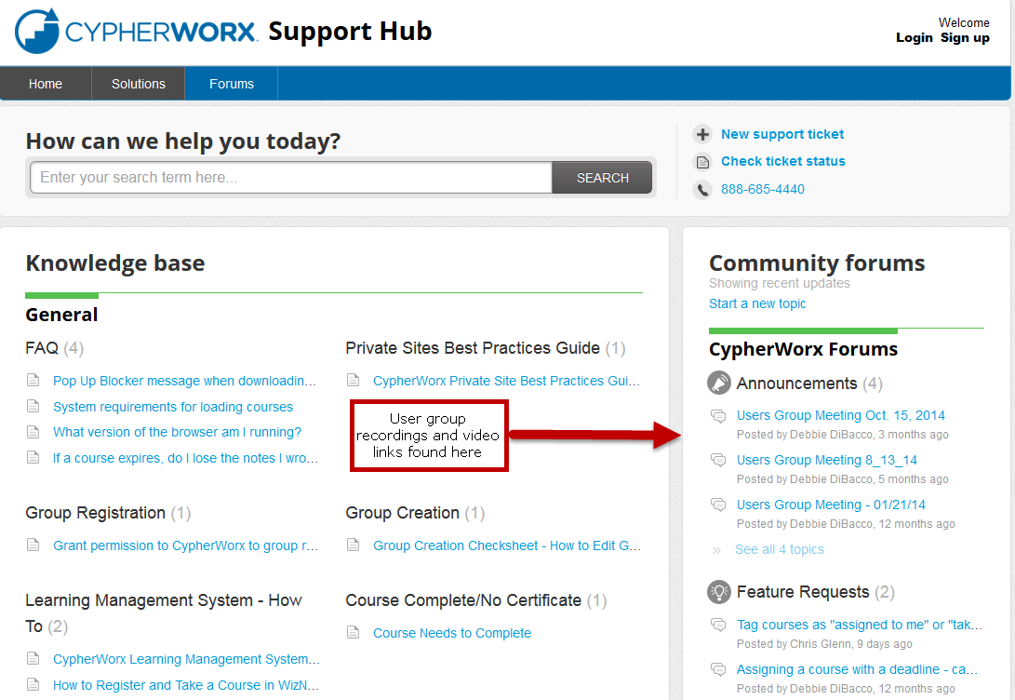
Support Hub

Slide 12
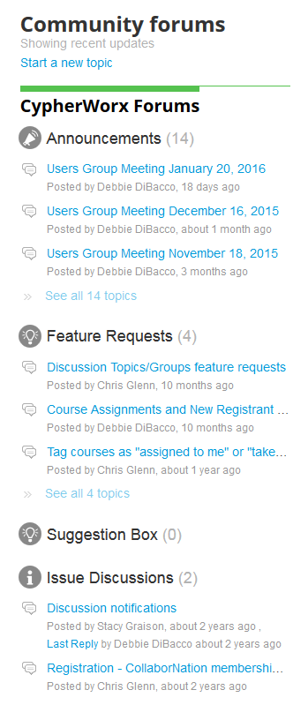
Suggestions
If you have any suggestions, and/or would like to request a new feature that would increase YOUR overall customer experience with our system, then please share them with us.
Any features which are incorporated into our LMS will be announced on next month’s call. By sharing your ideas with us you are assigning us all rights to the features.
In appreciation of your time, submitters whose features are incorporated into our LMS will be sent a $5 Starbucks gift card as a quick “Thank You!”
http://support.cypherworx.com/support/discussions
Click on “Suggestion Box” to add your ideas
in our community forum

Slide 13
Contact Info
Please feel free to reach out to any of us after the webinar if you have more questions.
Debbie DiBacco – ddibacco@cypherworx.com
Chris Glenn – cglenn@cypherworx.com

