Slide 1
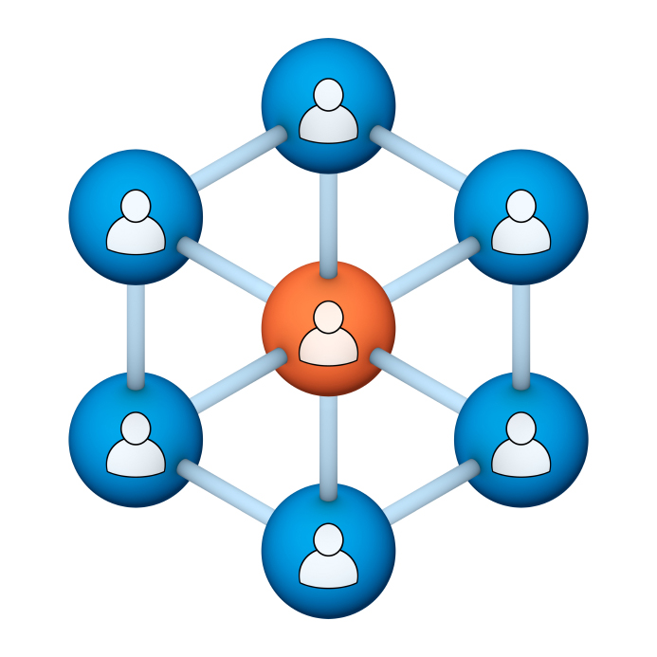
Administrators
Users Group
Meeting
4/19/17

Slide 2
Housekeeping
Right-click on the orange arrow and you’ll see two options: Auto-Hide Control Panel or Show Control Panel.
Clicking on “Show Control Panel” will let you keep the control panel open throughout the presentation.

Slide 3
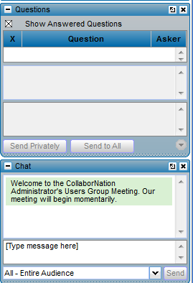
Housekeeping
If you have a question, please type it into the questions area on your “Go To Webinar” control panel.
We want to encourage questions, so please feel free to type them in at any time.

Slide 4
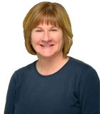
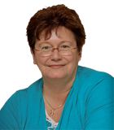
Our Presenters
Chris Glenn, Customer Service Rep CypherWorx, Inc.
Debbie DiBacco, Director, Client Services CypherWorx, Inc.

Slide 5
Agenda
Registration Overview
Reporting Groups Review
Additional Registration Information Fields
Adding Users
Support Hub
http://en.wikipedia.org/wiki/Firefighting_in_the_United_States
Notes:
Paul: Introduce who the development partners are – Newroads/Roberta & CypherWorx
The partners agree that all will be involved and be invited to every presentation. We will also agree to communicate in some form prior to each meeting.

Slide 6
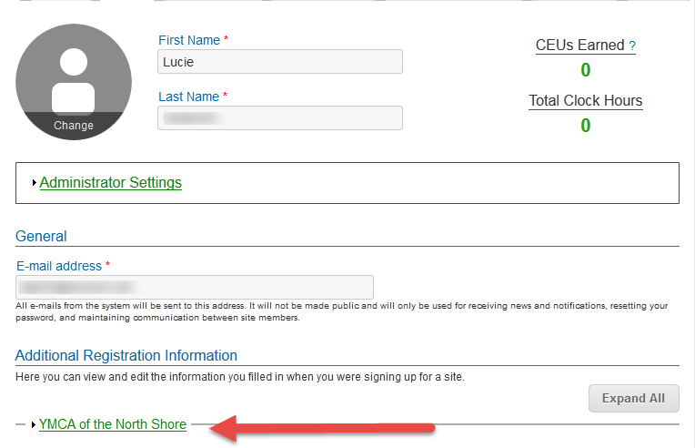
Registration
Importance of the URL:
Specific URLs for each site
Naming convention is: https://collabornation.net/ login/yoursiteinfohere
Without that URL, a customer registers incorrectly (usually into collabornation.net) and without the courses they need.
EXAMPLE: https://collabornation.net/login/ymcanorthshore

Slide 7
Reporting Groups
Permissions:
A site administrator never needs to be designated as a Reporting Group Administrator or Manager because site administrators can see and change all Reporting Groups.

Slide 8
Reporting Groups
Reporting Group Administrator menu:
Reporting Group Manager menu:

Slide 9
ARI
Additional Registration Information (ARI) fields can be created by all site admins and are commonly used to put new registrants into proper Reporting Groups for course assignments and reporting purposes. They can also be used to collect other information useful in reporting, such as employee numbers, answers to yes/no questions, etc. Two new enhancements to this feature are:
Site Admins can now delete ARI fields
Site Admins can now rearrange the order of ARI fields either by dragging or using the arrows at the left edge

Slide 10
Adding Users

Slide 11
Adding Users

Slide 12
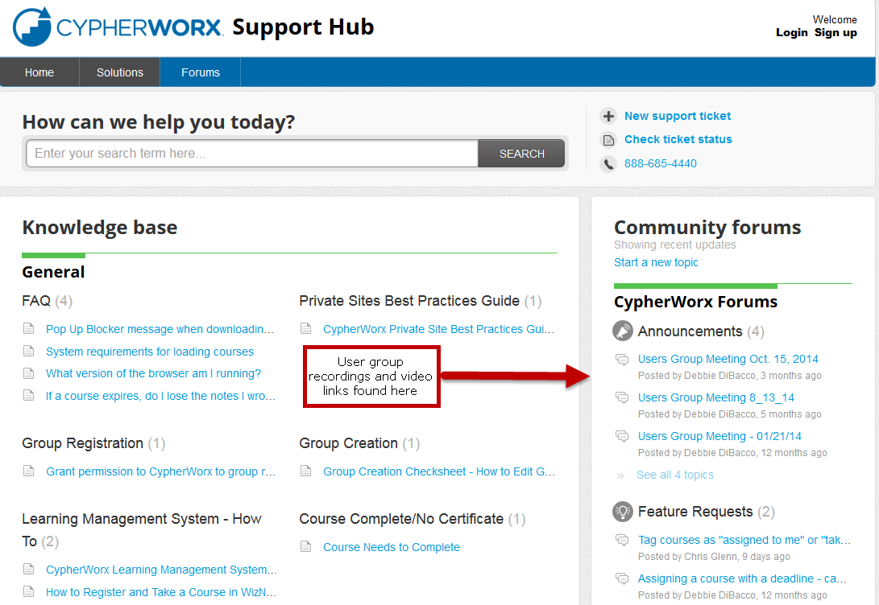
Support Hub

Slide 13
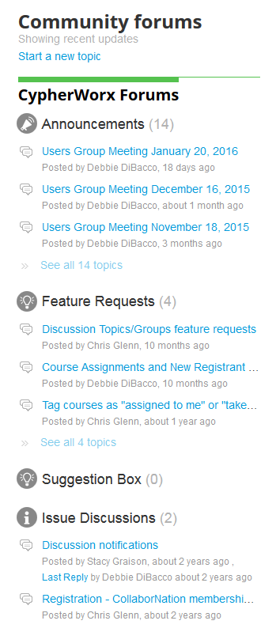
Suggestions
If you have any suggestions, and/or would like to request a new feature that would increase YOUR overall customer experience with our system, then please share them with us.
Any features which are incorporated into our LMS will be announced on next month’s call. By sharing your ideas with us you are assigning us all rights to the features.
In appreciation of your time, submitters whose features are incorporated into our LMS will be sent a $5 Starbucks gift card as a quick “Thank You!”
http://support.cypherworx.com/support/discussions
Click on “Suggestion Box” to add your ideas
in our community forum

Slide 14
Contact Info
Please feel free to reach out to any of us after the webinar if you have more questions.
Debbie DiBacco – ddibacco@cypherworx.com
Chris Glenn – cglenn@cypherworx.com

