Slide 1
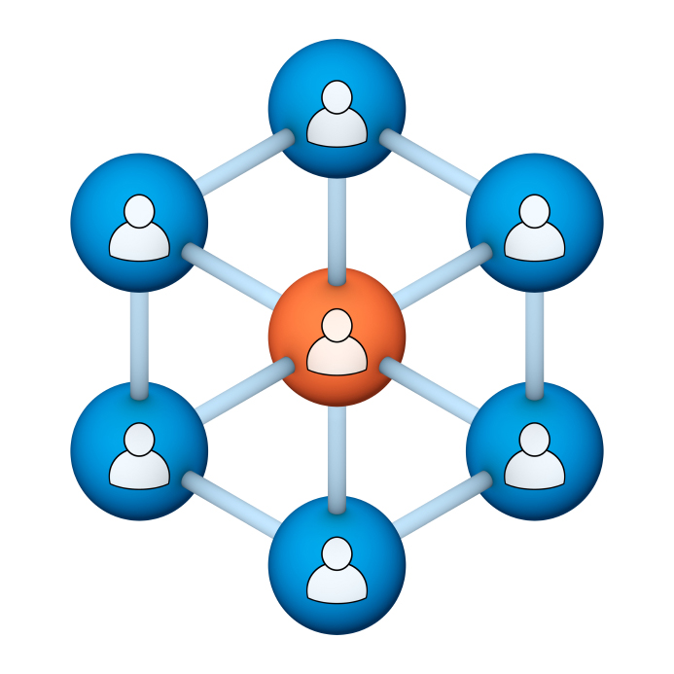
Administrators
Users Group
Meeting
6/21/17

Slide 2
Housekeeping
Right-click on the orange arrow and you’ll see two options: Auto-Hide Control Panel or Show Control Panel.
Clicking on “Show Control Panel” will let you keep the control panel open throughout the presentation.

Slide 3
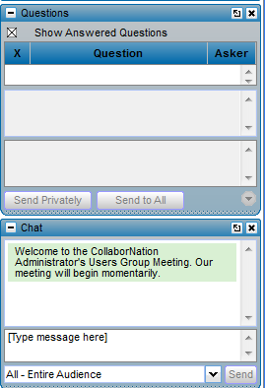
Housekeeping
If you have a question, please type it into the questions area on your “Go To Webinar” control panel.
We want to encourage questions, so please feel free to type them in at any time.

Slide 4
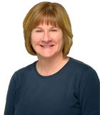
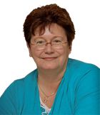
Our Presenters
Chris Glenn, Customer Service Rep CypherWorx, Inc.
Debbie DiBacco, Director, Client Services CypherWorx, Inc.

Slide 5
Agenda
Registration Overview
Mobile responsive screens
Internet Explorer (IE) 9
DIY Publish Later
Admins – what you can do
Reporting Overview
Support Hub
http://en.wikipedia.org/wiki/Firefighting_in_the_United_States
Notes:
Paul: Introduce who the development partners are – Newroads/Roberta & CypherWorx
The partners agree that all will be involved and be invited to every presentation. We will also agree to communicate in some form prior to each meeting.

Slide 6
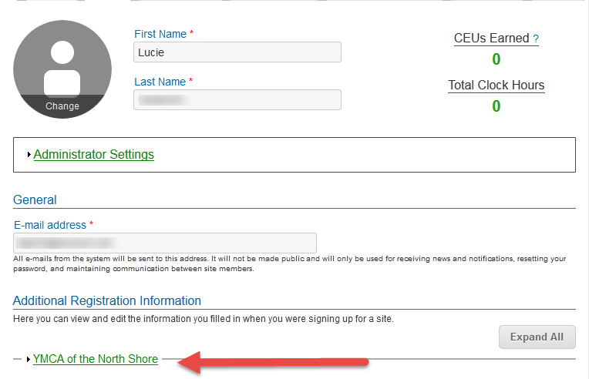
Registration
Importance of the URL:
Specific URLs for each site
Naming convention is: https://collabornation.net/ login/yoursiteinfohere
Without that URL, a customer registers incorrectly (usually into collabornation.net) and without the courses they need.
EXAMPLE: https://collabornation.net/login/ymcanorthshore

Slide 7
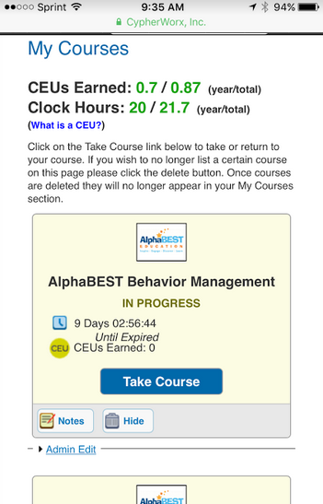
Mobile Devices
Now more mobile responsive.
To the right is a picture of a phone screen.
Below is from a browser that has been narrowed and the course catalog adjusted along the way:

Slide 8
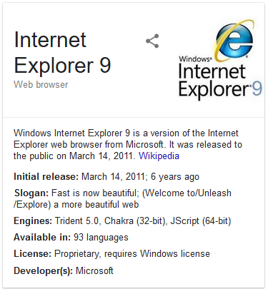
Internet Explorer 9
Microsoft has stopped its support for IE9. CypherWorx has also stopped official support for IE9. We now support IE10 +

Slide 9
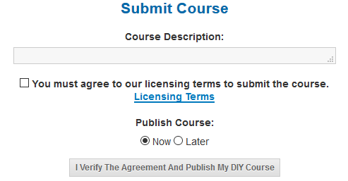
DIY – new option
Many of you have asked about being able to have courses be available only to certain segments of your site members. This can now be done in the DIY tool (but not the rest of the Course Catalog).
How it works – create a DIY course and choose “Later” after you have completed your review and are ready to publish. You must then use the Course Assignment tool to assign that course to those who you want to. The course will appear in the list of courses to select (in Step 2: Select Courses) so that you can assign it, but it will NOT appear in the DIY category in the Course Catalog.

Slide 10
Admins
Our programmers have made a lot of changes to Site Administrator permissions, so as a reminder, here’s what you can do on your own without having to depend on us:
Change passwords for site members
Change name spellings, email addresses for site members
Deactivate/reactivate site member accounts
Designate other site members to be site admins, Reporting Group Admins and/or Managers
Create Reporting Groups (and subgroups)
Print/view site members’ certificates
Print/view site members’ transcripts
Approve submitted Additional Training Records
Assign courses to site members
Create site member accounts
Create Additional Registration Information fields (and delete them)
If you have the feature, create your own courses (DIY)

Slide 11
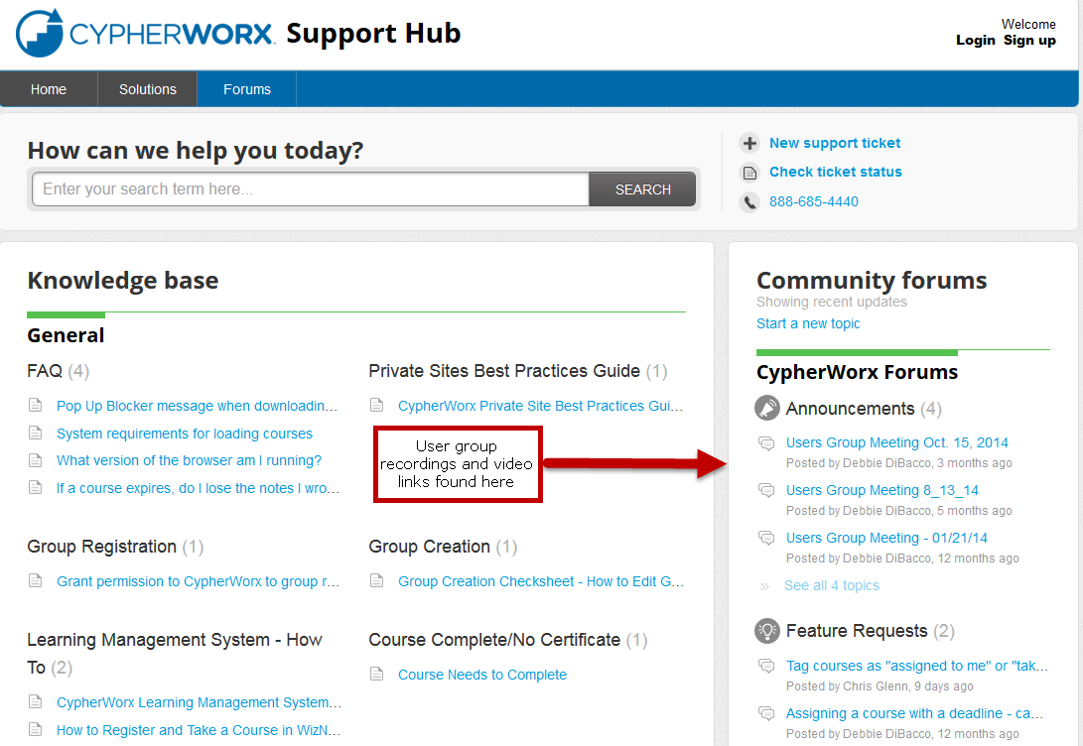
Support Hub

Slide 12
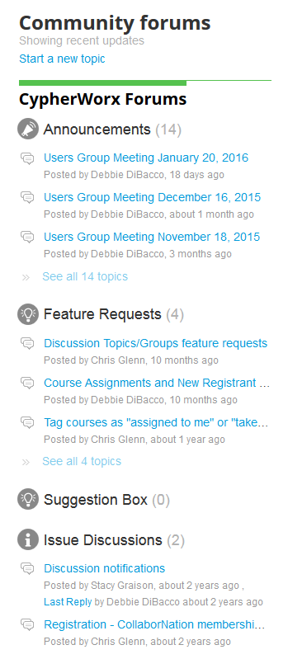
Suggestions
If you have any suggestions, and/or would like to request a new feature that would increase YOUR overall customer experience with our system, then please share them with us.
Any features which are incorporated into our LMS will be announced on next month’s call. By sharing your ideas with us you are assigning us all rights to the features.
In appreciation of your time, submitters whose features are incorporated into our LMS will be sent a $5 Starbucks gift card as a quick “Thank You!”
http://support.cypherworx.com/support/discussions
Click on “Suggestion Box” to add your ideas
in our community forum

Slide 13
Contact Info
Please feel free to reach out to any of us after the webinar if you have more questions.
Debbie DiBacco – ddibacco@cypherworx.com
Chris Glenn – cglenn@cypherworx.com

