Slide 1
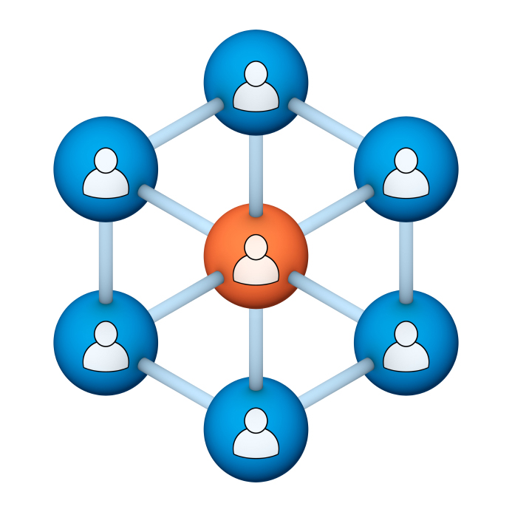
Administrators
Users Group
Meeting
5/16/18

Slide 2
Housekeeping
Right-click on the orange arrow and you’ll see two options: Auto-Hide Control Panel or Show Control Panel.
Clicking on “Show Control Panel” will let you keep the control panel open throughout the presentation.

Slide 3
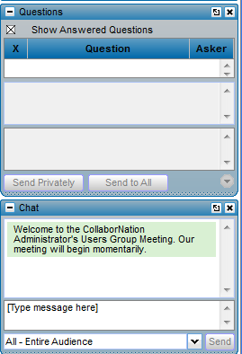
Housekeeping
If you have a question, please type it into the questions area on your “Go To Webinar” control panel.
We want to encourage questions, so please feel free to type them in at any time.

Slide 4
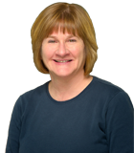
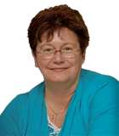
Our Presenters
Chris Glenn, Client Services
CypherWorx, Inc.
Debbie DiBacco, Client Services CypherWorx, Inc.

Slide 5
Agenda
Registration Overview
YouTube Training Videos
Site Status
Site Building Feature
Browsers/Flash
Support Hub Resources
http://en.wikipedia.org/wiki/Firefighting_in_the_United_States

Slide 6
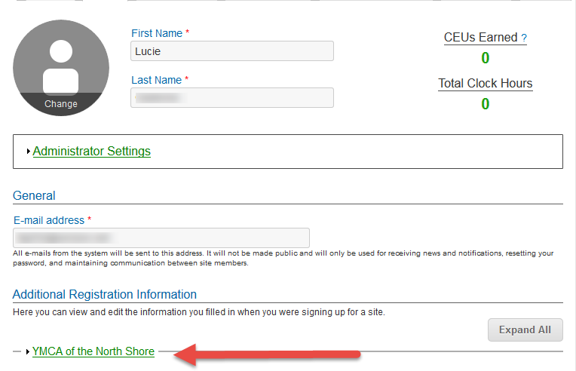
Registration
Importance of the URL:
Specific URLs for each site
Naming convention is: https://collabornation.net/ login/yoursiteinfohere
Without that URL, a customer registers incorrectly (usually into collabornation.net) and without the courses they need.
EXAMPLE: https://collabornation.net/login/ymcanorthshore

Slide 7
YouTube Training Videos
7:18 minute video
Learning Management System
Details how to take courses, participate in discussions, add events and upload resources. Admins can see how to use the reporting features, course assignment options and our DIY Course Creation tool.
https://www.youtube.com/watch?v=cOrfDxQdEY4
10:41 minute video
CollaborNation Create-a-Course (DIY) Tutorial
Details the step by step process on how to turn your existing material into an online course.
https://www.youtube.com/watch?v=cX4AXHe5Yak

Slide 8
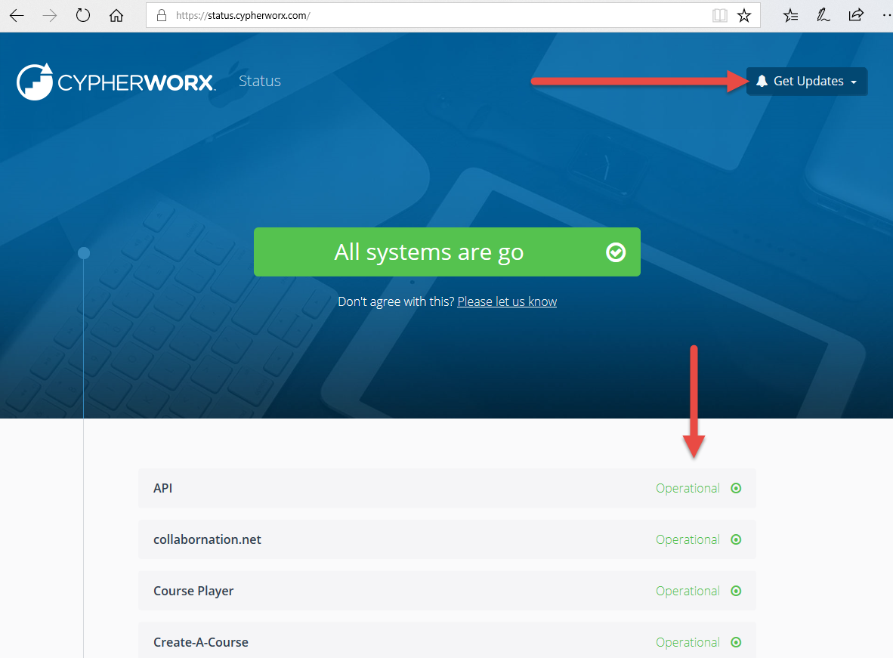
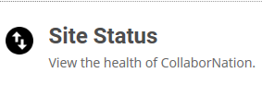
Status Page
support.cypherworx.com/support/home
Under the Knowledge Base section, click on “Site Status”
Click on “Get Updates” to be informed via email if the site is experiencing an issue.

Slide 9
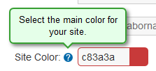
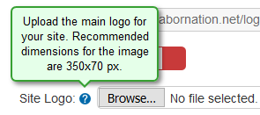
Site Building feature
What you can manage through the choices in the Site Building feature – top choice in the Admin Settings Menu:
Change the color of the banner at the top and change the logo and title:
After each modification, scroll to the bottom of the page and select the Save Changes button.

Slide 10
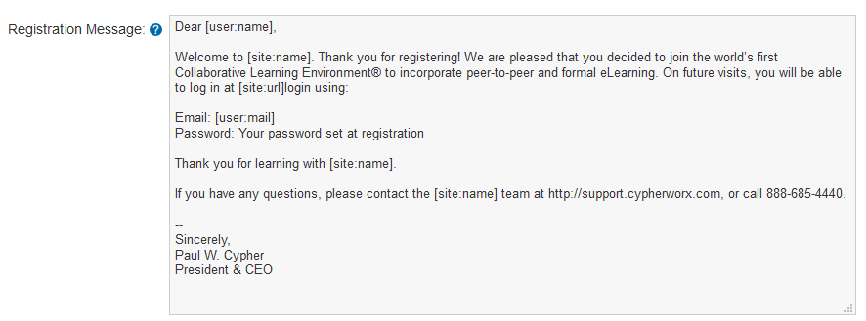
Site Building feature
Change the Registration Message – the email that a person receives confirming their registration. Customize this with information such as asking them to allow the admin@collabornation.net email address into their inboxes, specific welcome message or instructions on a course or event to get them started using the site, change the signature to be from someone at your organization.
This is only sent to people the first time they register into a site. If they subsequently join one of our other sites it is not necessary that they receive it.

Slide 11
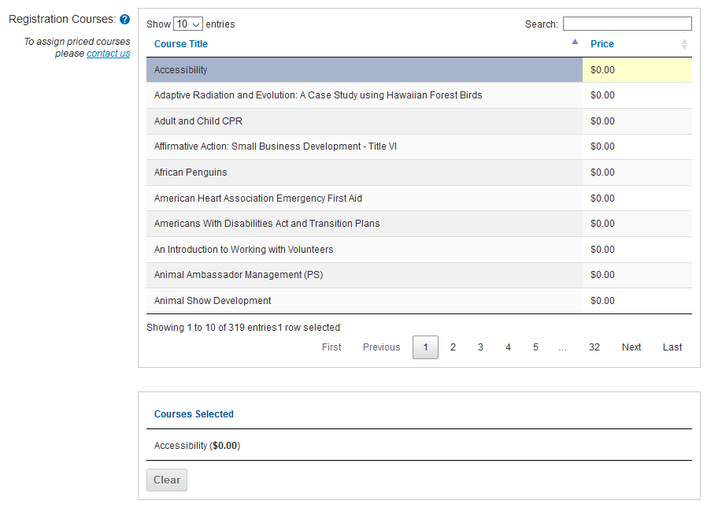
Site Building feature
Create auto-assignments.
If you choose a course or courses in this section, every new account into your site will have it/them assigned to them as part of the registration process. When they complete the process they will see the course(s) on their My Courses page instead of a blank page. Sample:

Slide 12
Site Building feature
Control the Social Feature tabs across the top menu bar in your site.
Below are the default settings for the 4 tabs on the top menu bar to the right of My Courses and Course Catalog. You can change these. Choices are shown in second picture:

Slide 13
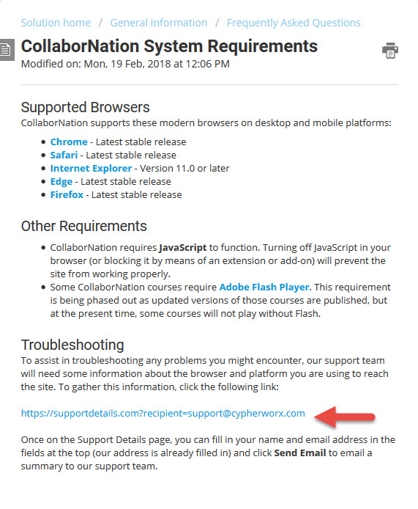
Browser/Flash Info

Slide 14
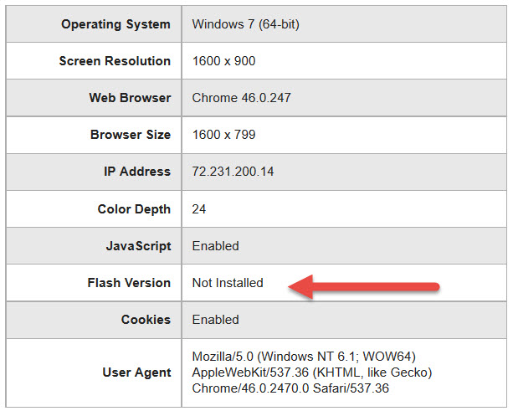
Browser/Flash Info

Slide 15
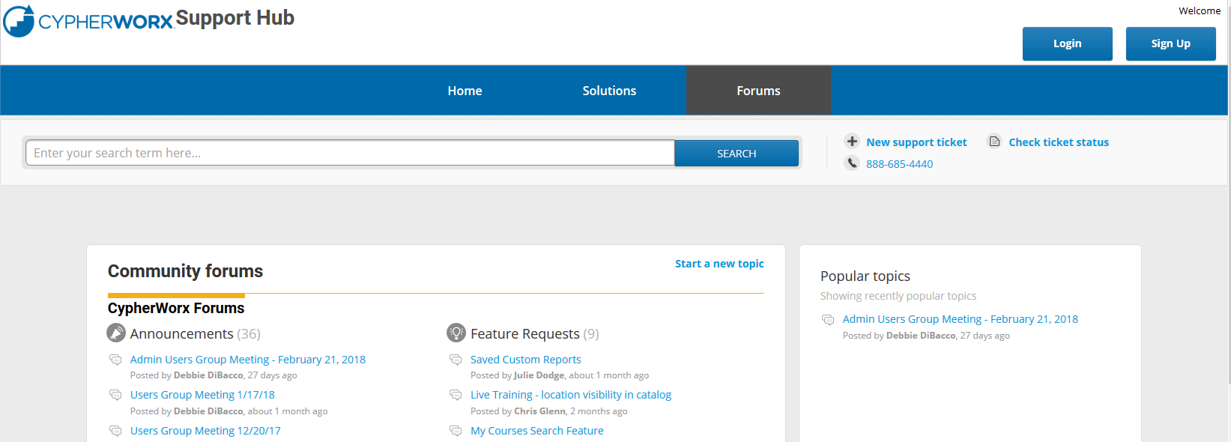
Support Hub
SUPPORT.CYPHERWORX.COM

Slide 16
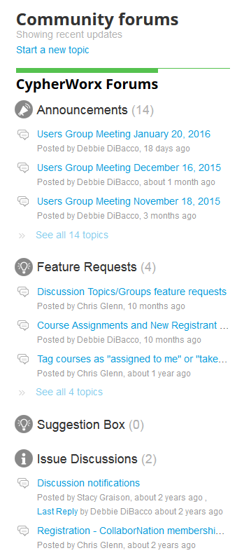
Suggestions
If you have any suggestions, and/or would like to request a new feature that would increase YOUR overall customer experience with our system, then please share them with us.
Any features which are incorporated into our LMS will be announced on next month’s call. By sharing your ideas with us you are assigning us all rights to the features.
In appreciation of your time, submitters whose features are incorporated into our LMS will be sent a $5 Starbucks gift card as a quick “Thank You!”
http://support.cypherworx.com/support/discussions
Click on “Suggestion Box” to add your ideas
in our community forum

Slide 17
Contact Info
Please feel free to reach out to our customer support folks after the webinar if you have more questions.
Debbie DiBacco – ddibacco@cypherworx.com
Chris Glenn – cglenn@cypherworx.com
Brett McIntosh – bmcintosh@cypherworx.com

