Slide 1
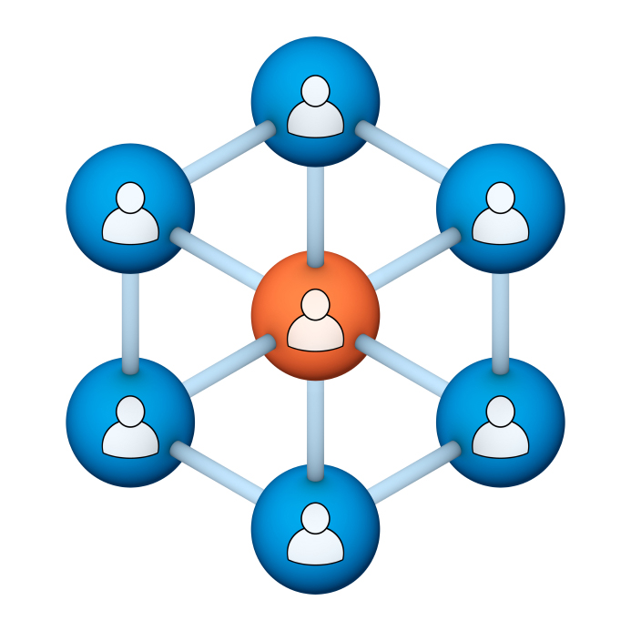
Administrators
Users Group
Meeting
4/18/18

Slide 2
Housekeeping
Right-click on the orange arrow and you’ll see two options: Auto-Hide Control Panel or Show Control Panel.
Clicking on “Show Control Panel” will let you keep the control panel open throughout the presentation.

Slide 3
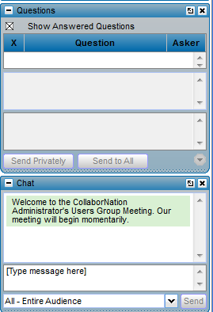
Housekeeping
If you have a question, please type it into the questions area on your “Go To Webinar” control panel.
We want to encourage questions, so please feel free to type them in at any time.

Slide 4
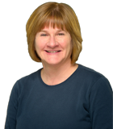
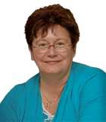
Our Presenters
Chris Glenn, Client Services
CypherWorx, Inc.
Debbie DiBacco, Client Services CypherWorx, Inc.

Slide 5
Agenda
Registration Overview
YouTube Training Videos
Additional Registration Info
Reporting Groups
Site Admin Privileges
Browsers/Flash
Support Hub Resources
http://en.wikipedia.org/wiki/Firefighting_in_the_United_States

Slide 6
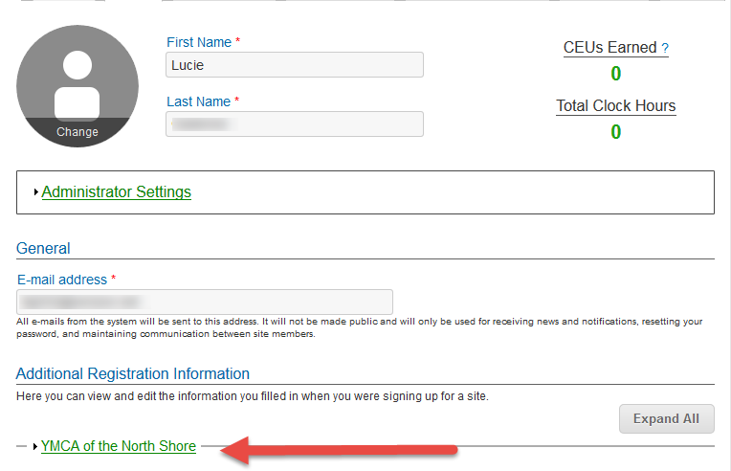
Registration
Importance of the URL:
Specific URLs for each site
Naming convention is: https://collabornation.net/ login/yoursiteinfohere
Without that URL, a customer registers incorrectly (usually into collabornation.net) and without the courses they need.
EXAMPLE: https://collabornation.net/login/ymcanorthshore

Slide 7
YouTube Training Videos
7:18 minute video
Learning Management System
Details how to take courses, participate in discussions, add events and upload resources. Admins can see how to use the reporting features, course assignment options and our DIY Course Creation tool.
https://www.youtube.com/watch?v=cOrfDxQdEY4
10:41 minute video
CollaborNation Create-a-Course (DIY) Tutorial
Details the step by step process on how to turn your existing material into an online course.
https://www.youtube.com/watch?v=cX4AXHe5Yak

Slide 8
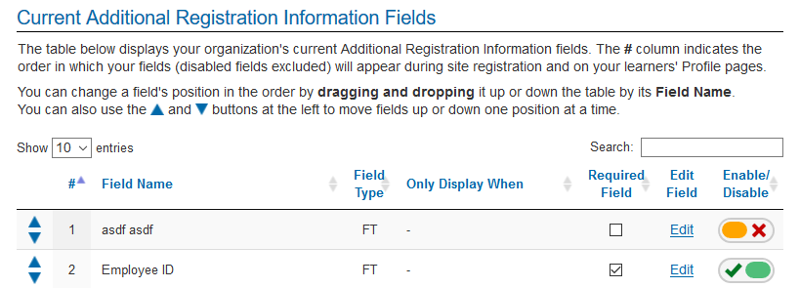
ARI
Additional Registration Information (ARI) fields can be created by all site admins and are commonly used to put new registrants into proper Reporting Groups for course assignments and reporting purposes. They can also be used to collect other information useful in reporting, such as employee numbers, answers to yes/no questions, etc.

Slide 9
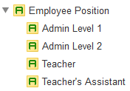
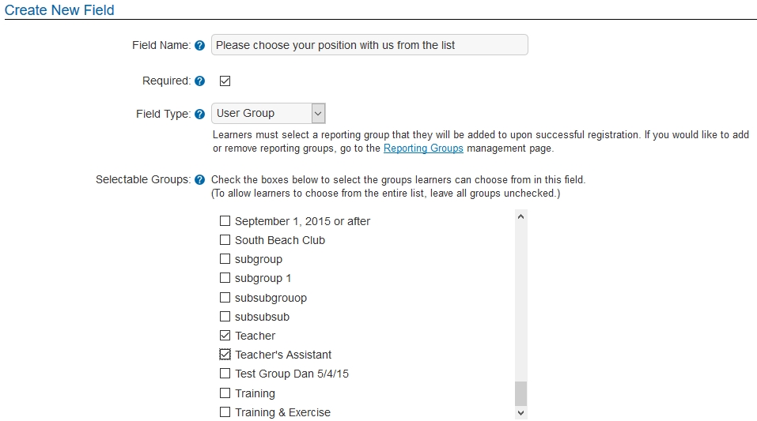
ARI and Reporting Groups
Steps to connect an ARI field to Reporting Groups:
1. Go to Reporting Groups, open the main group (top) and create your groups/subgroups –
Sample:
2. Go back to the Admin Settings Menu, open Additional Registration Information and enter your question/instruction in the Field Name field and complete the other steps.
Use drop down list to choose User Group
All groups will appear; check the boxes of the ones you want in the list.

Slide 10
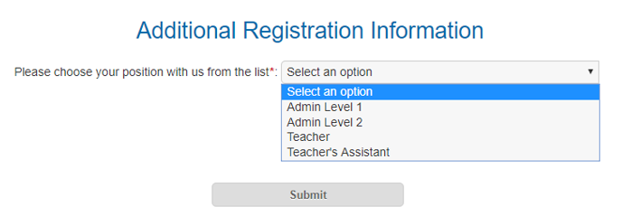
ARI and Reporting Groups
Here is what that will look like to someone registering into your site.
Note – the system adds a colon at the end of the field so you should leave out punctuation when you are creating your ARI fields.
And - Reporting Group information is available as a choice in Custom Reporting.

Slide 11
ARI and Free Text fields
Free Text fields are very useful for gathering additional information.
They can be set up with yes/no questions like “Do you drive a company vehicle?”
Or to collect employee id information: “Please enter your employee id number”
Or “Please enter your Zip Code”
Or specifics like “What age groups do you teach?”
Free Text field information is available as a choice in Custom Reporting.

Slide 12
Reporting Groups
Permissions:
A site administrator never needs to be designated as a Reporting Group Administrator or Manager because site administrators can see and change all Reporting Groups.

Slide 13
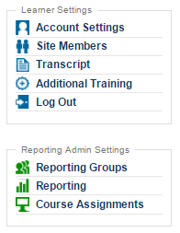
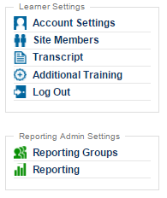
Reporting Groups
Reporting Group Administrator menu:
Reporting Group Manager menu:

Slide 14
Admins
Reminders –manage accounts and trainings in your site(s) from the menus at the left side of the page:
Learner Settings menu:
Site Members:
Activate/deactivate learner accounts
Designate others as site admins
Sort columns by headings
Search for specific learners
Export list of site members to excel
Access learner profiles:
Change passwords
Change/fix email addresses and names
Click to view transcript
Click to view reporting page
View short summary of activity
View CEUs and Clock Hours
Additional Training:
Add Multiple Records – batch in training records for your learners; training taken outside of the LMS

Slide 15
Admins con’t.
Admin Settings menu:
Site Building:
Change your site’s banner color and logo
Customize a Registration confirmation message (for those who set up their own accounts)
Select courses to be automatically assigned to new accounts
Control the settings of the “social” tabs (Discussions/Events/Resources/Teams)
Reporting:
View learner information on Courses, Events, Resources, Additional Training
Filter results by one or more Reporting Groups
Filter results by Date Span
Search titles or learner names
Sort columns by headings
Export result lists to excel
Custom Reporting:
Create custom reports by selecting individual fields, including Addl. Reg. Fields and Reporting Groups
Filter some fields to narrow results
If no filters used, save reports to be reused or sent to other admins

Slide 16
Admins con’t.
Admin Settings menu:
Reporting Groups:
Create Reporting Groups
Assign Admins and Managers for specific groups
Add/Remove group members
Rearrange groups/subgroups; move group members
Link courses to groups and subgroups for auto-assignment
Create subgroups
Course Assignments:
Assign courses to all or individuals or reporting groups
Alert of duplicate assignments
Changes can be made to list before committing
Deadlines (expirations) can be assigned
Customized messages can be sent for each assignment
Option to send no message or send a default message

Slide 17
Admins con’t.
Admin Settings menu:
Create-A-Course (if you have that feature):
Create custom courses for your learners
Reporting allows you to see information on learner answers
Videos may be added as slides to courses
Add a quiz if desired
Set a minimum passing grade
Publish to the course catalog or “publish later” (can assign is not in catalog)
Custom Certificates:
Create custom certificates with easy to use template (see 10-18-17 Users Group Meeting powerpoint in the support hub/Forums for step by step instructions)
Add Users (learners):
Single form for individual account set up
Add Multiples – set up multiple accounts at once with batch template

Slide 18
Admins con’t.
Admin Settings menu:
Additional Registration Information:
Create text fields to capture information like employee id, address information, yes/no questions, etc.
Create fields that link to Reporting Groups to organize your site members for Reporting and Course Assignments
Rearrange the order of the fields for better learner experience
Deactivate or delete fields
Course Feedback:
View feedback from learners on courses
Sort columns by headings
Search
Export to excel

Slide 19
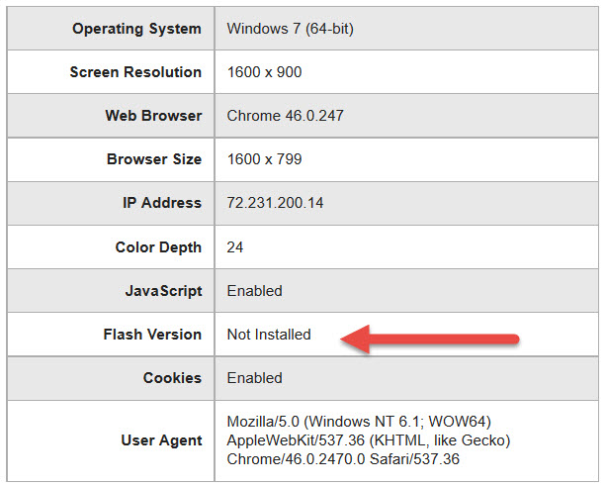
Browser/Flash Info

Slide 20
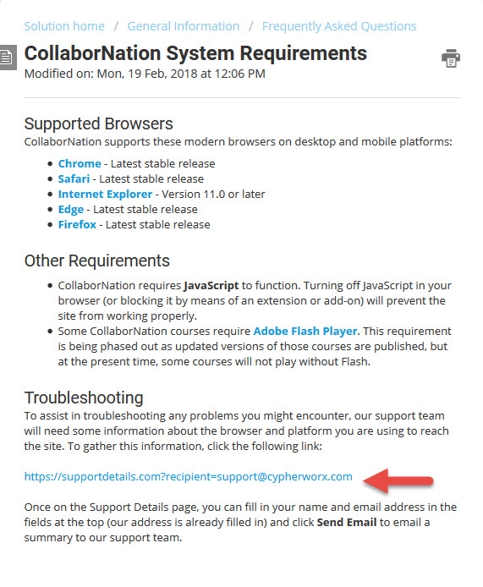
Browser/Flash Info

Slide 21
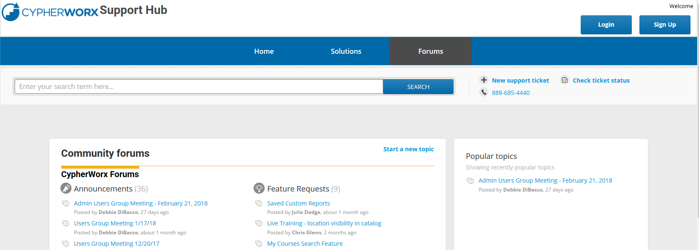
Support Hub
SUPPORT.CYPHERWORX.COM

Slide 22
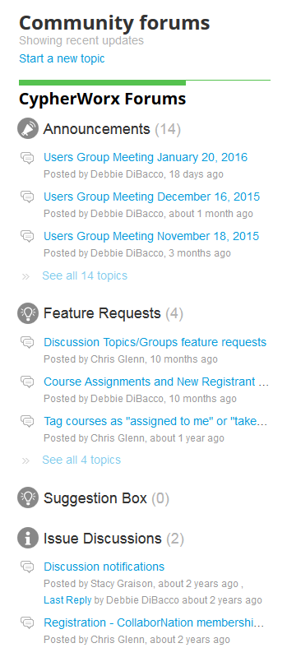
Suggestions
If you have any suggestions, and/or would like to request a new feature that would increase YOUR overall customer experience with our system, then please share them with us.
Any features which are incorporated into our LMS will be announced on next month’s call. By sharing your ideas with us you are assigning us all rights to the features.
In appreciation of your time, submitters whose features are incorporated into our LMS will be sent a $5 Starbucks gift card as a quick “Thank You!”
http://support.cypherworx.com/support/discussions
Click on “Suggestion Box” to add your ideas
in our community forum

Slide 23
Contact Info
Please feel free to reach out to our customer support folks after the webinar if you have more questions.
Debbie DiBacco – ddibacco@cypherworx.com
Chris Glenn – cglenn@cypherworx.com
Brett McIntosh – bmcintosh@cypherworx.com

