Slide 1
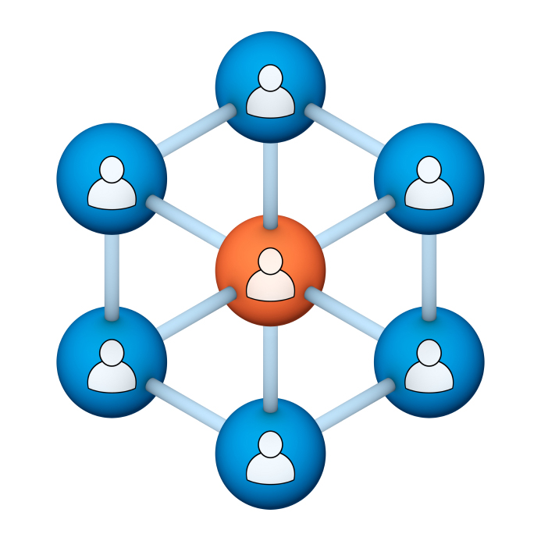
Administrators
Users Group
Meeting
8/15/18

Slide 2
Housekeeping
Right-click on the orange arrow and you’ll see two options: Auto-Hide Control Panel or Show Control Panel.
Clicking on “Show Control Panel” will let you keep the control panel open throughout the presentation.

Slide 3
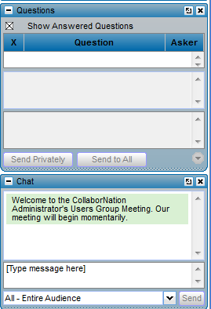
Housekeeping
If you have a question, please type it into the questions area on your “Go To Webinar” control panel.
We want to encourage questions, so please feel free to type them in at any time.

Slide 4
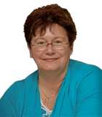
Our Presenters
Chris Glenn, Client Services
CypherWorx, Inc.
Debbie DiBacco, Client Services CypherWorx, Inc.

Slide 5
Agenda
Registration Overview
YouTube Training Videos
Learning Paths/Assessments
Course Assignment Updates
Reporting Group permissions
Browser/Flash
Support Hub Resources
http://en.wikipedia.org/wiki/Firefighting_in_the_United_States

Slide 6
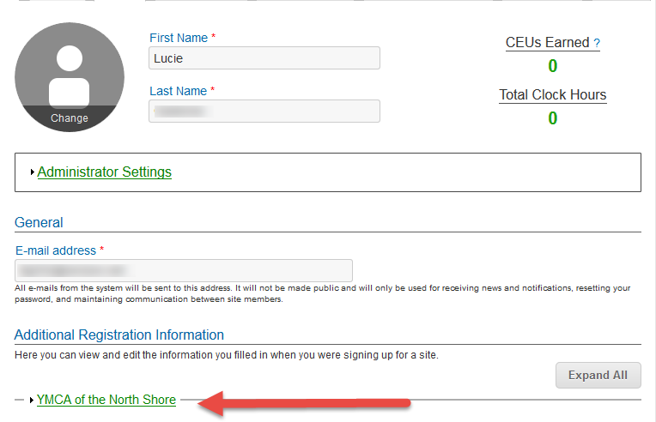
Registration
Importance of the URL:
Specific URLs for each site
Naming convention is: https://collabornation.net/ login/yoursiteinfohere
Without that URL, a customer registers incorrectly (usually into collabornation.net) and without the courses they need.
EXAMPLE: https://collabornation.net/login/ymcanorthshore

Slide 7
YouTube Training Videos
2:44 minute video
Maximize Employee Performance With Assessments
A quick look at our new Assessment Feature
https://www.youtube.com/watch?v=gi5qzVlPK2Q&t=34s
7:18 minute video
Learning Management System
Details how to take courses, participate in discussions, add events and upload resources. Admins can see how to use the reporting features, course assignment options and our DIY Course Creation tool.
https://www.youtube.com/watch?v=cOrfDxQdEY4
10:41 minute video
CollaborNation Create-a-Course (DIY) Tutorial
Details the step by step process on how to turn your existing material into an online course.
https://www.youtube.com/watch?v=cX4AXHe5Yak

Slide 8
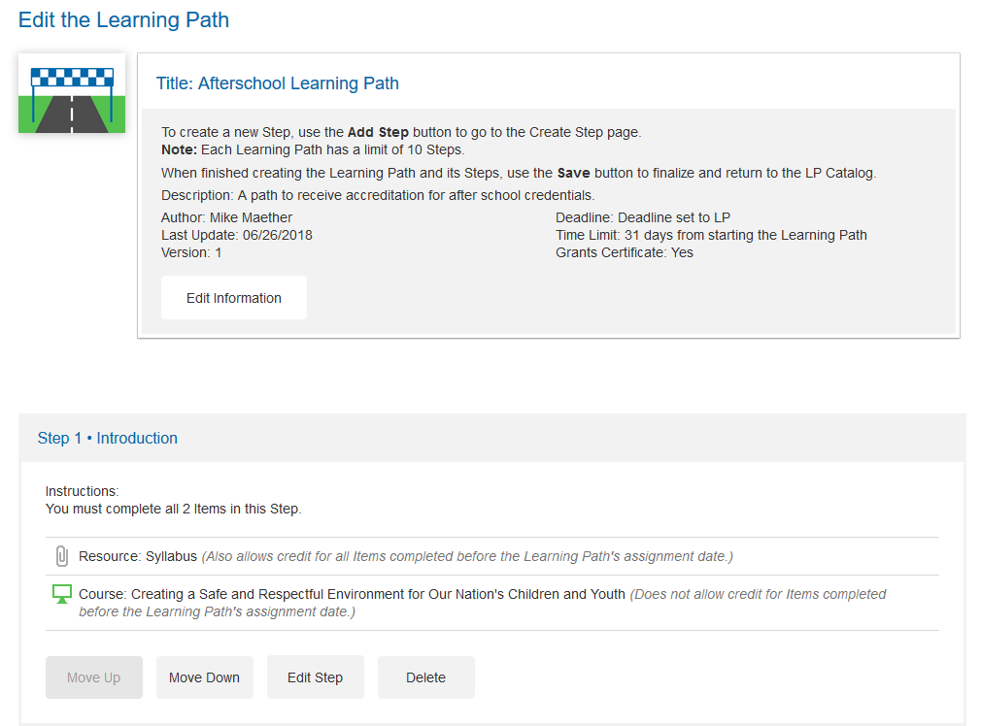
Learning Paths

Slide 9
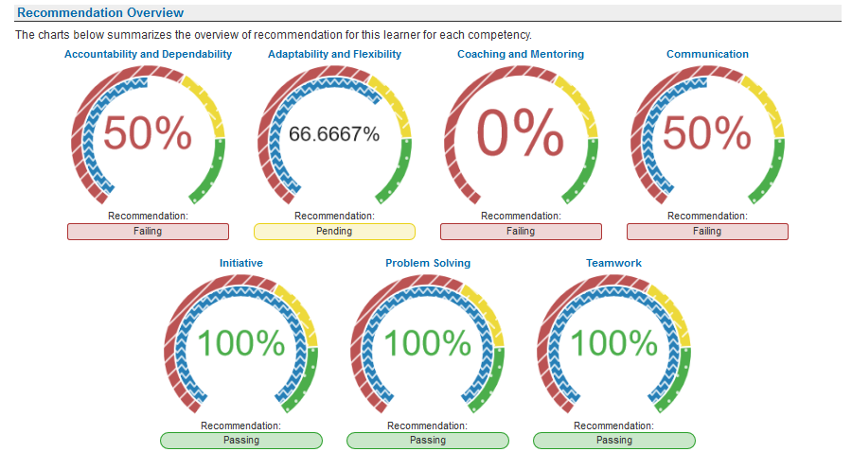
Assessments

Slide 10
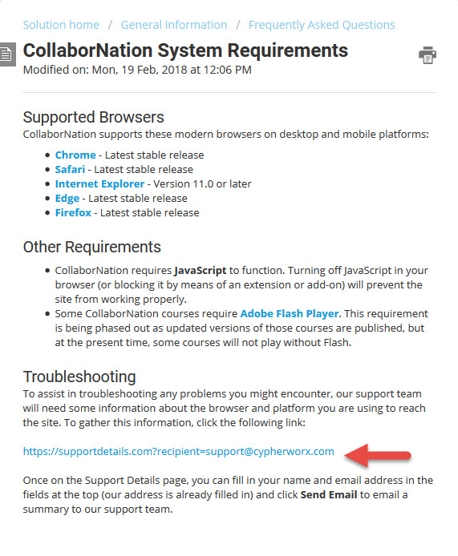
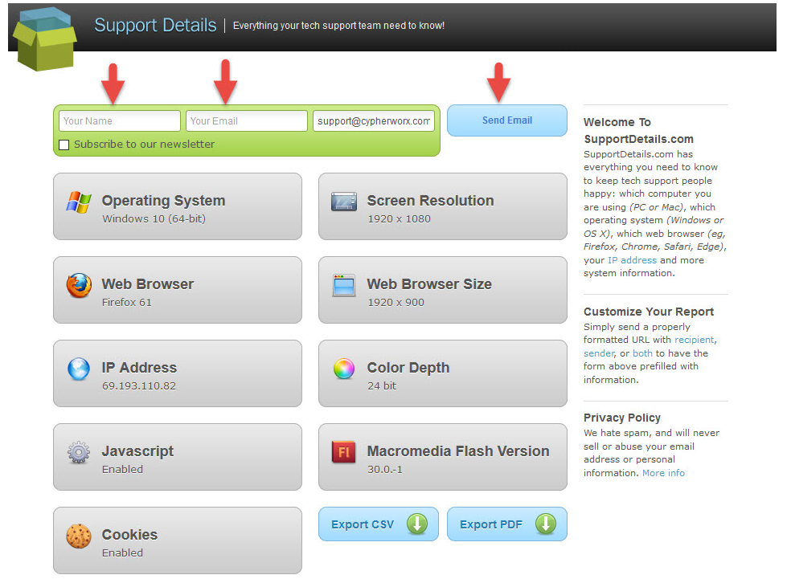
Browser/Flash Info

Slide 11
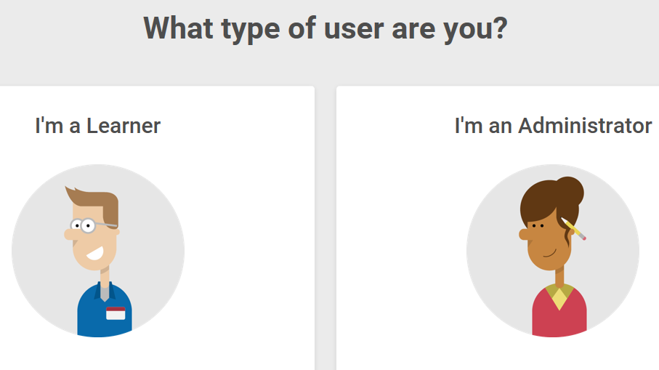
Support Hub
SUPPORT.CYPHERWORX.COM

Slide 12
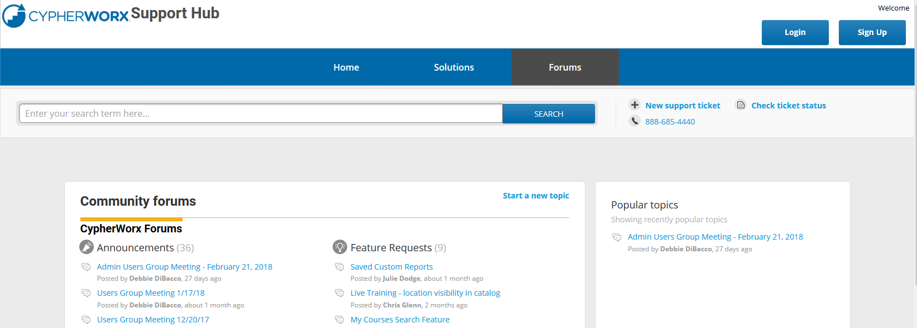
Review Meeting

Slide 13
Contact Info
Please feel free to reach out to our customer support folks after the webinar if you have more questions.
Chris Glenn – cglenn@cypherworx.com
Debbie DiBacco – ddibacco@cypherworx.com
Brett McIntosh – bmcintosh@cypherworx.com

