Slide 1
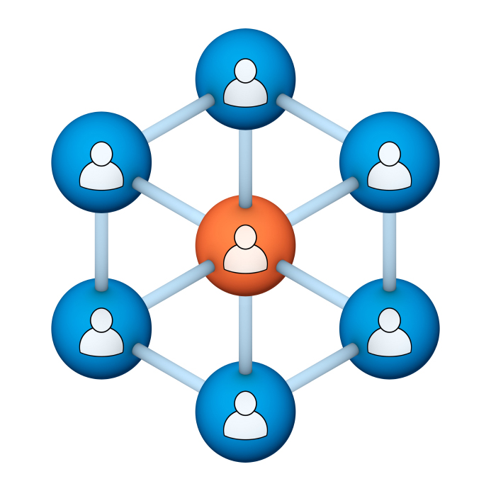
Administrators
Users Group
Meeting
9/19/18

Slide 2
Housekeeping
Right-click on the orange arrow and you’ll see two options: Auto-Hide Control Panel or Show Control Panel.
Clicking on “Show Control Panel” will let you keep the control panel open throughout the presentation.

Slide 3
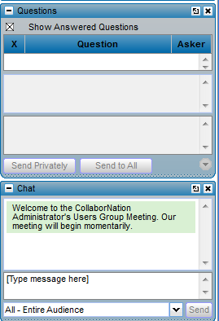
Housekeeping
If you have a question, please type it into the questions area on your “Go To Webinar” control panel.
We want to encourage questions, so please feel free to type them in at any time.

Slide 4
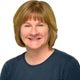
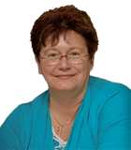
Our Presenters
Chris Glenn, Client Services
CypherWorx, Inc.
Debbie DiBacco, Client Services CypherWorx, Inc.

Slide 5
Agenda
Registration Overview
YouTube Training Videos
Admin Course Creation
Notifications
Accounts
Browser/Flash
Support Hub Resources
http://en.wikipedia.org/wiki/Firefighting_in_the_United_States

Slide 6
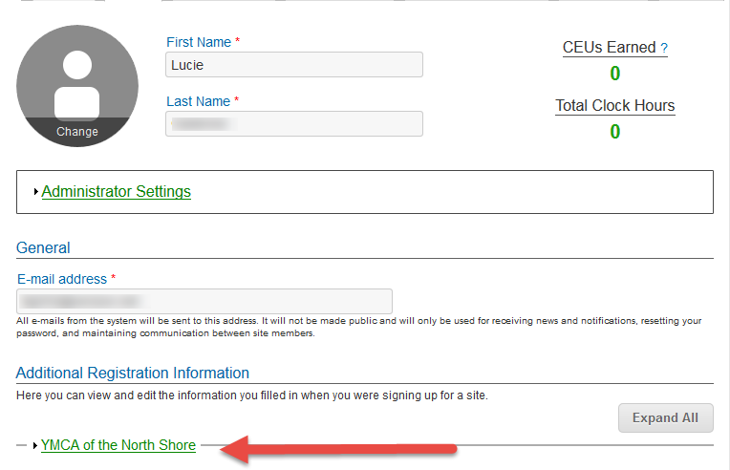
Registration
Importance of the URL:
Specific URLs for each site
Naming convention is: https://collabornation.net/ login/yoursiteinfohere
Without that URL, a customer registers incorrectly (usually into collabornation.net) and without the courses they need.
EXAMPLE: https://collabornation.net/login/ymcanorthshore

Slide 7
YouTube Training Videos
2:44 minute video
Maximize Employee Performance With Assessments
A quick look at our new Assessment Feature
https://www.youtube.com/watch?v=gi5qzVlPK2Q&t=34s
7:18 minute video
Learning Management System
Details how to take courses, participate in discussions, add events and upload resources. Admins can see how to use the reporting features, course assignment options and our DIY Course Creation tool.
https://www.youtube.com/watch?v=cOrfDxQdEY4
10:41 minute video
CollaborNation Create-a-Course (DIY) Tutorial
Details the step by step process on how to turn your existing material into an online course.
https://www.youtube.com/watch?v=cX4AXHe5Yak

Slide 8
Courses You Create
If you are creating your own courses using a course creation software such as Articulate Storyline or Articulate Rise and need us to load your course for you, we need to have the answers to the following questions.
Course title
Are there prerequisites (if there are, then they'd need to be supplied as well)
Is there an image that will show up when someone takes the course? Is so, I'll need that in jpg form.
What is the Course Availability? (This is how long - in weeks - a client has to take the course).
Course length (how long in hours)
Course Description
What catalog you want the course to go in?
If there is a test, what's the mastery score
If there is a certificate, does it need to populate on "passed" or "completed"
If there is a quiz, please provide me with the answers.

Slide 9
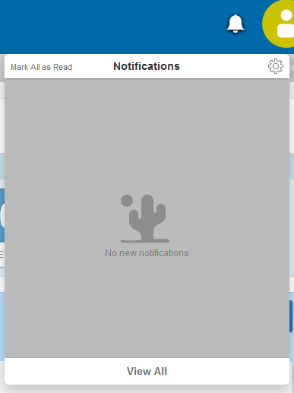
Notifications
New to your site navigation at the upper right corner after logging in – click on the bell to open and this is the view:
Click the gear icon to open up your notification settings and make changes on the Notification Settings page:

Slide 10
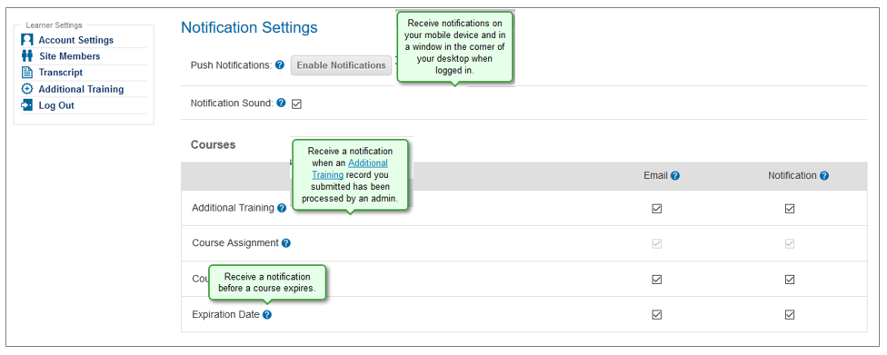
Notifications
Learner view – no admin privileges
Helper text at each of the question marks explains each setting that can be controlled by a learner. Grayed out checked boxes cannot be altered by the learner if a site admin has locked the option(s).

Slide 11
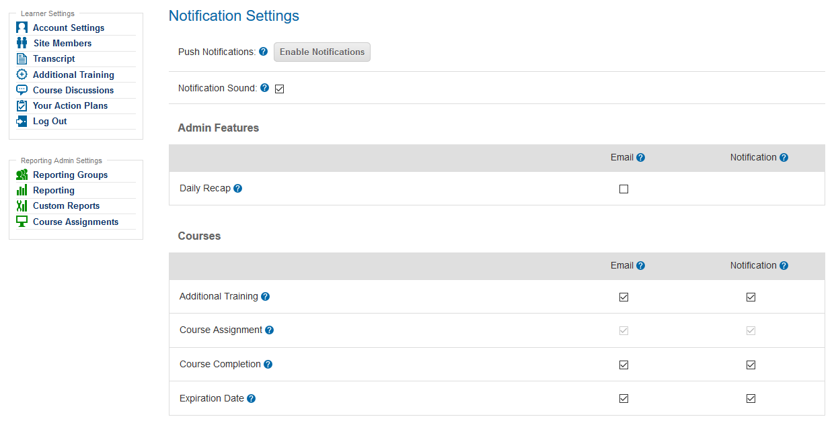
Notifications
Reporting Group Admin or Manager view - limited admin privileges
Admin Features section is what makes this settings section different between learners with no privileges and a Reporting Group Admin or Manager.

Slide 12
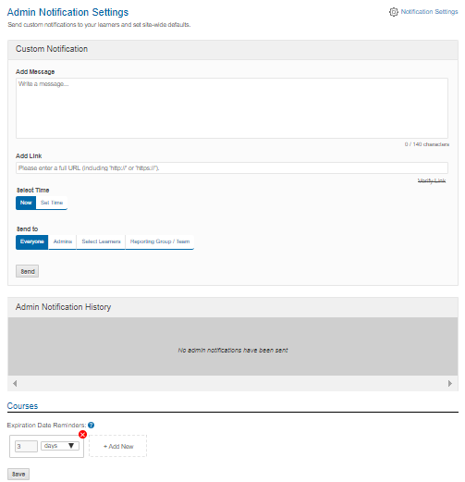
Notifications
Site Admin view – from the Admin Notification Settings menu option:
First page – described in the support article:
https://support.cypherworx.com/solution/articles/4000127474-administering-notifications

Slide 13
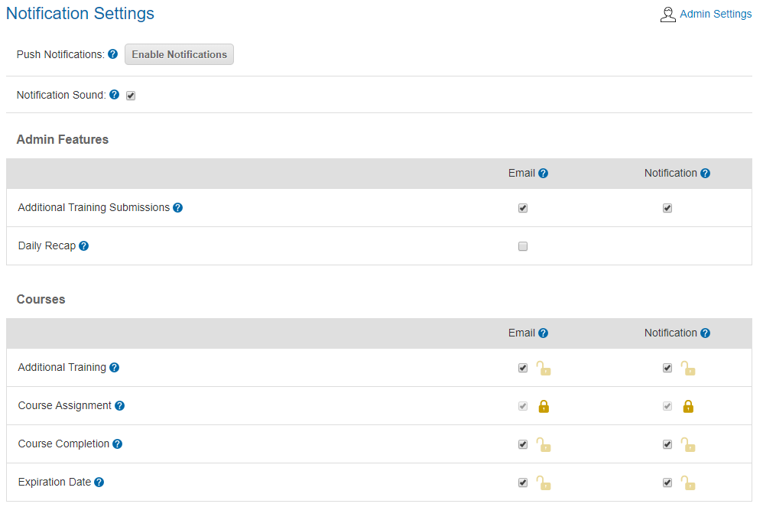
Notifications
Site Admin view – Second page, accessed either from the gear icon at the top right of the first page or from the gear icon at the bell (upper right).
Top 2 sections are specific to that site admin’s account; Courses section determines settings for the entire site membership:
Locks – If a site admin makes a change and keeps the lock unlocked then the change will only be for them – make a change and lock the lock and the setting will apply site-wide for all site members.

Slide 14
Accounts
…one account…one account…one account…one account…one account…one account…
We recommend that site administrators adopt the mantra above!
It will make your life easier when using the Reporting feature to look up course results or even to get an accurate count of how many learners you have registered in your site.
Remind your learners that each person can access their own profile to change and/or fix the email address associated with their account and also to change their own password.
The catch is that they need to be logged in to do that and when they forget their login information they tend to create a new account instead of contacting either you, the site admin, or our customer service department.

Slide 15
Accounts
…one account…one account…one account…one account…one account…one account…
As a rule, they should select the link in the LOG IN section as the first step when they do not recall their login information:
which will take them to this form:
If they do remember the email associated with their account, a link to reset their password will be emailed from admin@collabornation.net and they should check their spam folder if they do not see it in their inbox.
If they are not remembering that email address, then they are provided the phone number to call and the link to submit a ticket.

Slide 16
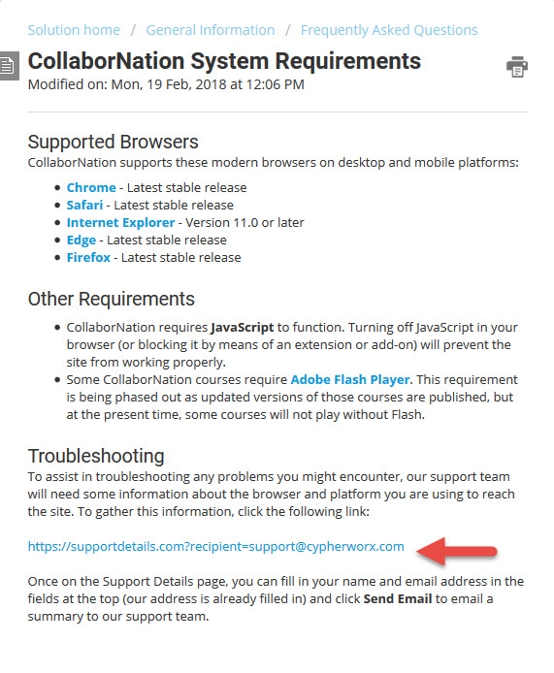
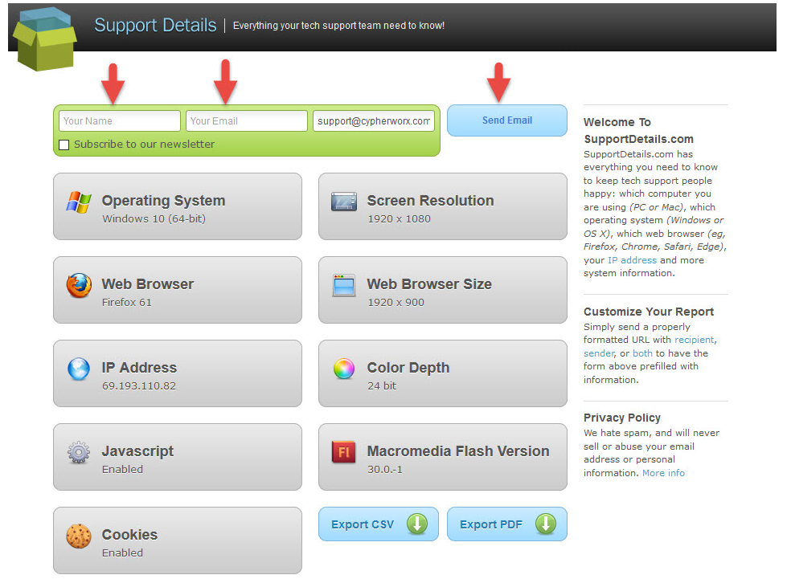
Browser/Flash Info

Slide 17
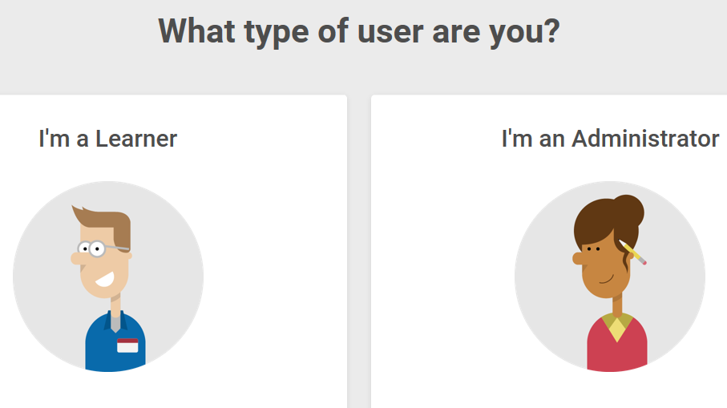
Support Hub
SUPPORT.CYPHERWORX.COM

Slide 18
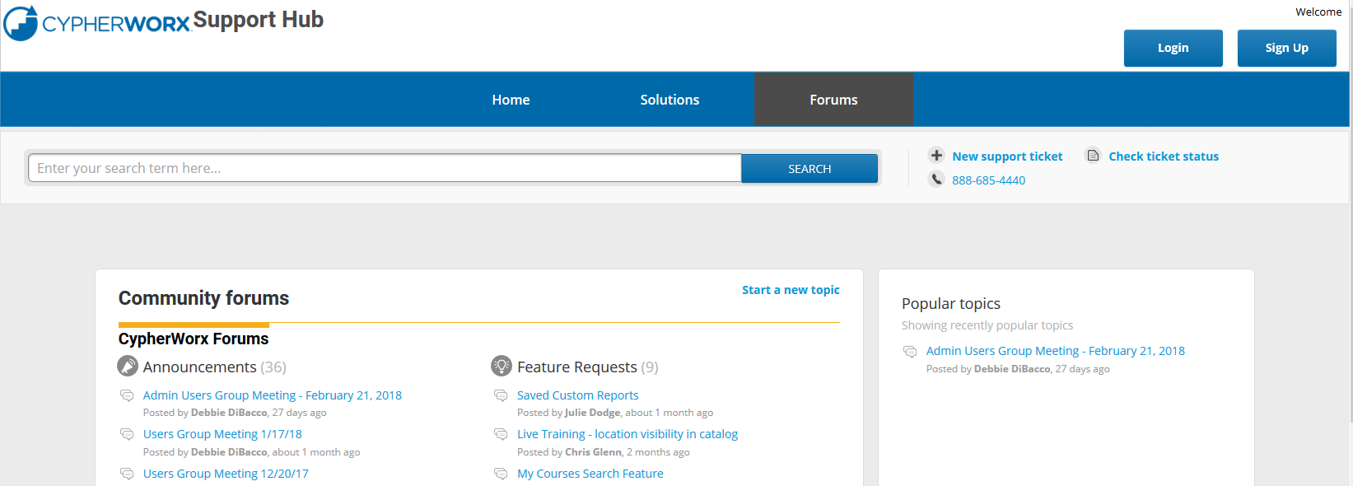
Review Meeting

Slide 19
Contact Info
Please feel free to reach out to our customer support folks after the webinar if you have more questions.
Chris Glenn – cglenn@cypherworx.com
Debbie DiBacco – ddibacco@cypherworx.com
Brett McIntosh – bmcintosh@cypherworx.com

