Slide 1
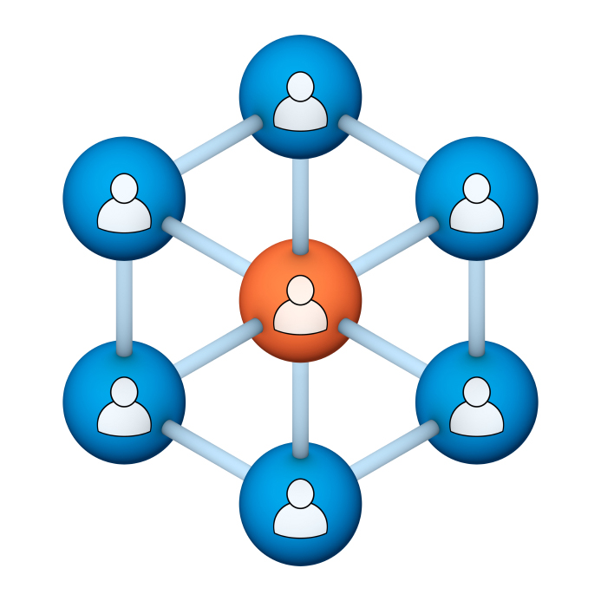
Administrators
Users Group
Meeting
9/19/18

Slide 2
Housekeeping
Click on Chat to send a question or comment:

Slide 3
Our Presenter
Chris Glenn, Client Services
CypherWorx, Inc.

Slide 4
Customer Support
Brett McIntosh – bmcintosh@cypherworx.com
Welcome to our newest team member:
Christopher Schramm – cschramm@cypherworx.com

Slide 5
Agenda
Registration Overview
YouTube Training Videos
Admin Course Creation
Browser/Flash
Reporting – Navigation tips
Reporting Groups
Learning Paths
Support Hub Resources
http://en.wikipedia.org/wiki/Firefighting_in_the_United_States

Slide 6
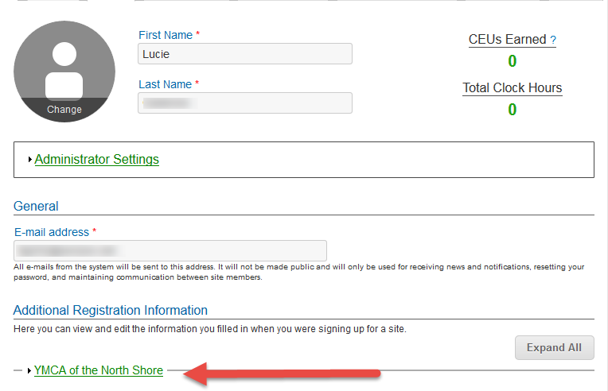
Registration
Importance of the URL:
Specific URLs for each site
Naming convention is: https://collabornation.net/ login/yoursiteinfohere
Without that URL, a customer registers incorrectly (usually into collabornation.net) and without the courses they need.
EXAMPLE: https://collabornation.net/login/ymcanorthshore

Slide 7
YouTube Training Videos
2:44 minute video
Maximize Employee Performance With Assessments
A quick look at our new Assessment Feature
https://www.youtube.com/watch?v=gi5qzVlPK2Q&t=34s
7:18 minute video
Learning Management System
Details how to take courses, participate in discussions, add events and upload resources. Admins can see how to use the reporting features, course assignment options and our DIY Course Creation tool.
https://www.youtube.com/watch?v=cOrfDxQdEY4
10:41 minute video
CollaborNation Create-a-Course (DIY) Tutorial
Details the step by step process on how to turn your existing material into an online course.
https://www.youtube.com/watch?v=cX4AXHe5Yak

Slide 8
Courses You Create
If you are creating your own courses using a course creation software such as Articulate Storyline or Articulate Rise and need us to load your course for you, we need to have the answers to the following questions.
Course title
Are there prerequisites (if there are, then they'd need to be supplied as well)
Is there an image that will show up when someone takes the course? Is so, I'll need that in jpg form.
What is the Course Availability? (This is how long - in weeks - a client has to take the course).
Course length (how long in hours)
Course Description
What catalog you want the course to go in?
If there is a test, what's the mastery score
If there is a certificate, does it need to populate on "passed" or "completed"
If there is a quiz, please provide me with the answers.

Slide 9
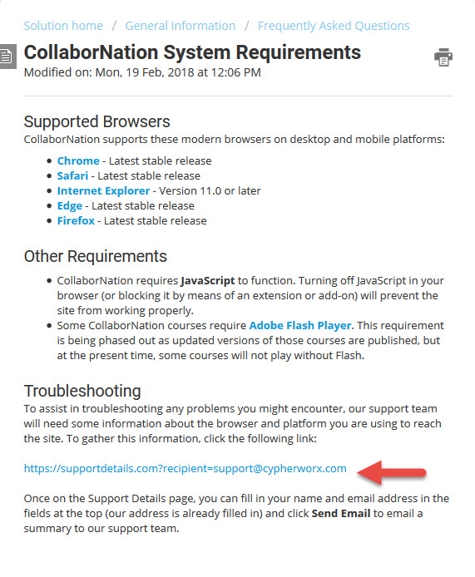
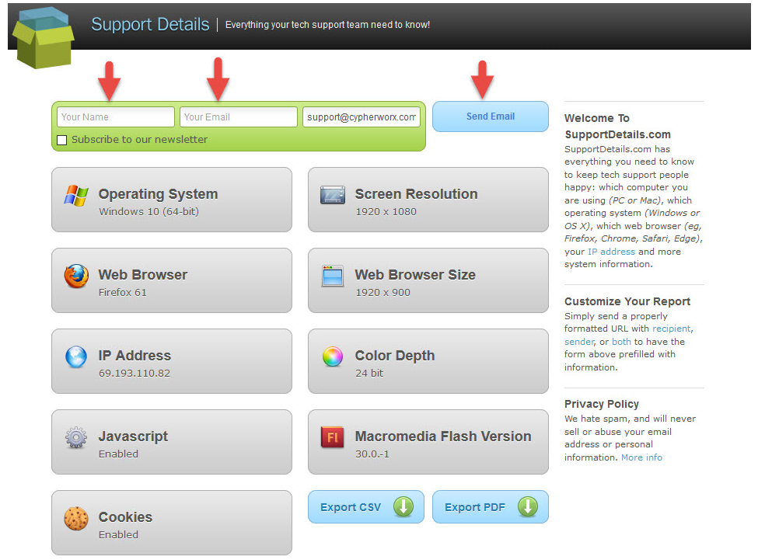
Browser/Flash Info

Slide 10
Reporting
Reporting is where you can look up a variety of status information.
Always be thinking of what you need to find and then use the Navigation Tools that are at the top of the page.
First, always check the date of your Data. Best practice is to select the Refresh button before doing anything else.

Slide 11
Reporting
Tools in Reporting are similar to the ones that are in most of our other features.
Decide how many records you want to see at a time, export a list to a csv document, and Search:
Column headings can be clicked on to sort by the information in a column.
Underlined text can be selected to drill down for further details.
Certificates can be opened by clicking on the date/time in that column.
A horizontal sliding bar moves you to the columns at the far right.

Slide 12
Reporting
The top navigation section allows you to go straight to different areas depending on what you need and is the quickest way to check lists of training (for instance, a list of everyone who has one particular course in their accounts and the statuses) and also a quick view of participation (All Learners) where you get information on the last login dates for your site members.

Slide 13
Reporting
Reporting Groups are linked to this section. You can select all or one or several.
Will show details on the next slide, but a good thing to remember is that even if you are wanting to view records for all site members, you can select the Change button and then filter to view just the active site members.

Slide 14
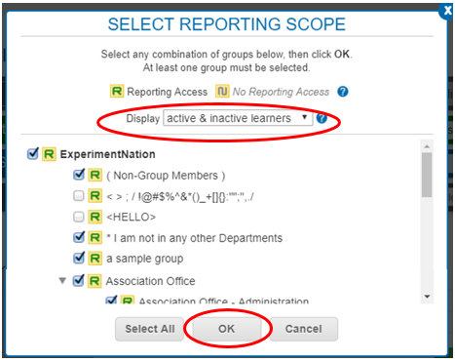
Reporting
When you select the Change button in the Select Reporting Scope section, your list of Reporting Groups will appear. Pictured below is an instance where multiple groups have been chosen.
Note that when the form is opened you have the ability to filter even further based on account status.
Reporting Group Admins and Managers will see the complete listing of groups, but the ones they do not have privileges for will be grayed out.

Slide 15
Reporting
You can narrow your search to a time frame:

Slide 16
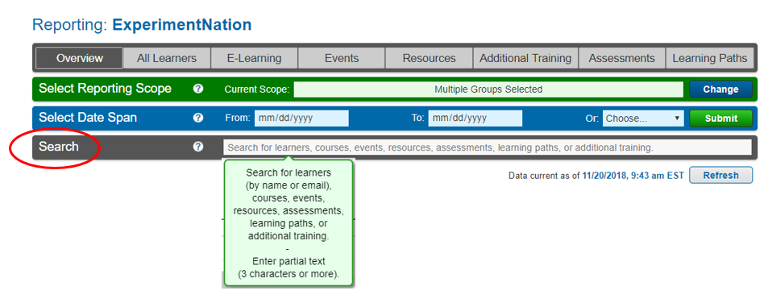
Reporting
For a quick search use the Search field in the 4th section from the top.
(As most of you know, you can also go to your Site Members listing and look up an individual, click the icon next to their name to go to their profile, and from there click a link that will take you to their record in the Reporting section.)

Slide 17
Reporting Groups
Reporting Groups and subgroups are the best way to put your site members into categories that you determine are useful to use as filters when using Reporting and Course Assignments because you can choose the group(s) once they are all set up.
For instance, many YMCAs set up Reporting Groups with the names of their branch locations and sometimes subgroups of the departments in each branch. Or the branches with separate subgroups for full time employees, part time employees and volunteers.
Zoos and Aquariums use Reporting Groups to hold the members of different departments.
After School organizations also set up Reporting Groups by site location and sometimes by job position titles.

Slide 18
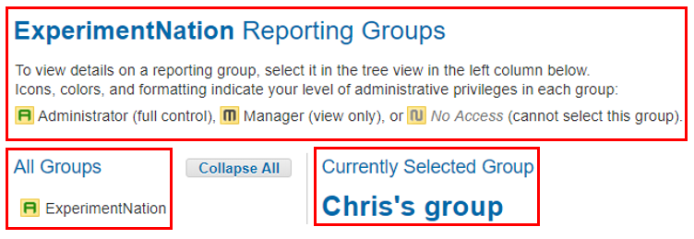
Reporting Groups
Reporting Groups and subgroups are structured in a “tree” fashion. To look at the details of any one group, just click on the title and it will open to the right of the tree.
You will always see the key to symbols used and then the top of the tree to the left under “All Groups” and the title of the opened group to the right under “Currently Selected Group.”

Slide 19
Reporting Groups
The top group is always empty and is where you go to create groups.

Slide 20
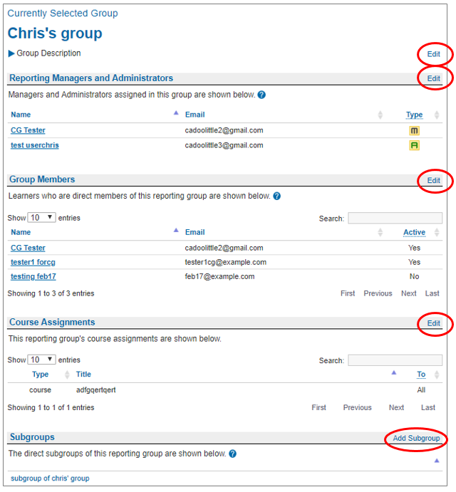
Reporting Groups
Each section of a group has an Edit button at the right side, with the Subgroups section having the option to Add Subgroup:
Change the Group Name and Description, drop down menu allowing you to relocate the group.
Appoint Group Admins and Managers, change settings of current choices.
Site Admins and Group Admins can add and remove Group members; Group Managers can view but not make changes. When open, you can filter for Active/Inactive members.
Although you can link courses to Reporting Groups, note that using this method will not allow you to set deadlines or change deadline dates or remove the assignments; Course Assignment tool gives you more choices.
Add Subgroups to the main group.

Slide 21
Learning Paths
Learning Paths allow you to group different trainings together so that the learner follows a progression through steps that are linked (as opposed to assigning several trainings separately). Only Site Administrators can create Learning Paths.
Please visit our support hub for the article on Learning Paths:
https://support.cypherworx.com/solution/articles/4000125234-learning-paths
This article, wonderfully crafted by our Programming Director, Mike Maether, has multiple screen shots and explanation of steps.
Recommendation: Following the steps in the support hub article, create a sample Learning Path in your site. Create a test user (Add Users feature), and assign the Learning Path to that user. Then log in as that user and go through the steps so that you can get a feel for what your learners will experience.

Slide 22
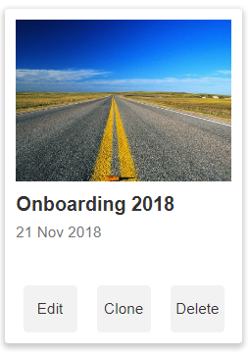
Learning Paths
Here is a sample Learning Path created specifically for one person. Screenshots that follow will show both the Admin view and the Learner view.
A Learning Path as seen by an Admin in the Learning Path section of the Admin Settings menu:

Slide 23
Learning Paths
Admin view after selecting Edit:

Slide 24
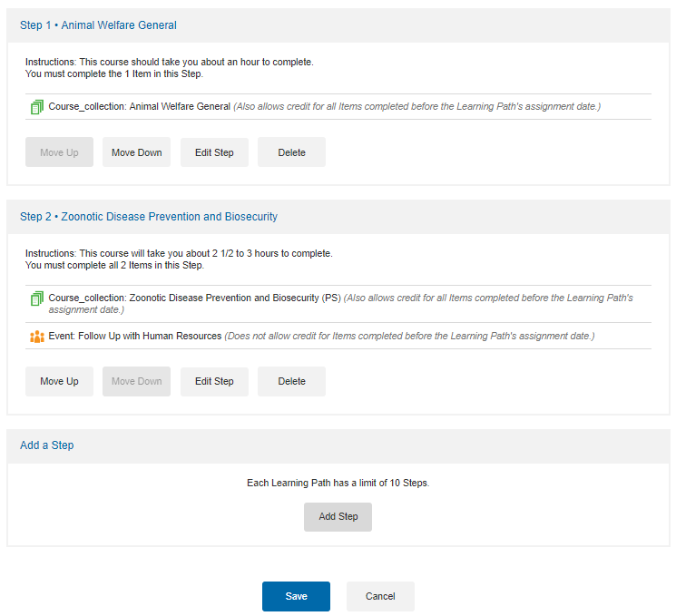
Learning Paths
Admin view – Steps section that follows the Description section:

Slide 25
Learning Paths
Admin – assigning the Learning Path using the Course Assignments tool:

Slide 26
Learning Paths
Admin – assigning the Learning Path:

Slide 27
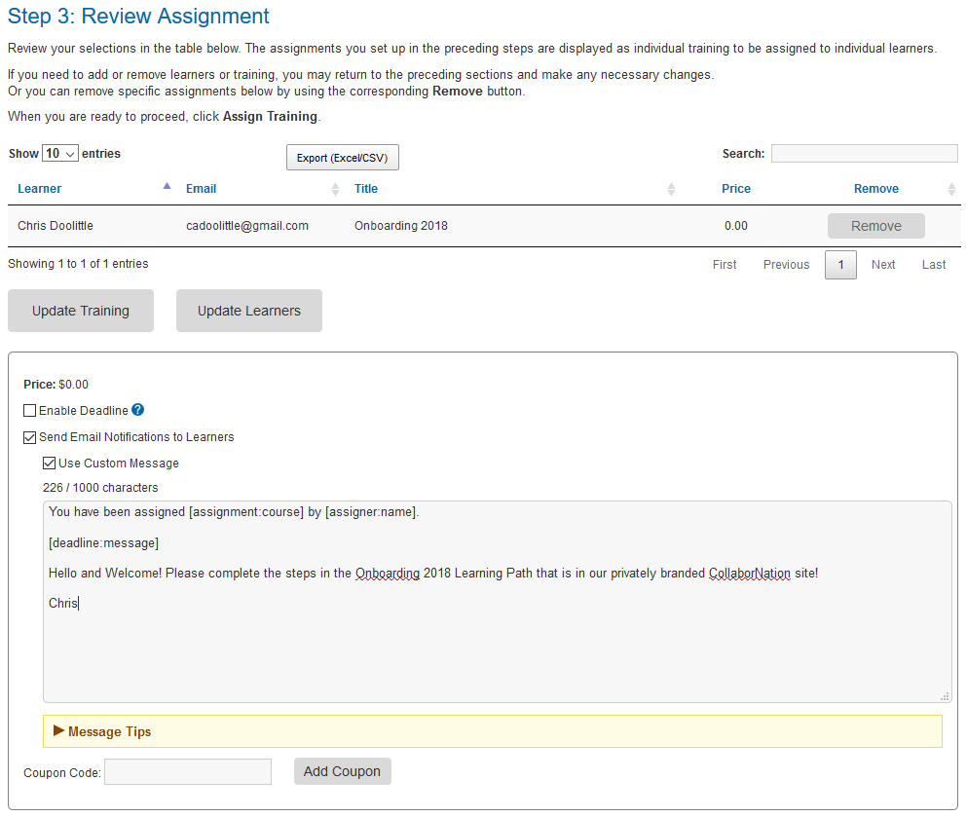
Learning Paths
Admin – assigning the Learning Path:

Slide 28
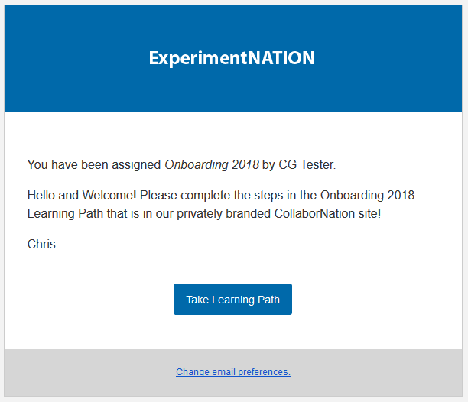
Learning Paths
Learner’s view – email notification from admin@collabornation.net

Slide 29
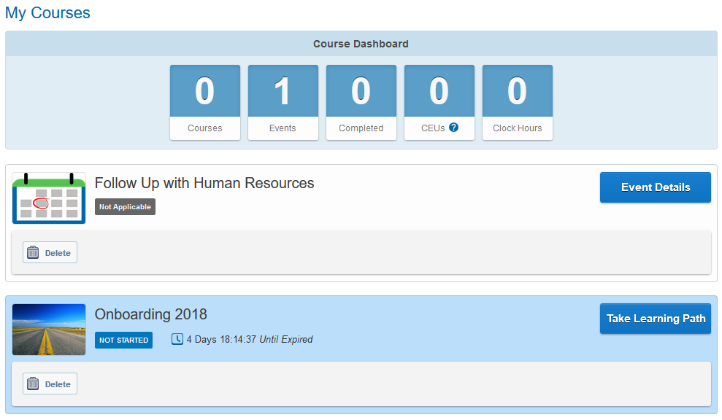
Learning Paths
Learner’s view – has logged in and is on My Courses page:

Slide 30
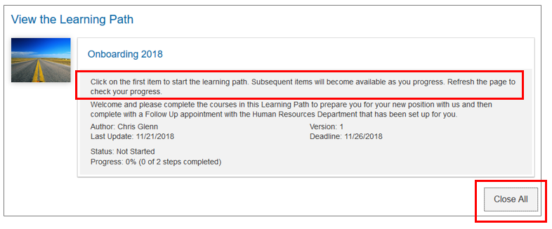
Learning Paths
Learner’s view – Introduction section:
The system adds these instructions before the language that has been added by the Admin when creating the Learning Path
The steps open up when the Learning Path is first opened but can be reduced to list view with the Close All button.

Slide 31
Learning Paths
Learner’s view – list view after Close All button has been selected:

Slide 32
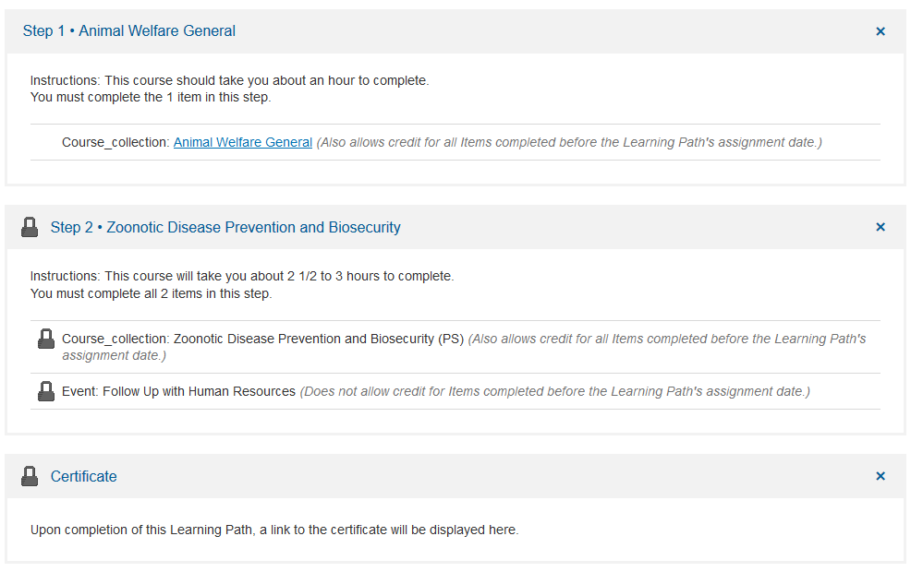
Learning Paths
Learner’s view – expanded view. Because of the way the Learning Path was set up, Step 2 is locked until Step 1 is completed.

Slide 33
Learning Paths
Learner’s view – acquiring the course in Step 1:
When a course has been assigned, it will not show in the My Courses page until the learner has opened the Learning Path and clicked on the link:

Slide 34
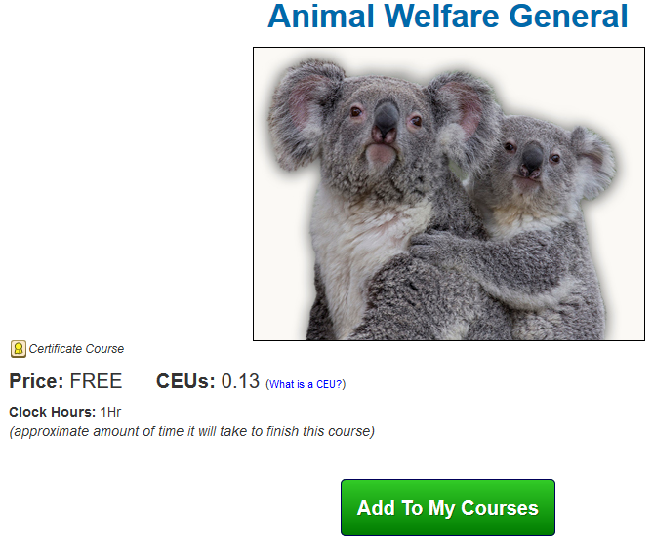
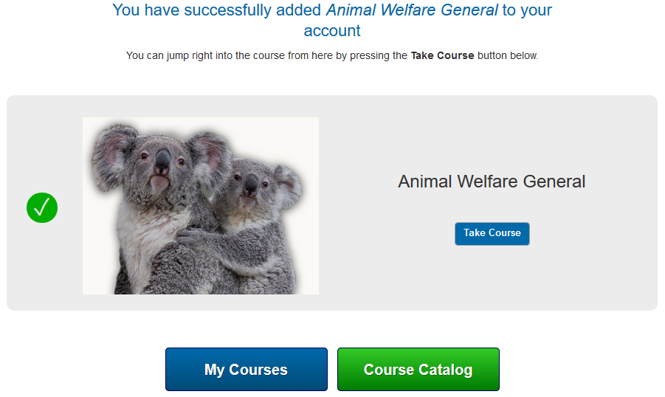
Learning Paths
Learner’s view – after clicking the link, the next step is to choose “Add to My Courses” and then the learner has the choice to begin right away or not:

Slide 35
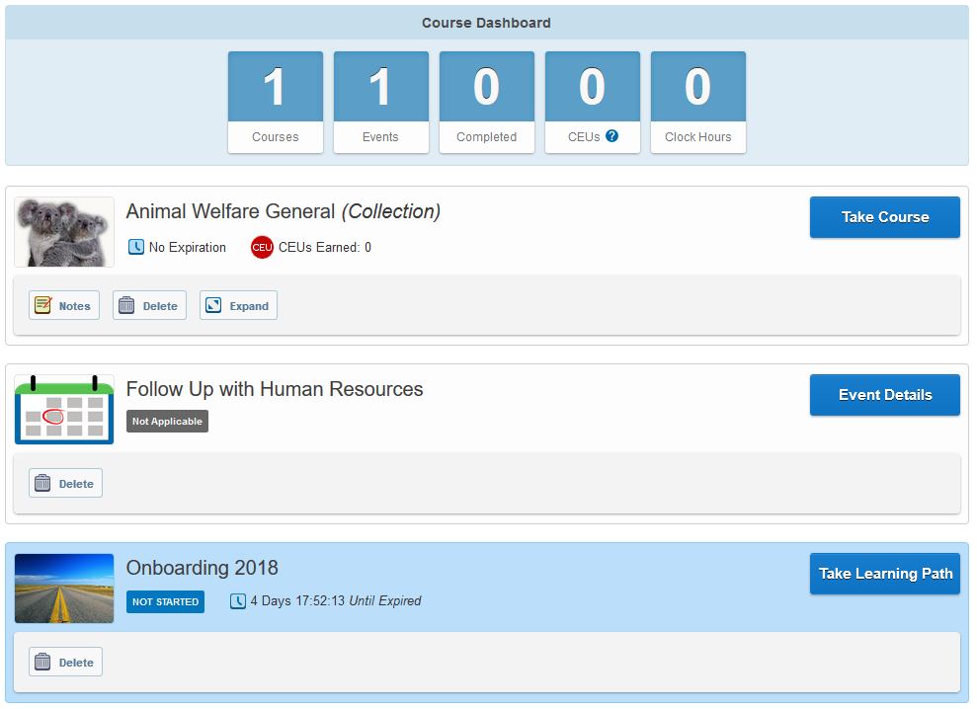
Learning Paths
Learner’s view of My Courses page after acquiring the course for Step 1:

Slide 36
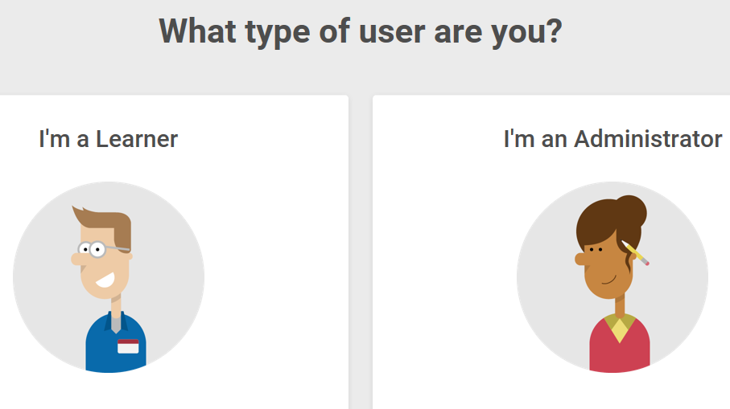
Support Hub
SUPPORT.CYPHERWORX.COM

Slide 37
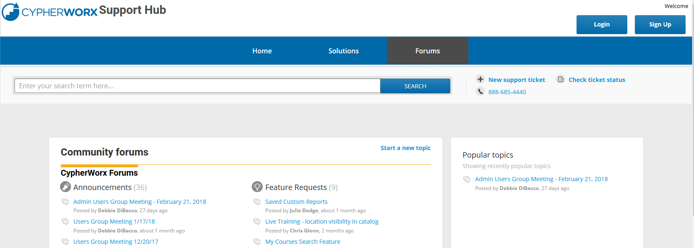
Review Meeting

Slide 38
Contact Info
Please feel free to reach out to our customer support folks after the webinar if you have more questions.
Chris Glenn – cglenn@cypherworx.com
Brett McIntosh – bmcintosh@cypherworx.com
Christopher Schramm – cschramm@cypherworx.com

