Slide 1
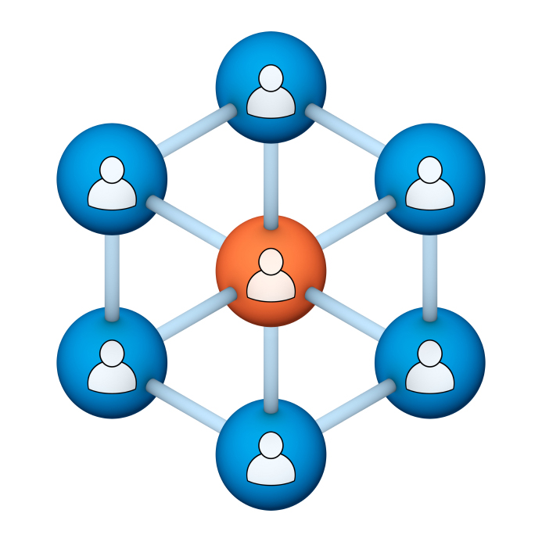
Administrators
Users Group
Meeting
1/16/19

Slide 2
Housekeeping
Click on Chat to send a question or comment:

Slide 3
Our Presenter
Chris Glenn, Client Services
CypherWorx, Inc.

Slide 4
Customer Support
Brett McIntosh – bmcintosh@cypherworx.com
Christopher Schramm – cschramm@cypherworx.com

Slide 5
Agenda
Registration Overview
YouTube Training Videos
Admin Course Creation
Browser/Flash
Assessments
Support Hub Resources
http://en.wikipedia.org/wiki/Firefighting_in_the_United_States

Slide 6
Registration
Importance of the URL:
Specific URLs for each site
Naming convention is: https://collabornation.net/ login/yoursiteinfohere
Without that URL, a learner registers incorrectly (usually into collabornation.net) and without the courses they need.
To find your site’s unique URL – go to the Site Building section in your Admin Settings menu (left edge of page) and you will the URL entered in the “Login URL” field.
Below is the URL for the YMCA of the North Shore site as an example:

Slide 7
YouTube Training Videos
2:44 minute video
Maximize Employee Performance With Assessments
A quick look at our new Assessment Feature
https://www.youtube.com/watch?v=gi5qzVlPK2Q&t=34s
7:18 minute video
Learning Management System
Details how to take courses, participate in discussions, add events and upload resources. Admins can see how to use the reporting features, course assignment options and our DIY Course Creation tool.
https://www.youtube.com/watch?v=cOrfDxQdEY4
10:41 minute video
CollaborNation Create-a-Course (DIY) Tutorial
Details the step by step process on how to turn your existing material into an online course.
https://www.youtube.com/watch?v=cX4AXHe5Yak

Slide 8
Courses You Create
If you are creating your own courses using a course creation software such as Articulate Storyline or Articulate Rise and need us to load your course for you, we need to have the answers to the following questions.
Course title
Are there prerequisites (if there are, then they'd need to be supplied as well)
Is there an image that will show up when someone takes the course? Is so, I'll need that in jpg form.
What is the Course Availability? (This is how long - in weeks - a client has to take the course).
Course length (how long in hours)
Course Description
What catalog you want the course to go in?
If there is a test, what's the mastery score
If there is a certificate, does it need to populate on "passed" or "completed"
If there is a quiz, please provide me with the answers.
There is also an article in our support hub about using your own courses in your site:
https://support.cypherworx.com/a/solutions/articles/4000115164-how-to-create-courses-and-upload-them-to-your-site

Slide 9
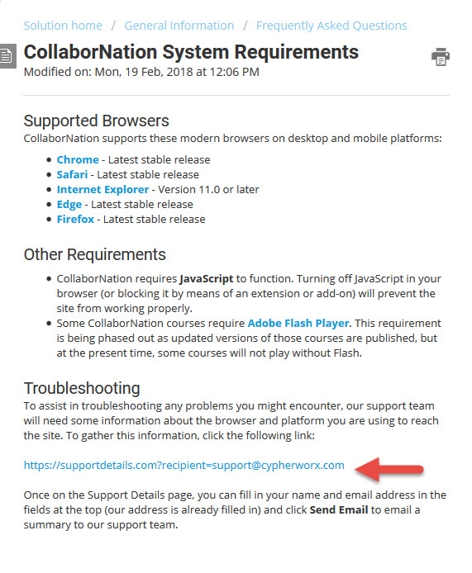
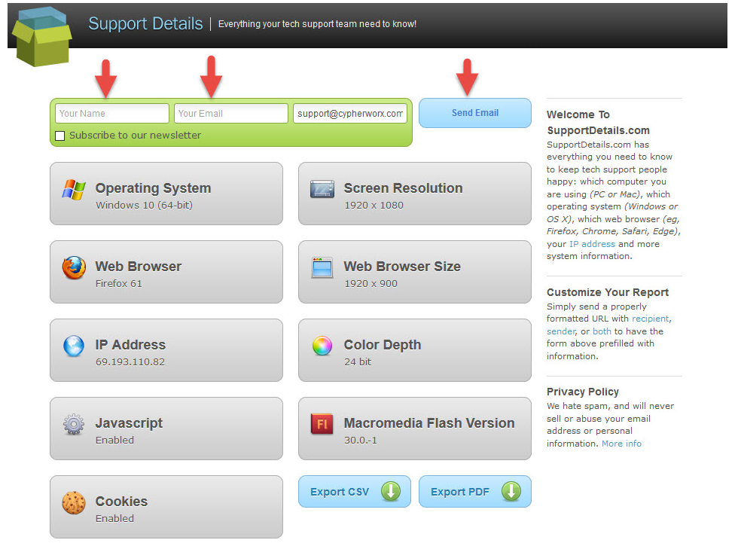
Browser/Flash Info

Slide 10
Assessments
Assessments is one of the newer features on CollaborNation. This tool allows site administrators to discover learning needs and knowledge gaps, then use the results of the Assessment questionnaire to create individualized training plans.
Please visit our support hub for the article on Learning Paths:
https://support.cypherworx.com/a/solutions/articles/4000124682-assessments
This article, wonderfully crafted by our Programming Director, Mike Maether, has multiple screen shots and explanations of steps.
Recommendation: Following the steps in the support hub article, create a sample Assessment in your site. Send the link to an email address that you have access to in order to go through the receiver’s experience.

Slide 11
Assessments
To create an Assessment, go to the Assessments feature on your Admin Settings menu.
That will take you to the Assessment Catalog, where you can create a new Assessment:

Slide 12
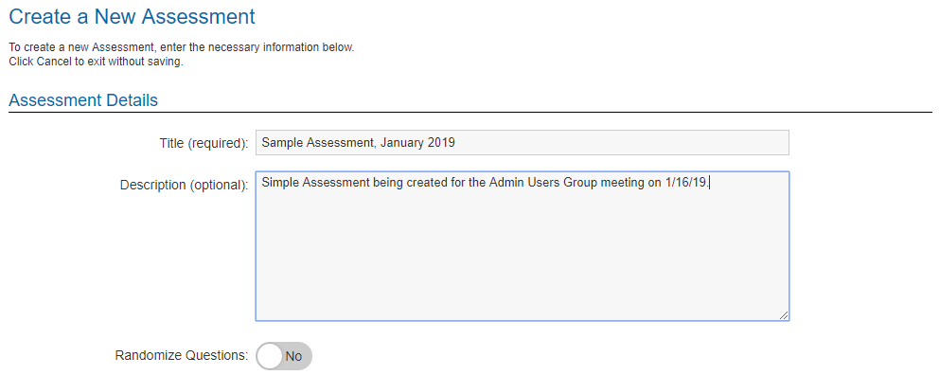
Assessments
The first task involves adding a Title and Description, then deciding if you want the questions that you create to be randomized in order or not:

Slide 13
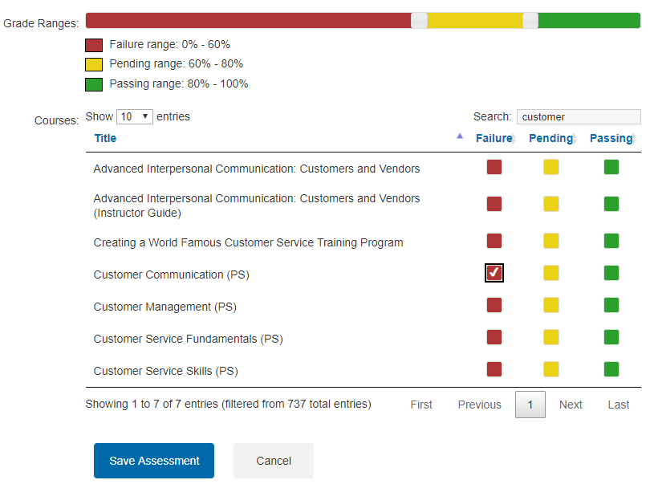
Assessments
Next you can decide how you want grading to occur and can slide the white boxes to make adjustments. This picture is set to the default, but you can slide the red and green together if you have no need for a “Pending” range or change the ranges.
The courses in your site will appear below the Grade Ranges section and for this example, the Search field has been used to bring up a small selection. One course has been selected to be assigned if the Assessment results fall into the Failure range:

Slide 14
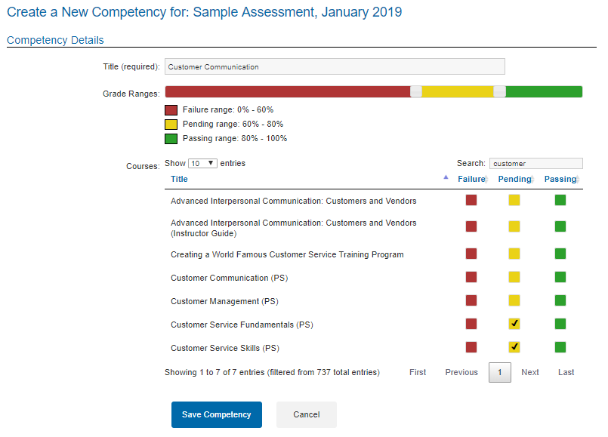
Assessments
Then set up Competencies (only one for this example). Two courses have been selected to be assigned if the answers to the Competency questions fall into the Pending range.

Slide 15
Assessments
Create questions and answers for each Competency. Below are the ones created for this sample. You can add more, reorder them (triangle toward the right) or open them by clicking on the question.

Slide 16
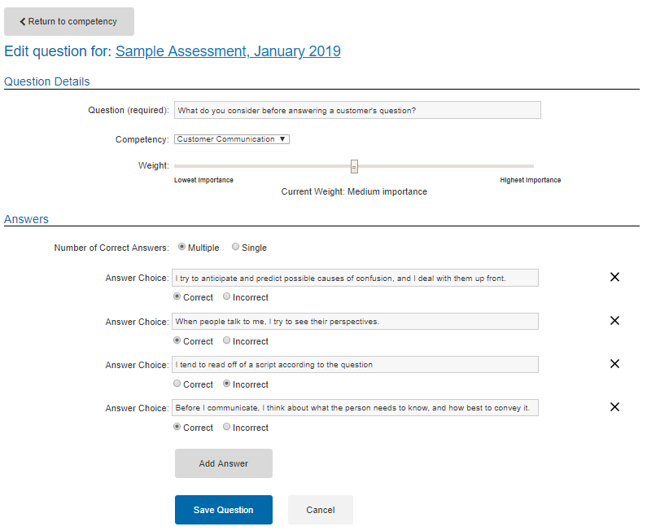
Assessments
Here is a question as seen after you click on it to open:

Slide 17
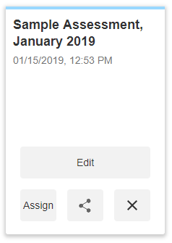
Assessments
After completing the set up of the Assessment, it will be visible in the Catalog of the Assessments feature (not the catalog in the Course Catalog tab in your site).
You can then assign it. Selecting the “Assign” button will send you to the Course Assignment tool, Step 2. An account is necessary in your site in order to assign an assessment. Use the middle button to send the link to people who do not have an account in your site.
Recommendation – use the custom message section in the Course Assignment tool to inform the receiver of what courses will be auto-assigned depending on the results if you want to give advance notice. Otherwise the system will send them an email when assignments are made as a result of the Assessment results.

Slide 18
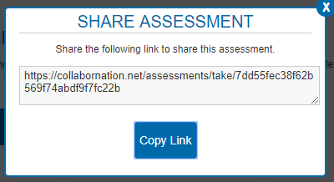
Assessments
To send the link to someone who does not have an account in your site, select the middle button on the bottom and you will be given the information you need.

Slide 19
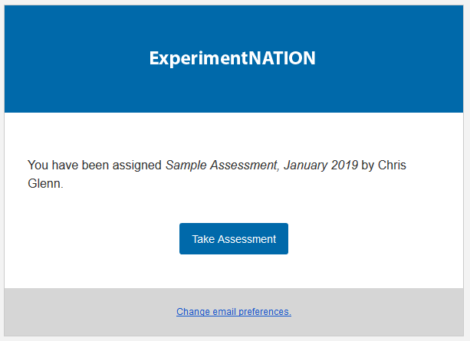
Assessments
Learner’s view – email notification from admin@collabornation.net

Slide 20
Assessments
Learner’s view – has logged in and is on My Courses page:

Slide 21
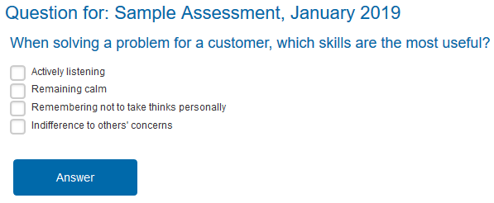
Assessments
Learner’s view – questions: select and then click the Answer button. The Answer button appears with each question but is only pictured once for this example.

Slide 22
Assessments
Learner’s view – Completion of Assessment notice:
And now the My Courses listing shows the Assessment as Completed:

Slide 23
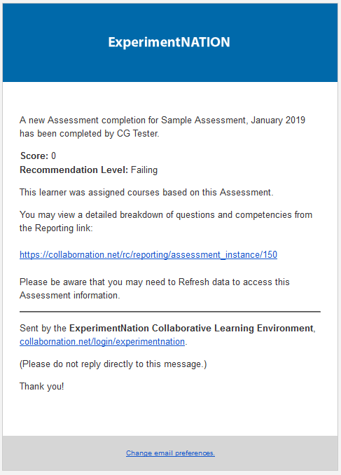
Assessments
Back to Admin view: An email will be sent to site administrators when Assessments are completed (from admin@collabornation.net):

Slide 24
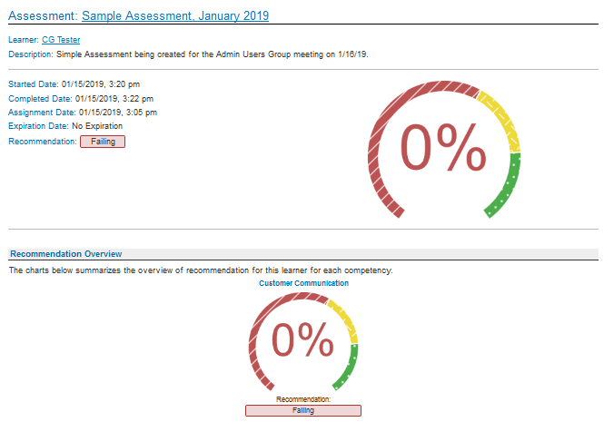
Assessments
Admin view: clicking the link in the email will take you to Reporting:

Slide 25
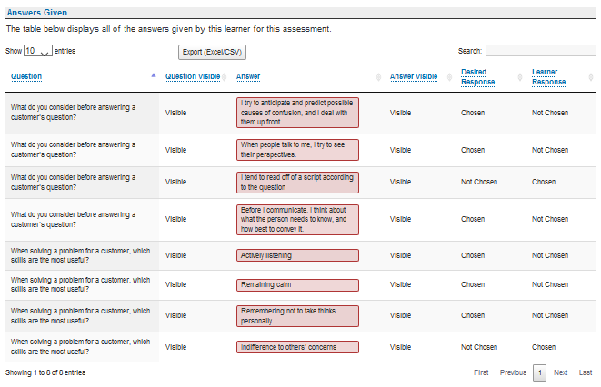
Assessments
Admin view: and the questions and answers breakdown is shown:

Slide 26
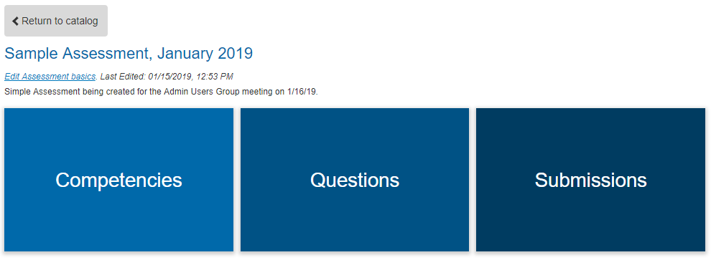
Assessments
Admin view: Alternatively, visit Assessments in the Admin Settings menu and select Edit on your Assessment. You will be taken to the section pictured below. Choose Submissions to be taken directly to the Reporting feature. Remember to select the Refresh button when you get there.

Slide 27
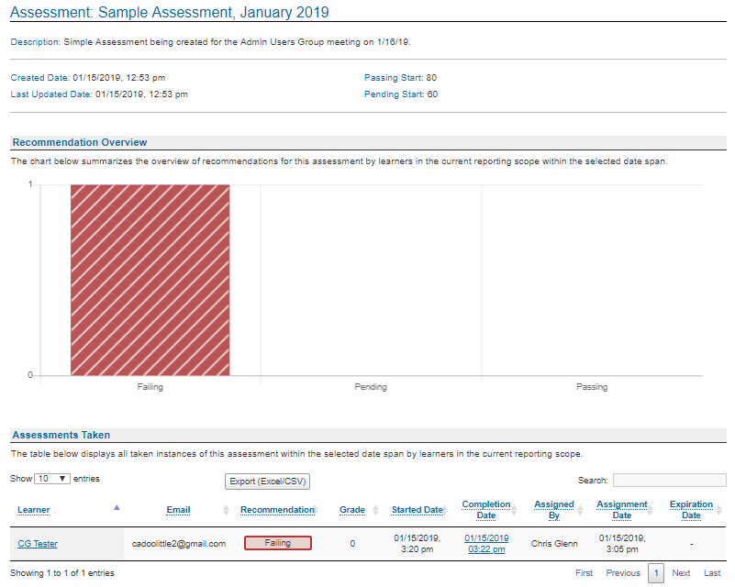
Assessments
Admin view: Under the navigation bars at the top (not pictured), you will see the results and some basic information about the Assessment.

Slide 28
Assessments
Admin view: As an Admin, specifics in the account can be viewed in the Reporting feature by searching for the learner by name and then scrolling down to view information on assignments and other activity.
Shown here is verification that the course selected to be auto-assigned if the Assessment results were in the Failing range was indeed assigned:

Slide 29
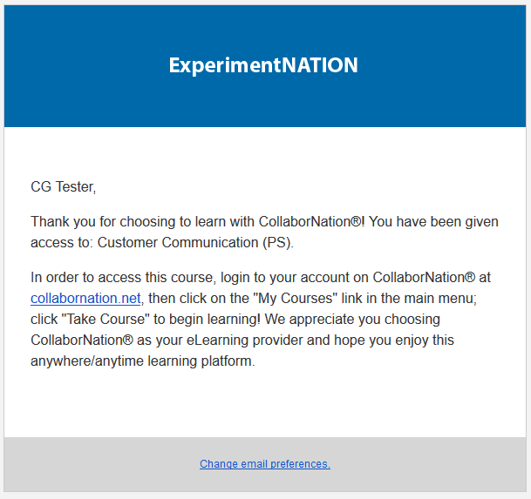
Assessments
Learner view: The auto assignment(s) will trigger an email to the learner. Emails will come from admin@collabornation.net.

Slide 30
Assessments
Learner view: And the course will be waiting for them in their My Courses listing:

Slide 31
Assessments
We encourage you to think creatively and share with us the uses you come up with to utilize the Assessments feature!

Slide 32
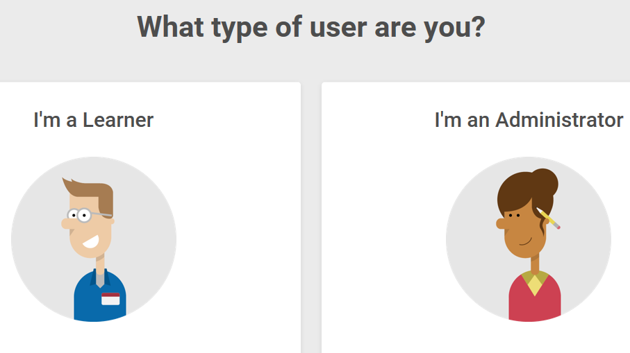
Support Hub
SUPPORT.CYPHERWORX.COM

Slide 33
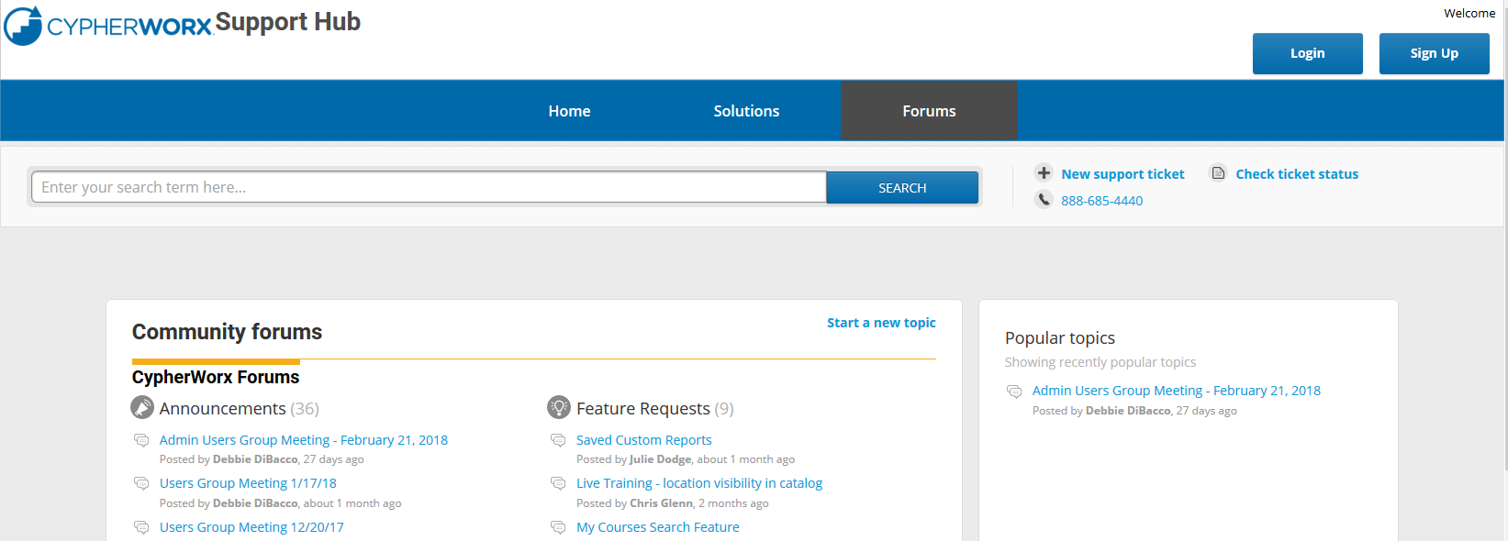
Review Meeting

Slide 34
Contact Info
Please feel free to reach out to our customer support folks after the webinar if you have more questions.
Chris Glenn – cglenn@cypherworx.com
Brett McIntosh – bmcintosh@cypherworx.com
Christopher Schramm – cschramm@cypherworx.com

