Slide 1
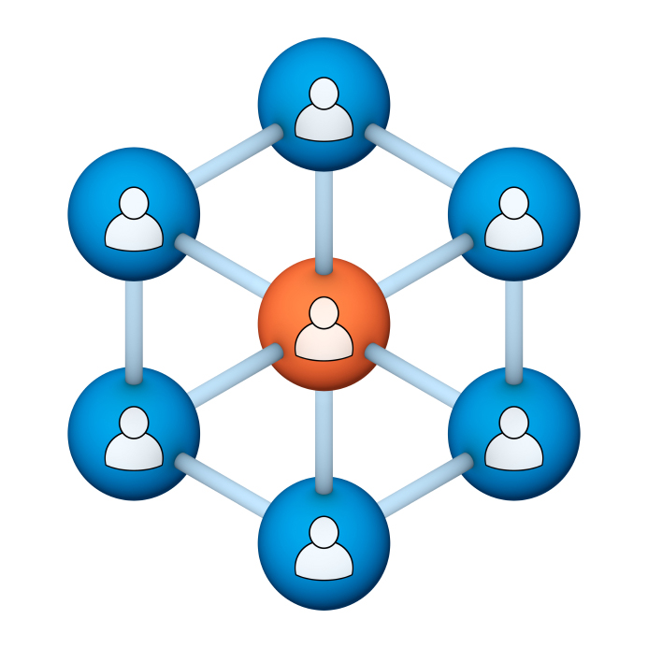
Administrators
Users Group
Meeting
3/20/19

Slide 2
Housekeeping
Using the Zoom navigation bar, click on Chat to send a question or comment:

Slide 3
Our Presenter
Chris Glenn, Client Services
CypherWorx, Inc.

Slide 4
Customer Support
Brett McIntosh – bmcintosh@cypherworx.com
Christopher Schramm – cschramm@cypherworx.com

Slide 5
Agenda
Registration Overview
Training Videos
Admin Course Creation
Browser/Flash
New since the Redesign
Admin Tools in the Redesign
Support Hub Resources
http://en.wikipedia.org/wiki/Firefighting_in_the_United_States

Slide 6
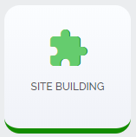
Registration
Importance of the URL/site link:
There are specific URLs for each site, and since the Redesign, different URLs for logging in and registering (new account creation).
Find the unique URLs for your site in Site Building, in the General section after you select the green shield from the menu at the left edge of your screen:

Slide 7
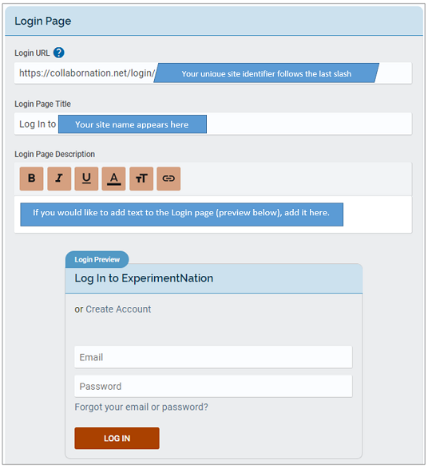
Login URL
After you select
you will see several sections and a “Save Changes” button underneath all of them.
Here is the Login Page section.

Slide 8
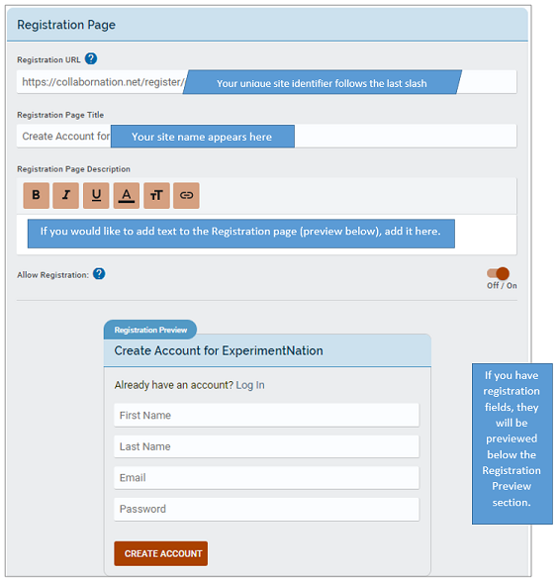
Registration URL
And here is the Registration Page section.

Slide 9
Training Videos
25:36 minute video
CollaborNation Site Redesign
A quick look at our site redesign
https://support.cypherworx.com/solution/articles/4000137266-collabornation-site-redesign
48:39 minute video
Admin Users Group Meeting – February 21, 2019
Mike Maether gives a tour of the redesign for Site Administrators
https://www.screencast.com/t/oaoysdg4ef
2:44 minute video
Maximize Employee Performance With Assessments
A quick look at our new Assessment Feature
https://www.youtube.com/watch?v=gi5qzVlPK2Q&t=34s
7:18 minute video
Learning Management System
Details how to take courses, participate in discussions, add events and upload resources. Admins can see how to use the reporting features, course assignment options and our DIY Course Creation tool.
https://www.youtube.com/watch?v=cOrfDxQdEY4
10:41 minute video
CollaborNation Create-a-Course (DIY) Tutorial
Details the step by step process on how to turn your existing material into an online course.
https://www.youtube.com/watch?v=cX4AXHe5Yak

Slide 10
Courses You Create
If you are creating your own courses using a course creation software such as Articulate Storyline or Articulate Rise and need us to load your course for you, we need to have the answers to the following questions.
Course title
Are there prerequisites (if there are, then they'd need to be supplied as well)
Is there an image that will show up when someone takes the course? Is so, I'll need that in jpg form.
What is the Course Availability? (This is how long - in weeks - a client has to take the course).
Course length (how long in hours)
Course Description
What catalog you want the course to go in?
If there is a test, what's the mastery score
If there is a certificate, does it need to populate on "passed" or "completed"
If there is a quiz, please provide me with the answers.
There is also an article in our support hub about using your own courses in your site:
https://support.cypherworx.com/a/solutions/articles/4000115164-how-to-create-courses-and-upload-them-to-your-site

Slide 11
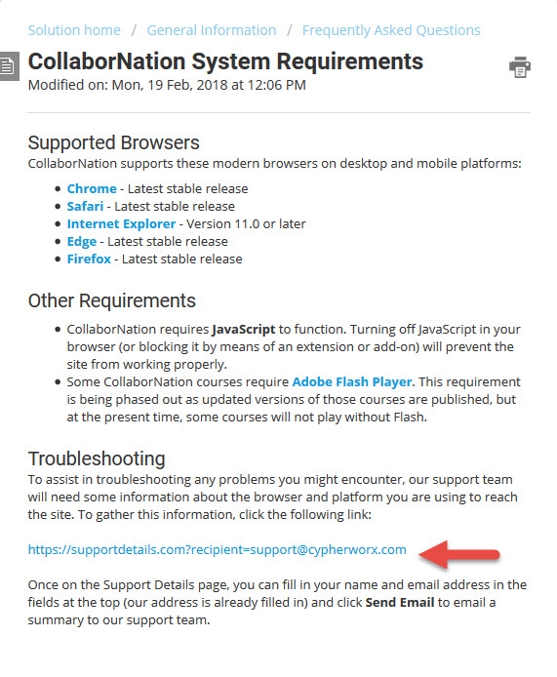
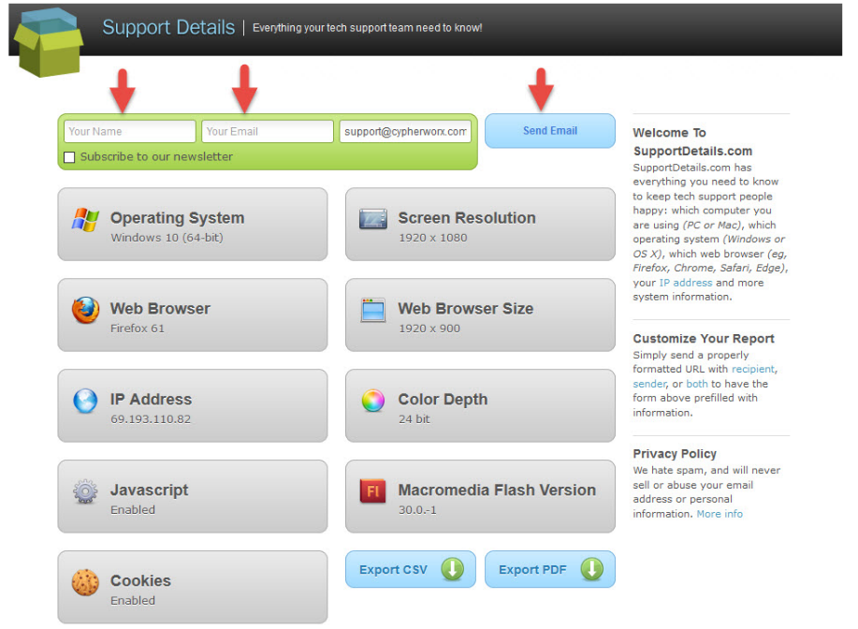
Browser/Flash Info

Slide 12
New for 3/20/19
Since the Redesign launch in February:
Learning Paths - will now automatically refresh the status of the item upon completion (no need to refresh the browser page).
Course Catalog - admins can now toggle on/off displaying the Course Catalog in their site – setting is in the Registration Page section after you select the Site Building button. Admins will still see the Course Catalog and also be able make assignments as always.
Reporting – Event and Assessment descriptions will no longer be displayed in a table column in standard Reporting, but will still display when viewing individually.

Slide 13
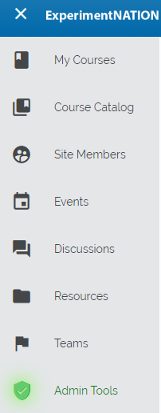
Redesign navigation
On the left side of your page, depending on how you have set up your site, you will see these icons. Click on the “hamburger” (top left) to view the icon titles:

Slide 14
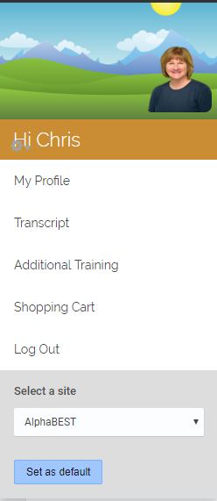
Redesign navigation
The learner profile and general menu resides at the top right:

Slide 15
Redesign navigation
The bell icon to the left of the person picture or icon at the top right (profile) is for viewing notifications and notification settings.

Slide 16
Redesign navigation
The magnifying glass icon to the left of the notification bell is for searching the site.

Slide 17
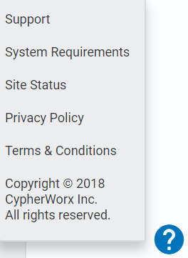
Redesign navigation
Access our Support Hub and other site information by clicking on the question mark at the bottom right of the page to display a menu.

Slide 18
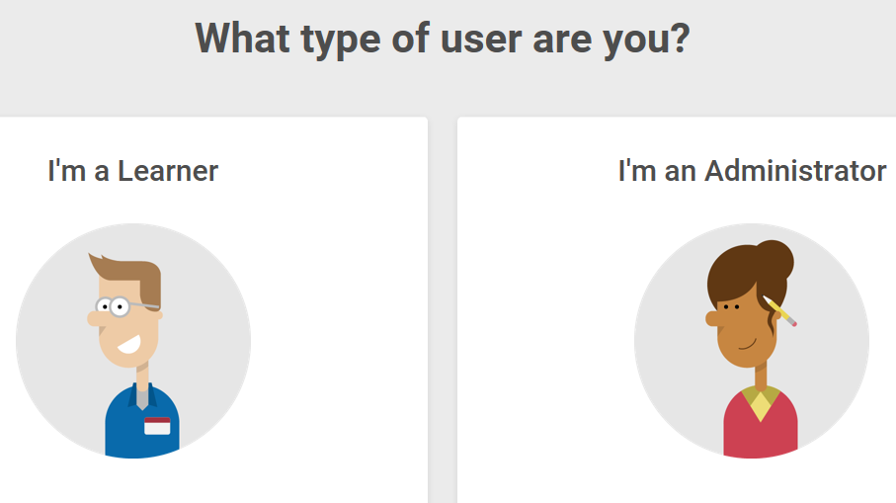
Support Hub
SUPPORT.CYPHERWORX.COM

Slide 19
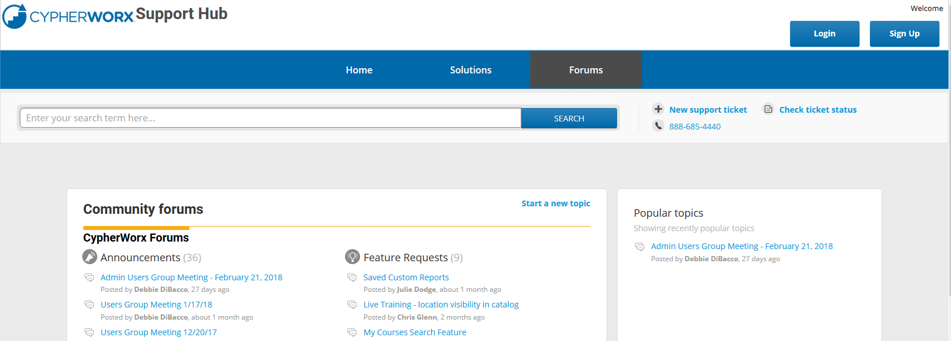
Review Meeting

Slide 20
Contact Info
Please feel free to reach out to our customer support folks after the webinar if you have more questions.
Chris Glenn – cglenn@cypherworx.com
Brett McIntosh – bmcintosh@cypherworx.com
Christopher Schramm – cschramm@cypherworx.com

Slide 21
