Slide 1
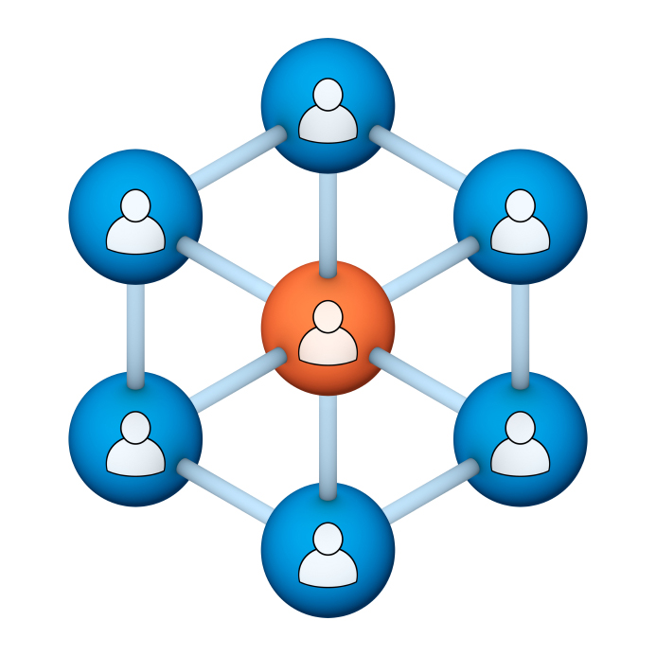
Administrators
Users Group
Meeting
6/19/19
Notes:
Welcome to the April 2019 Administrators Users Group Meeting!

Slide 2
Housekeeping
Using the Zoom navigation bar, click on Chat to send a question or comment:

Slide 3
Our Presenter
Chris Glenn, Client Services
CypherWorx, Inc.
Notes:
.

Slide 4
Customer Support
Brett McIntosh – bmcintosh@cypherworx.com
Christopher Schramm – cschramm@cypherworx.com

Slide 5
Agenda
Registration Overview
Training Videos
Admin Course Creation
Browser/Flash
Recertification
Course Completion Notification (new!)
WYSIWYG (new!)
Permissions review
Learning Paths tip
http://en.wikipedia.org/wiki/Firefighting_in_the_United_States

Slide 6
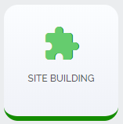
Registration
Importance of the URL/site link:
There are specific URLs (web addresses) for each site, and since our Redesign in February 2019, separate URLs for logging in and for registering (new account creation).
Find the unique URLs for your site in Site Building, in the General section after you select the green shield from the menu at the left edge of your screen:

Slide 7
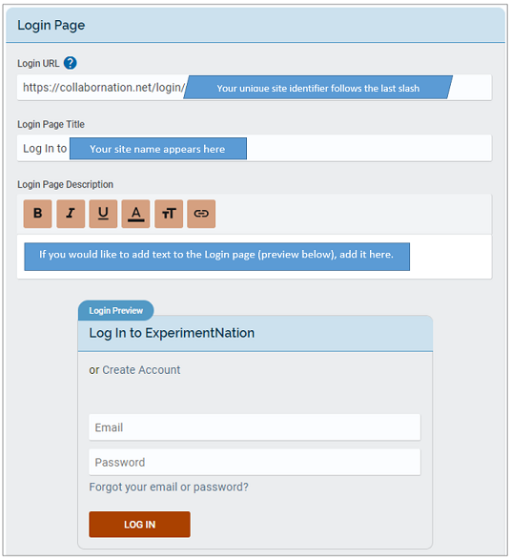
Login URL
After you select
you will see several sections and a “Save Changes” button underneath all of them.
At the top of the Login Page section you will see your unique link.

Slide 8
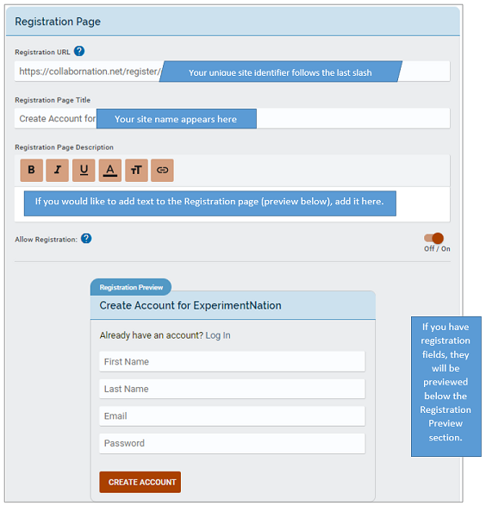
Registration URL
Below to the right is the Registration Page section and above it is a larger picture of the unique link field.
Remember, both the login URL and the registration URL will always begin with:
https://collabornation.net/

Slide 9
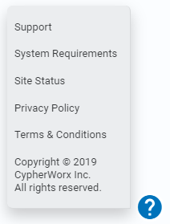
Training Videos
25:36 minute video
CollaborNation Site Redesign
A quick look at our site redesign
https://support.cypherworx.com/solution/articles/4000137266-collabornation-site-redesign
48:39 minute video
Admin Users Group Meeting – February 21, 2019
Mike Maether gives a tour of the redesign for Site Administrators
https://www.screencast.com/t/oaoysdg4ef
2:44 minute video
Maximize Employee Performance With Assessments
A quick look at our new Assessment Feature
https://www.youtube.com/watch?v=gi5qzVlPK2Q&t=34s
7:18 minute video
Learning Management System
Details how to take courses, participate in discussions, add events and upload resources. Admins can see how to use the reporting features, course assignment options and our DIY Course Creation tool.
https://www.youtube.com/watch?v=cOrfDxQdEY4
10:41 minute video
CollaborNation Create-a-Course (DIY) Tutorial
Details the step by step process on how to turn your existing material into an online course.
https://www.youtube.com/watch?v=cX4AXHe5Yak

Slide 10
Courses You Create
If you are creating your own courses using a course creation software such as Articulate Storyline or Articulate Rise and need us to load your course for you, we need to have the answers to the following questions.
Course title
Are there prerequisites (if there are, then they'd need to be supplied as well)
Is there an image that will show up when someone takes the course? Is so, I'll need that in jpg form.
What is the Course Availability? (This is how long - in weeks - a client has to take the course).
Course length (how long in hours)
Course Description
What catalog you want the course to go in?
If there is a test, what's the mastery score
If there is a certificate, does it need to populate on "passed" or "completed"
If there is a quiz, please provide me with the answers.
There is also an article in our support hub about using your own courses in your site:
How to create courses and upload them to your site

Slide 11
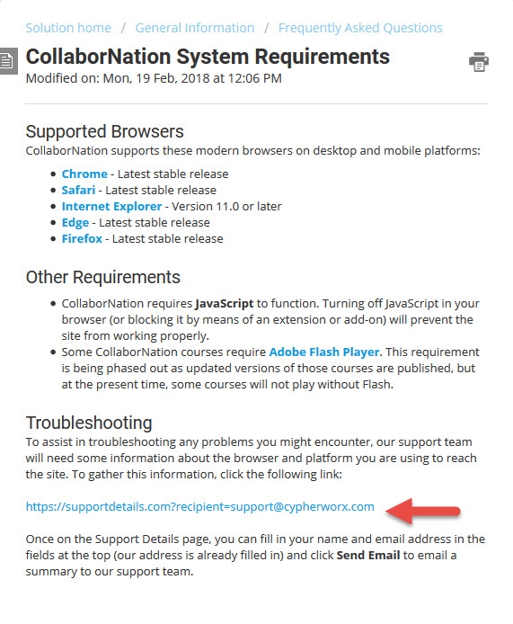
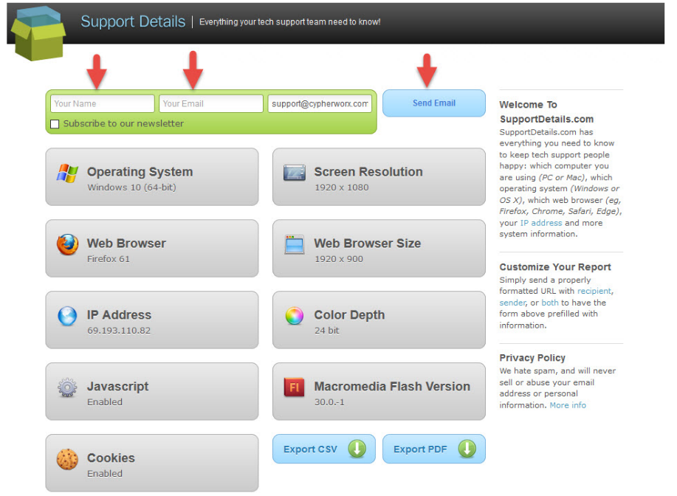
Browser/Flash Info
Visit the Support Hub to see the full article: CollaborNation System Requirements

Slide 12
Recertification
Many of you need to have Learners re-certify in certain areas, and that may mean that they need to repeat taking a course they have completed in the past.
It is very important to explain to Learners that once you have completed a course and see the Certificate button on it in the My Courses list, the date will not change on the certificate if you re-take that course. Although the system allows you to re-take a course for review, your own benefit, etc., the original date of a successful completion will remain on the certificate.
Either through Course Assignments or Self-Assignment, a Learner seeking recertification in the current year must obtain a new instance of the same course and complete that.
Sample of a course NOT to re-take:
Sample of a course that will receive a current date on a certificate upon completion:

Slide 13
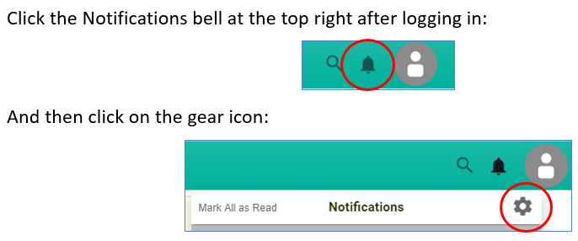
What’s New!
Course Completion Notification
Admins can now choose to receive notifications when courses are completed. Reporting Group Admins and Managers can choose to receive these notifications for members of their Group(s).
This is defaulted to off, so each person needs to log in, go to their Notification Settings, and check either both the email and notification boxes or just one to toggle this on – no need to select a save button, change is automatically saved.

Slide 14
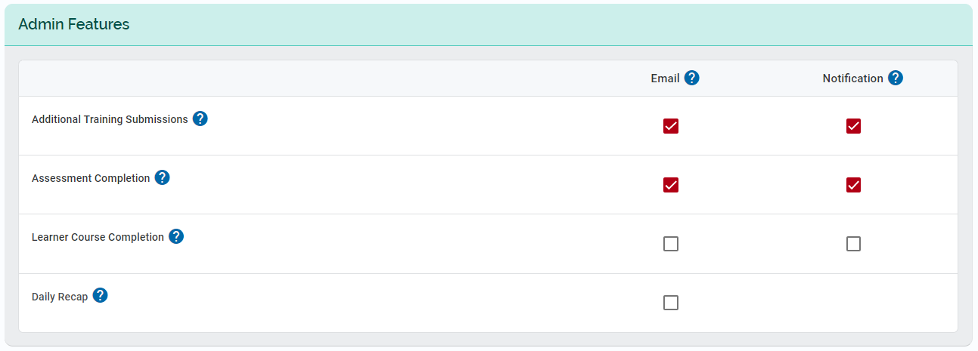
What’s New!
Course Completion Notification
Selecting the gear icon button opens 3 sections in Notification Settings:
Settings, Admin Features, and Courses.
Go to the Admin Features section (middle) and check the boxes for your individual preferences as an admin. The Learner Course Completion line will be defaulted to off so that you can choose to receive an email, a site notification, or both.

Slide 15
What’s New!
WYSIWYG
The programmers have added a WYSIWYG (pronounced "wiz-ee-wig") editor to Discussions, Learning Paths, Events, Assessments, Teams and Site Building. This allows you to add more styling to your text (bold, italicize, ordered lists, unordered lists, quotes) and embed videos. Below is what the Description section now looks like when you create a new Learning Path:

Slide 16
Permissions
There are several different levels of permissions that can be assigned to accounts. For an article on permissions, please visit our support hub:
https://support.cypherworx.com/solution/articles/4000114785-user-permissions-in-collabornation
Pictured below is the beginning of the article. As you can see, there are both explanations and screenshots.

Slide 17
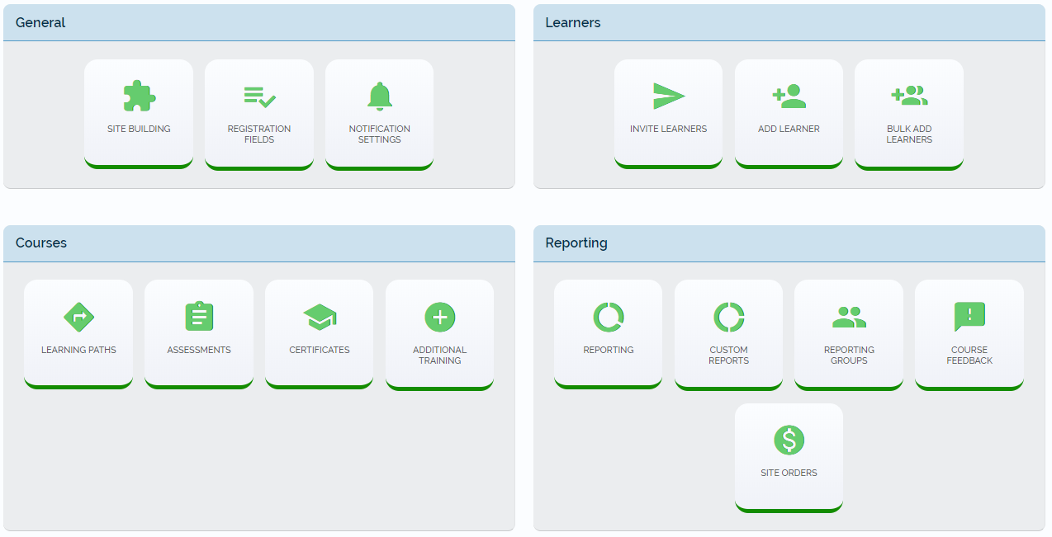
Permissions
Site Administrators will see these tools at their disposal. Some may not have Create A Course and some may have other custom tools for file transfer information:

Slide 18
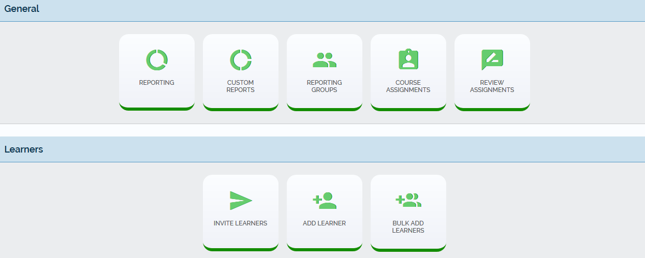
Permissions
Reporting Group Administrators will have these tools, and also have permission to use the After-Event Reporting feature Events:

Slide 19
Permissions
Reporting Group Managers will have these tools, and also have permission to use the After-Event Reporting feature Events:

Slide 20
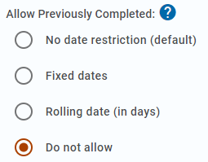
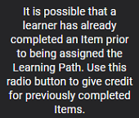
Learning Paths tip
Here’s a scenario that I had not thought about – the snag it caused and correction/tip for future use:
Admin created a Learning Path, and set a deadline on it so that it expires 7 days after it has been assigned:
Deadline: Yes
Rolling Deadline: 7 days from assignment
Also, each step has this setting:

Slide 21
Learning Paths tip
Learner completes a step, gets part way through the next step, and then the 7 days is up and the Learning Path expires, so the Learner can no longer open it.
Learner goes back to Admin who assigned, and the Admin re-assigns the Learning Path. (This is where things took a wrong turn.)
Now the Learner has a partially-completed, expired Learning Path and a new, unstarted one.
Since the Learning Path is set to not allow previously completed courses, the newly assigned Learning Path is not letting the Learner take up where she left off, and is requiring that she takes the courses that she has recently completed when the Learning Path was originally assigned.
Admin contacts CypherWorx support because Learner is frustrated that she cannot move forward in the Learning Path steps.

Slide 22
Learning Paths tip
Solution and lesson learned…
Go to the Admin Tools and visit Review Assignments (in the Courses section).
Search for the Learner name and change the deadline date on the originally assigned Learning Path to new, acceptable date.
Changing the date in the Review Assignments feature will override the “rolling deadline” setting in the Learning Path for that Learner.
To finish, use the Remove button to eliminate the second assignment from the Learner’s view.
Once that is done, the Learner can take up where she left off.

Slide 23
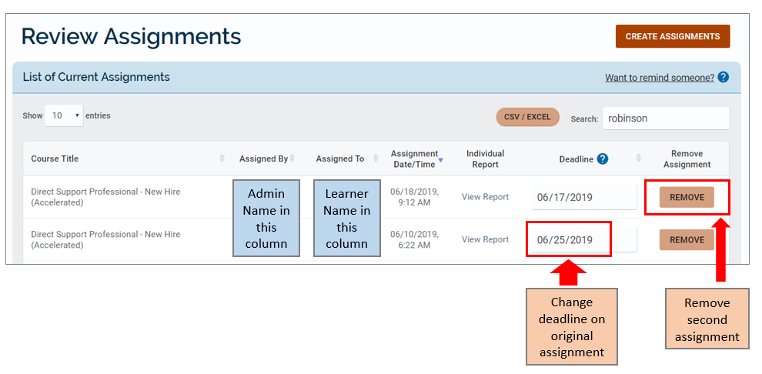
Learning Paths tip

Slide 24
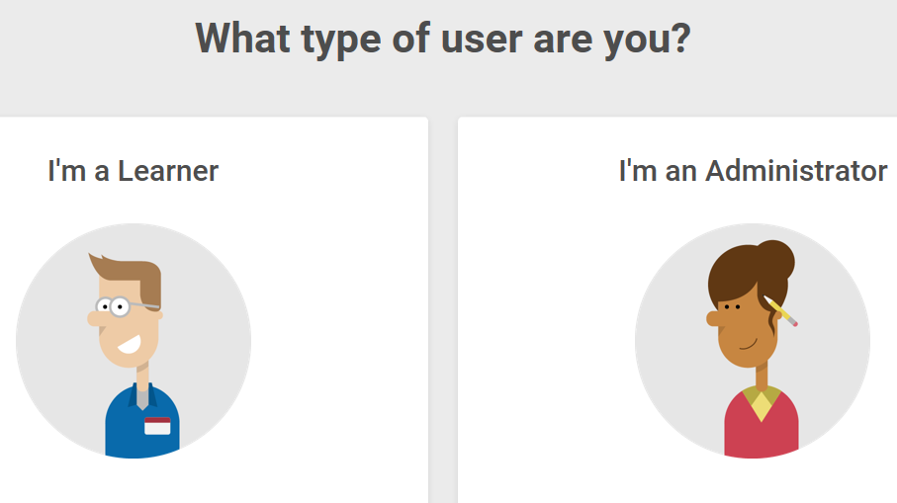
Support Hub
SUPPORT.CYPHERWORX.COM

Slide 25
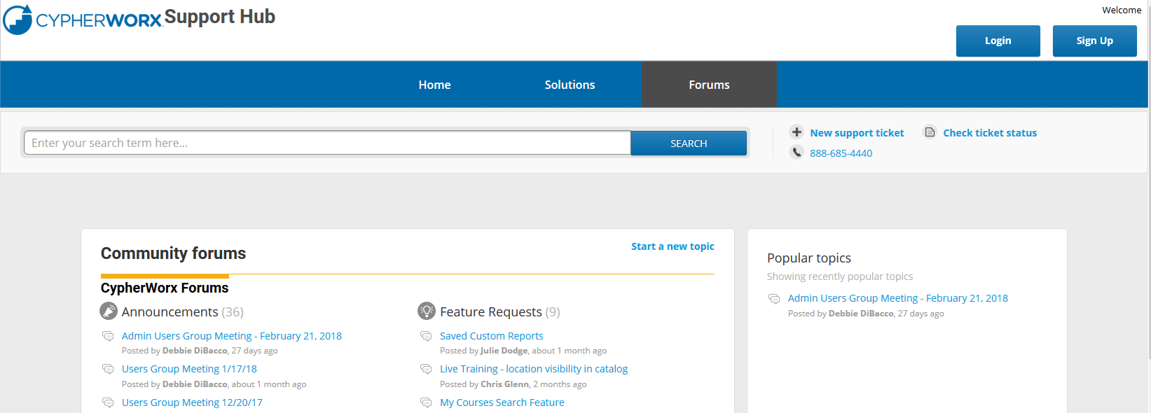
Review Meeting

Slide 26
Contact Info
Please feel free to reach out to our customer support folks after the webinar if you have more questions.
Chris Glenn – cglenn@cypherworx.com
Brett McIntosh – bmcintosh@cypherworx.com
Christopher Schramm – cschramm@cypherworx.com

Slide 27
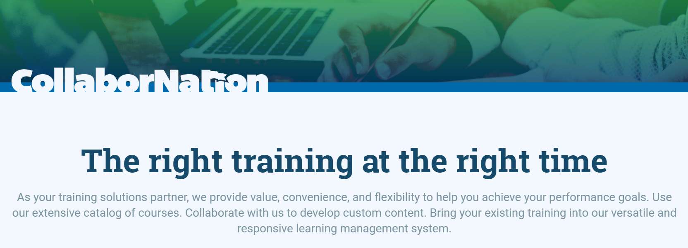
Thank you for your time today!
If there is ever anything that you would like to review or spend some time going into more detail about, please don’t hesitate to send a note to Chris G. to schedule a one-on-one session or small group session.

