Slide 1
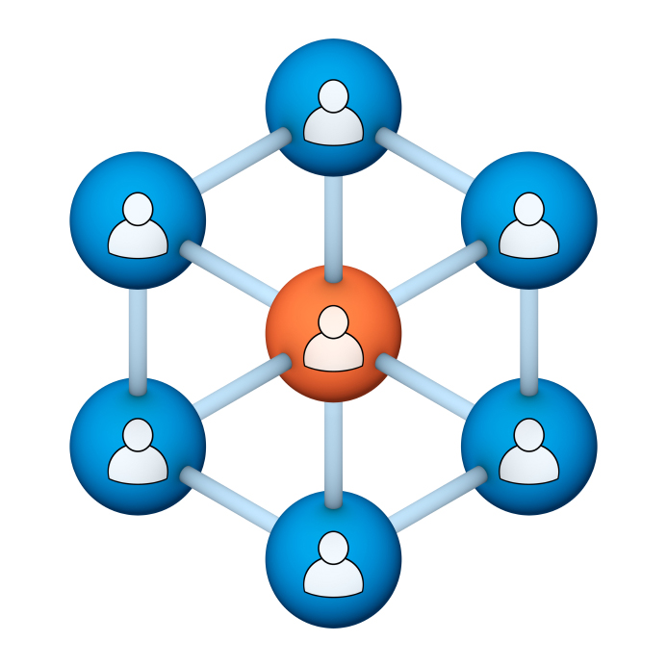
Administrators
Users Group
Meeting
3/19/21

Slide 2
Housekeeping
Using the Zoom navigation bar, click on Chat to send a question or comment:

Slide 3
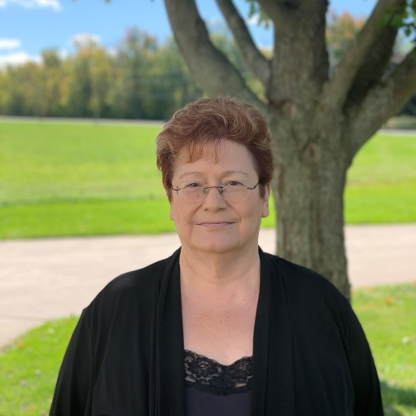
Today’s Presenters
Chris Schramm, Client Services CypherWorx, Inc.
Debbie DiBacco, Client Services CypherWorx, Inc.

Slide 4
Agenda
Registration Overview
Support Hub/Admin Articles
Admin Tools
Additional Training
Scheduled Registration Assignments
Contact Information
http://en.wikipedia.org/wiki/Firefighting_in_the_United_States

Slide 5
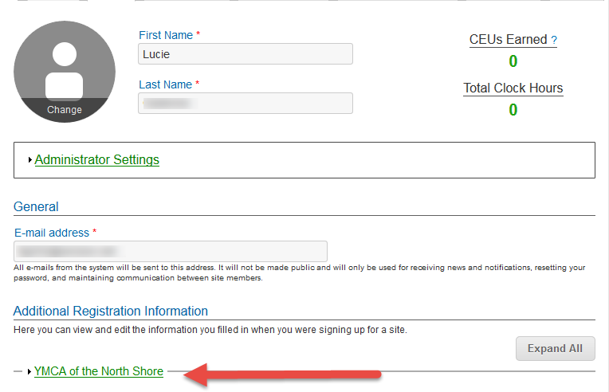
Registration
Importance of the URL:
Specific URLs for each site
Naming convention is: https://collabornation.net/ login/yoursiteinfohere
Without that URL, a customer registers incorrectly (usually into collabornation.net) and without the courses they need.
EXAMPLE: https://collabornation.net/login/ymcanorthshore

Slide 6
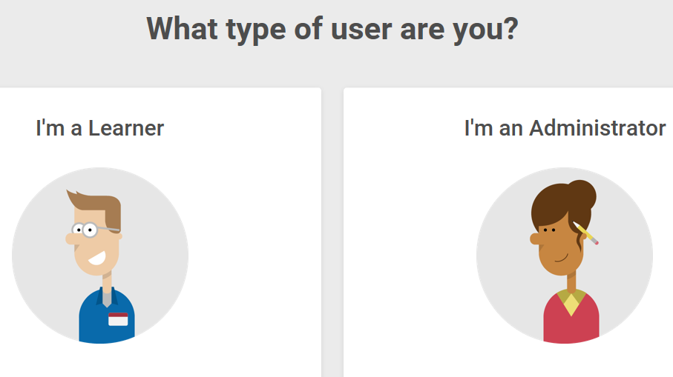
Support Hub
SUPPORT.CYPHERWORX.COM

Slide 7
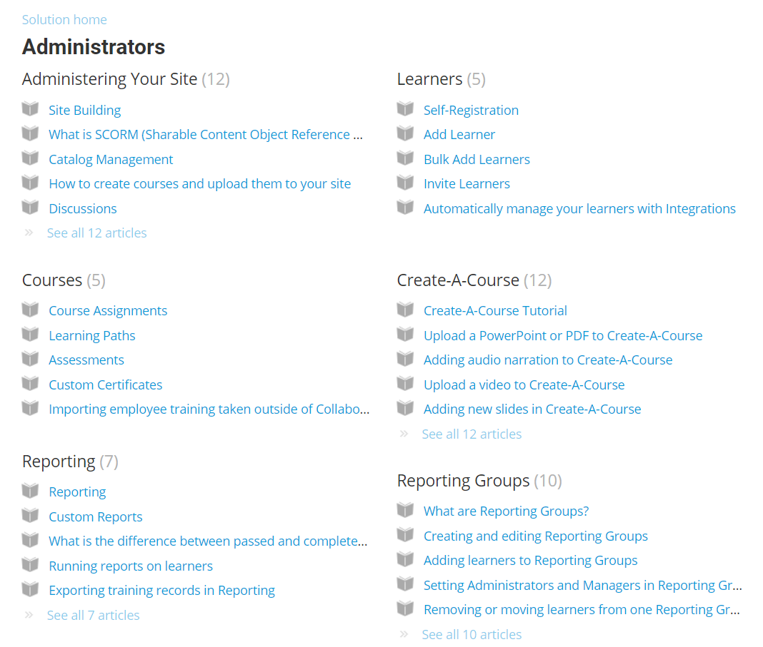
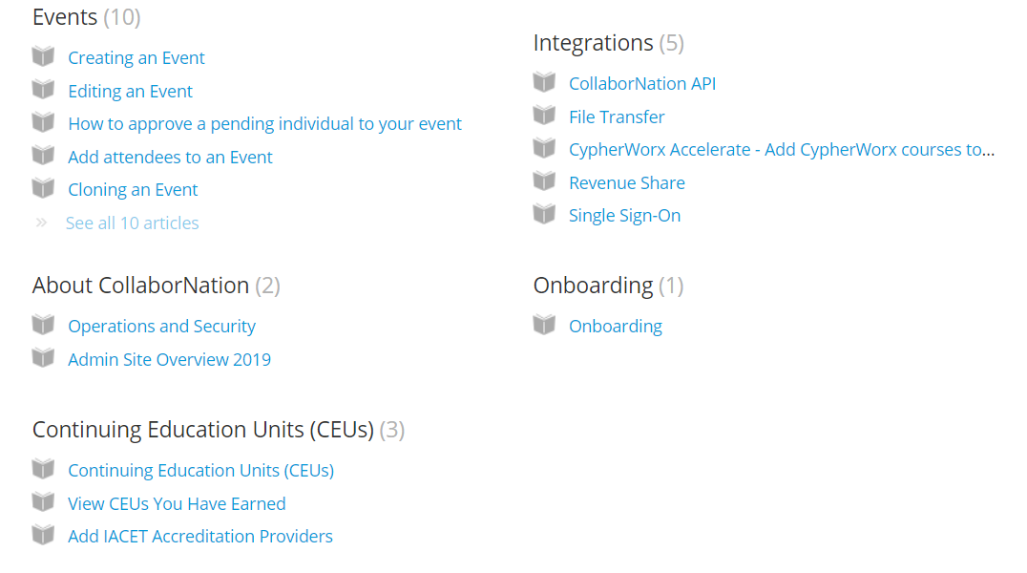
Admin Articles

Slide 8
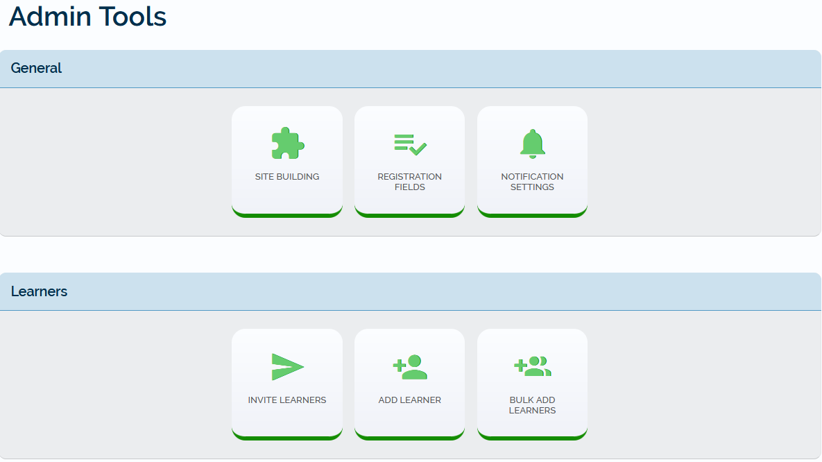
Admin Tools
Notes:
Go to the PDF and show them.

Slide 9
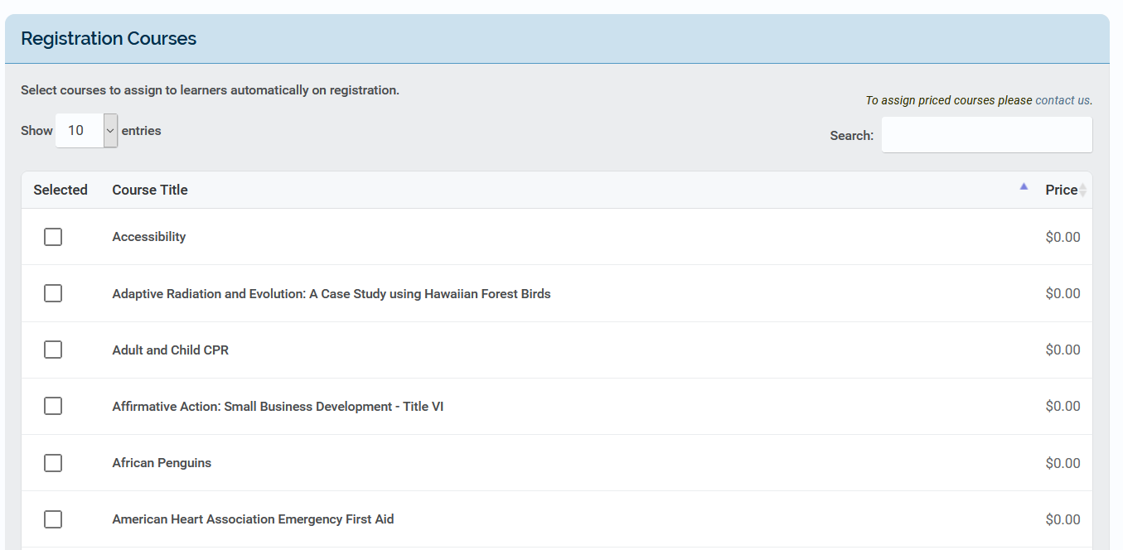
Scheduled Registration Assignments

Slide 10
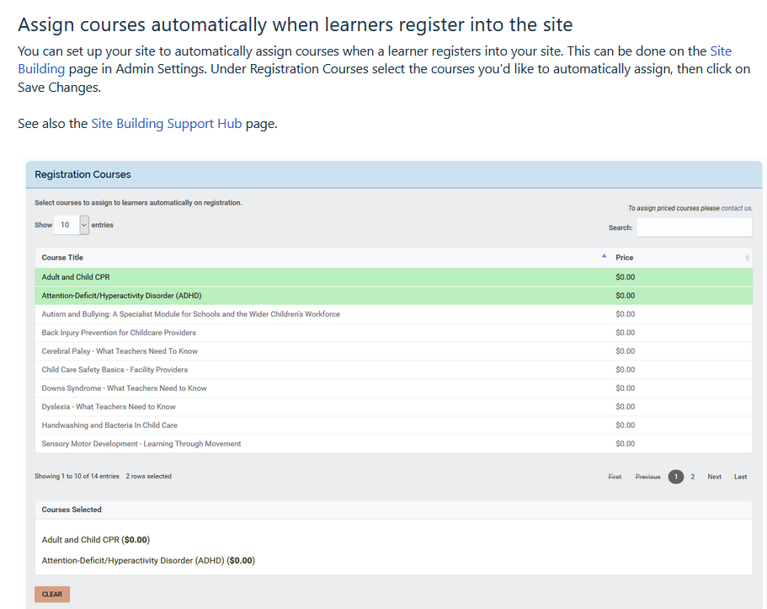
Scheduled Registration Assignments

Slide 11
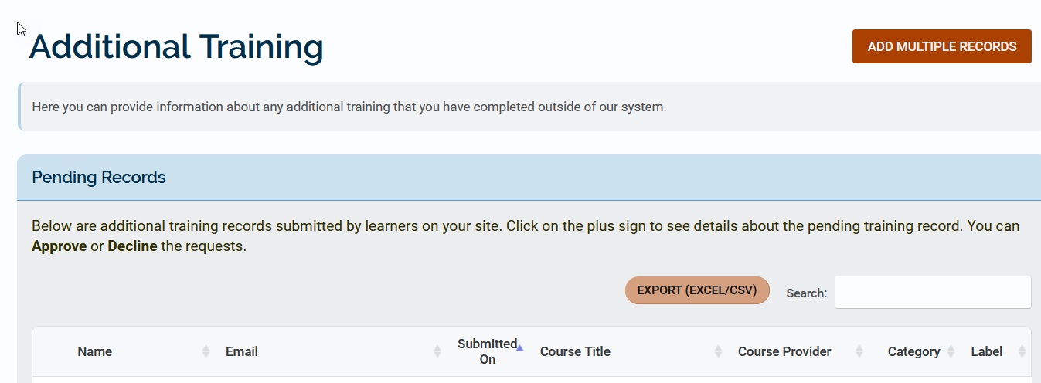
Additional Training

Slide 12
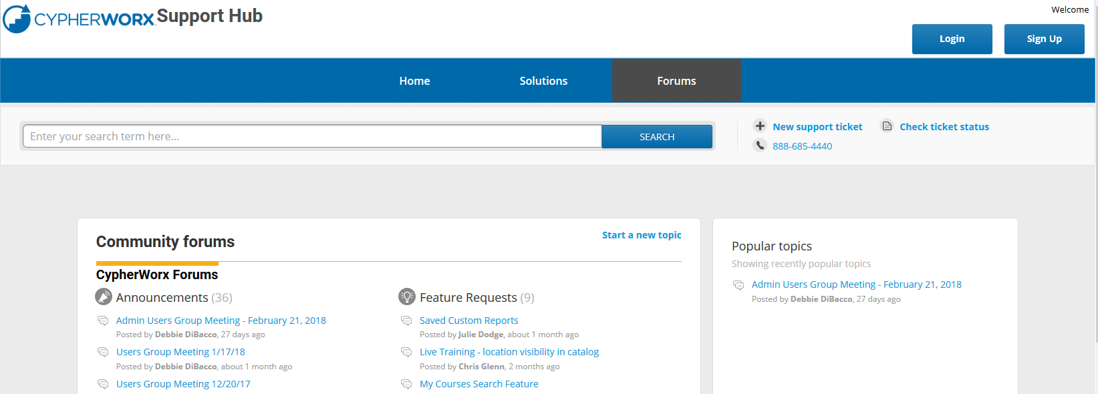
Review Meeting

Slide 13
Contact Info
Please feel free to reach out after the webinar if you have more questions.
Chris Schramm – cschramm@cypherworx.com
Debbie DiBacco – ddibacco@cypherworx.com

