Slide 1
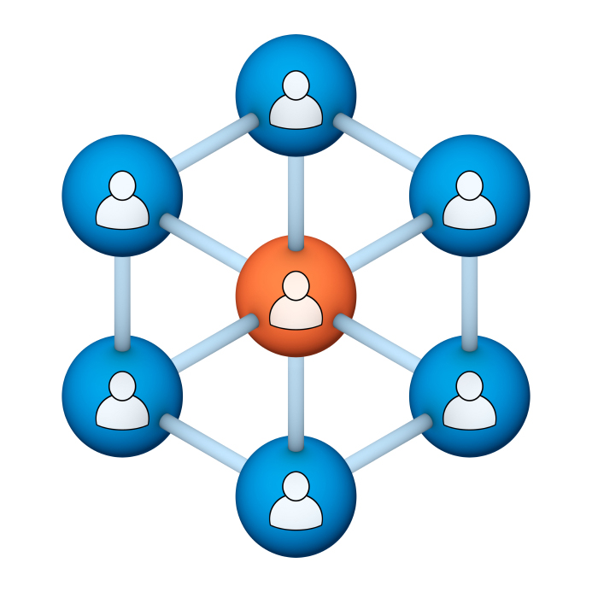
Administrators
Users Group
Meeting
11/15/17

Slide 2
Housekeeping
Right-click on the orange arrow and you’ll see two options: Auto-Hide Control Panel or Show Control Panel.
Clicking on “Show Control Panel” will let you keep the control panel open throughout the presentation.

Slide 3
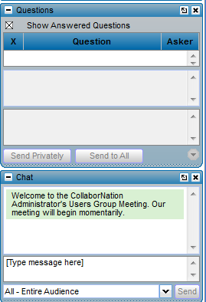
Housekeeping
If you have a question, please type it into the questions area on your “Go To Webinar” control panel.
We want to encourage questions, so please feel free to type them in at any time.

Slide 4
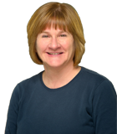
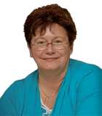
Our Presenters
Chris Glenn, Client Services
CypherWorx, Inc.
Debbie DiBacco, Client Services CypherWorx, Inc.

Slide 5
Agenda
Welcome Brett
Registration Overview
Chrome and Flash
YouTube Training Videos
Recertification
Site Members List
ARI
Feature Requests
Support Hub
http://en.wikipedia.org/wiki/Firefighting_in_the_United_States

Slide 6
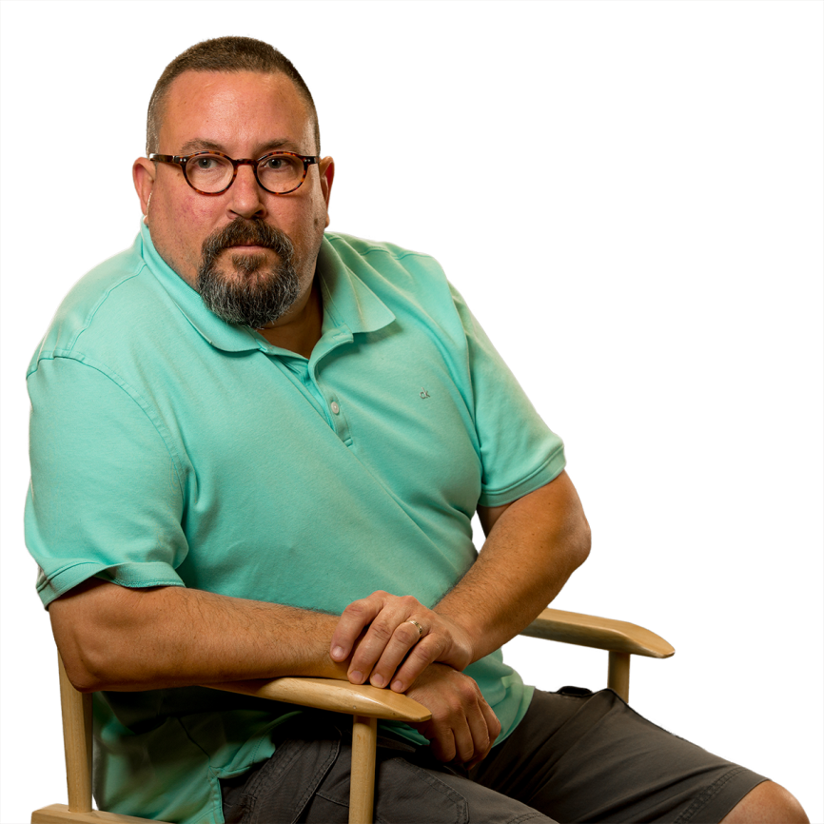
Welcome Brett!
Brett McIntosh – our new voice on the phones, helping folks with trouble calls.

Slide 7
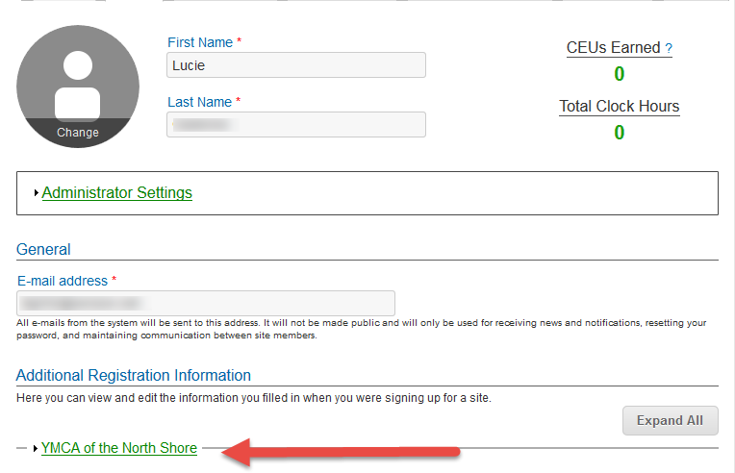
Registration
Importance of the URL:
Specific URLs for each site
Naming convention is: https://collabornation.net/ login/yoursiteinfohere
Without that URL, a customer registers incorrectly (usually into collabornation.net) and without the courses they need.
EXAMPLE: https://collabornation.net/login/ymcanorthshore

Slide 8
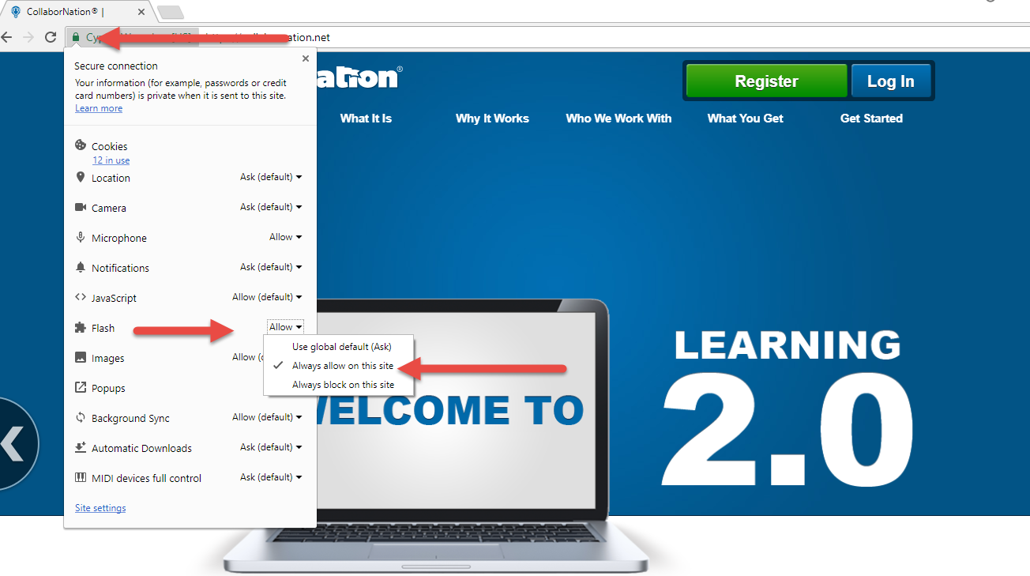
Chrome and Flash

Slide 9
YouTube Training Videos
7:18 minute video
Learning Management System
Details how to take courses, participate in discussions, add events and upload resources. Admins can see how to use the reporting features, course assignment options and our DIY Course Creation tool.
https://www.youtube.com/watch?v=cOrfDxQdEY4
10:41 minute video
CollaborNation Create-a-Course (DIY) Tutorial
Details the step by step process on how to turn your existing material into an online course.
https://www.youtube.com/watch?v=cX4AXHe5Yak

Slide 10
Recertification
Many of you are using the end of the year to have Learners re-certify in certain areas, and that may mean that they need to repeat taking a course they have completed in the past.
It is very important to explain to Learners that once you have completed a course and see the Certificate button on it in the My Courses list, the date will not change on the certificate if you re-take that course. Although the system allows you to re-take a course for review, your own benefit, etc., the original date of a successful completion will remain on the certificate.
Either through Course Assignments or Self-Assignment, a Learner seeking recertification in the current year must obtain a new instance of the same course and complete that.
Sample of a course NOT to re-take:
Sample of a course that will receive a current date on a certificate upon completion:

Slide 11
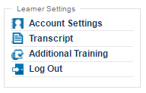
Site Members list
If for any reason you do not want the Learners in your site to be able to view the Site Members list, remember that CypherWorx can disable it for you – just contact Chris! Site admins will still have the same view of the Site Members list, with the ability to change passwords and email addresses.
Here’s what a Learner normally sees after clicking on the Site Members menu item:
And after the setting has changed to eliminate the Site Members list, the Learner Settings menu will be:

Slide 12
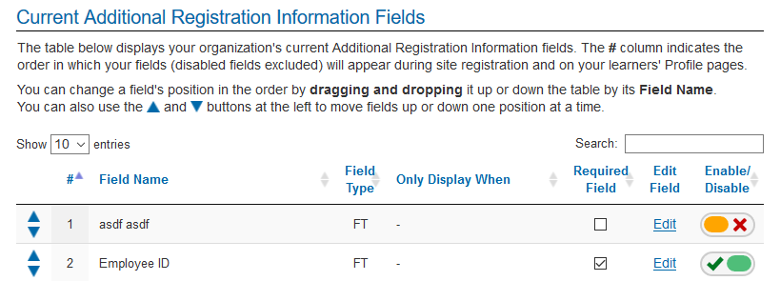
ARI
Additional Registration Information (ARI) fields can be created by all site admins and are commonly used to put new registrants into proper Reporting Groups for course assignments and reporting purposes. They can also be used to collect other information useful in reporting, such as employee numbers, answers to yes/no questions, etc. Two new enhancements to this feature are:
Site Admins can delete ARI fields
Site Admins can rearrange the order of ARI fields either by dragging or using the arrows at the left edge

Slide 13
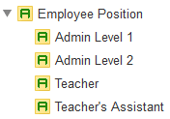
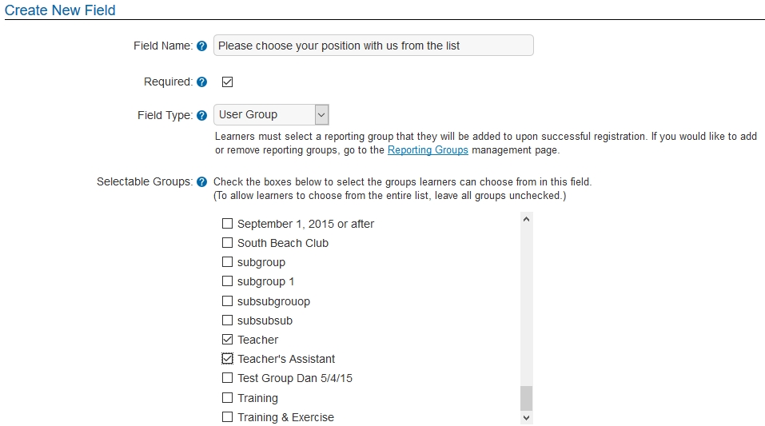
ARI and Reporting Groups
Steps to connect an ARI field to Reporting Groups:
1. Go to Reporting Groups, open the main group (top) and create your groups/subgroups –
Sample:
2. Go back to the Admin Settings Menu, open Additional Registration Information and enter your question/instruction in the Field Name field and complete the other steps.
Use drop down list to choose User Group
All groups will appear; check the boxes of the ones you want in the list.

Slide 14
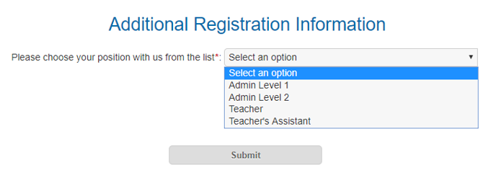
ARI and Reporting Groups
Here is what that will look like to someone registering into your site.
Note – the system adds a colon at the end of the field so you should leave out punctuation when you are creating your ARI fields.
And - Reporting Group information is available as a choice in Custom Reporting.

Slide 15
ARI and Free Text fields
Free Text fields are very useful for gathering additional information.
They can be set up with yes/no questions like “Do you drive a company vehicle?”
Or to collect employee id information: “Please enter your employee id number”
Or “Please enter your Zip Code”
Or specifics like “What age groups do you teach?”
Free Text field information is available as a choice in Custom Reporting.

Slide 16
Feature Requests
You frequently let us know of enhancements you would like to see in CollaborNation and we send them on to our programming department.
Please keep letting us know what you want! We asked the programmers what bits of information help them out when mulling over new possibilities. Here are some of their ideas for information to include when you happen to come up with your next great idea for us:
Include specifics like what system/browsers you use, network restrictions, etc.
Explain how you would use the new feature – like in your everyday operations, from users’ perspectives and admin perspectives, benefits.
If the new idea has to do with reporting, describe what the “ideal” report would include and how you need to use it – what your peers and/or superiors are looking for.
(Visit the About Us section at https://cypherworx.com for bios on our programmers!)

Slide 17
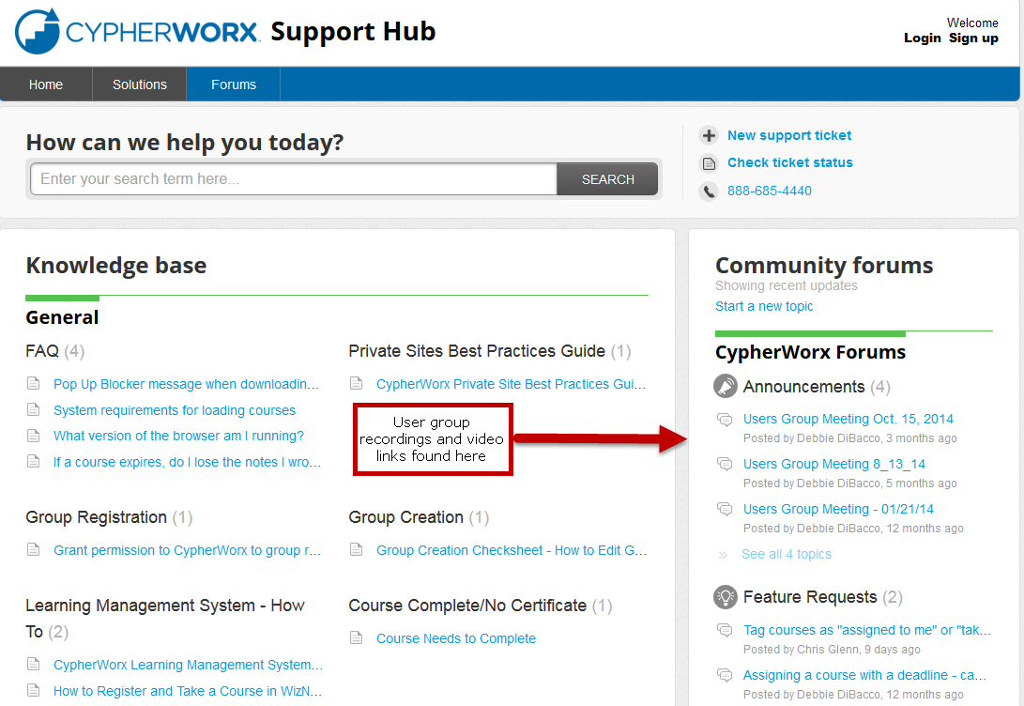
Support Hub
SUPPORT.CYPHERWORX.COM

Slide 18
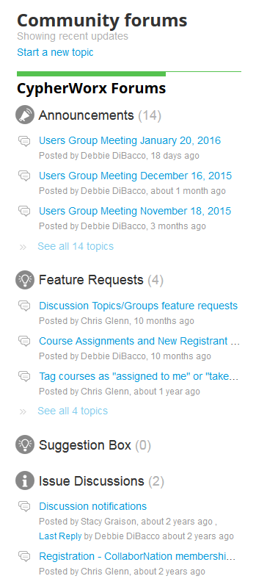
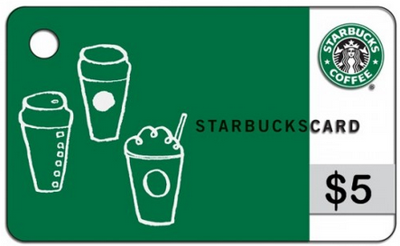
Suggestions
If you have any suggestions, and/or would like to request a new feature that would increase YOUR overall customer experience with our system, then please share them with us.
Any features which are incorporated into our LMS will be announced on next month’s call. By sharing your ideas with us you are assigning us all rights to the features.
In appreciation of your time, submitters whose features are incorporated into our LMS will be sent a $5 Starbucks gift card as a quick “Thank You!”
http://support.cypherworx.com/support/discussions
Click on “Suggestion Box” to add your ideas
in our community forum

Slide 19
Contact Info
Please feel free to reach out to our customer support folks after the webinar if you have more questions.
Debbie DiBacco – ddibacco@cypherworx.com
Chris Glenn – cglenn@cypherworx.com
Brett McIntosh – bmcintosh@cypherworx.com

