Slide 1
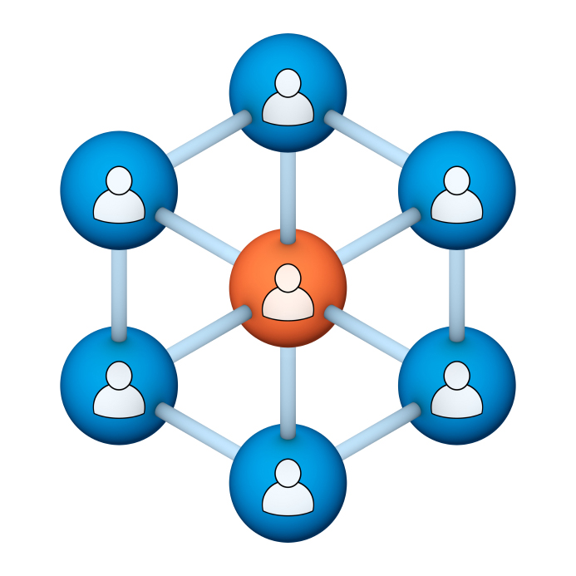
Administrators
Users Group
Meeting
3/21/18

Slide 2
Housekeeping
Right-click on the orange arrow and you’ll see two options: Auto-Hide Control Panel or Show Control Panel.
Clicking on “Show Control Panel” will let you keep the control panel open throughout the presentation.

Slide 3
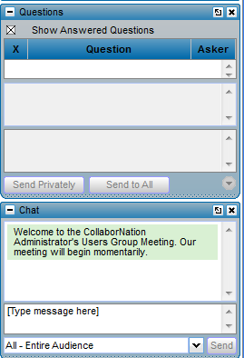
Housekeeping
If you have a question, please type it into the questions area on your “Go To Webinar” control panel.
We want to encourage questions, so please feel free to type them in at any time.

Slide 4
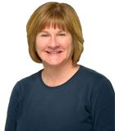
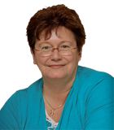
Our Presenters
Chris Glenn, Client Services
CypherWorx, Inc.
Debbie DiBacco, Client Services CypherWorx, Inc.

Slide 5
Agenda
Registration Overview
YouTube Training Videos
Recertification
Feature Requests
New Look – Support Hub
Resources
Reporting
Onboarding
Support Hub
http://en.wikipedia.org/wiki/Firefighting_in_the_United_States

Slide 6
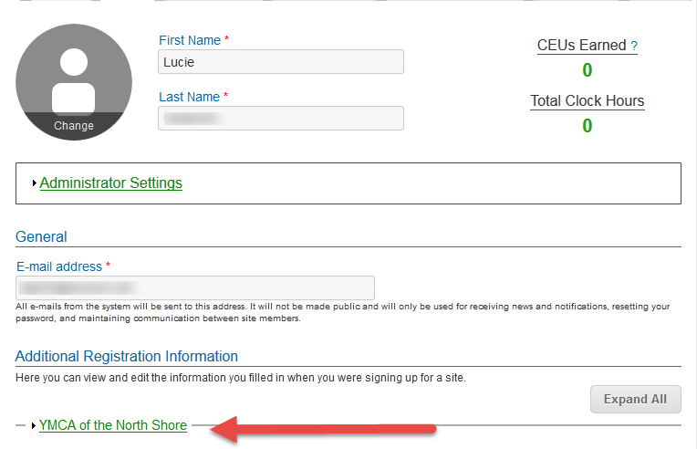
Registration
Importance of the URL:
Specific URLs for each site
Naming convention is: https://collabornation.net/ login/yoursiteinfohere
Without that URL, a customer registers incorrectly (usually into collabornation.net) and without the courses they need.
EXAMPLE: https://collabornation.net/login/ymcanorthshore

Slide 7
YouTube Training Videos
7:18 minute video
Learning Management System
Details how to take courses, participate in discussions, add events and upload resources. Admins can see how to use the reporting features, course assignment options and our DIY Course Creation tool.
https://www.youtube.com/watch?v=cOrfDxQdEY4
10:41 minute video
CollaborNation Create-a-Course (DIY) Tutorial
Details the step by step process on how to turn your existing material into an online course.
https://www.youtube.com/watch?v=cX4AXHe5Yak

Slide 8
Recertification
Many of you are using the end of the year to have Learners re-certify in certain areas, and that may mean that they need to repeat taking a course they have completed in the past.
It is very important to explain to Learners that once you have completed a course and see the Certificate button on it in the My Courses list, the date will not change on the certificate if you re-take that course. Although the system allows you to re-take a course for review, your own benefit, etc., the original date of a successful completion will remain on the certificate.
Either through Course Assignments or Self-Assignment, a Learner seeking recertification in the current year must obtain a new instance of the same course and complete that.
Sample of a course NOT to re-take:
Sample of a course that will receive a current date on a certificate upon completion:

Slide 9
Feature Requests
You frequently let us know of enhancements you would like to see in CollaborNation and we send them on to our programming department.
Please keep letting us know what you want! We asked the programmers what bits of information help them out when mulling over new possibilities. Here are some of their ideas for information to include when you happen to come up with your next great idea for us:
Include specifics like what system/browsers you use, network restrictions, etc.
Explain how you would use the new feature – like in your everyday operations, from users’ perspectives and admin perspectives, benefits.
If the new idea has to do with reporting, describe what the “ideal” report would include and how you need to use it – what your peers and/or superiors are looking for.
(Visit the About Us section at https://cypherworx.com for bios on our programmers!)

Slide 10
New Look – Support Hub
We are working hard on making our Support Hub easy to use and filled with useful information. A visit to https://support.cypherworx.com/support/home will now bring you here:

Slide 11
New Look – Support Hub
And this is the format you will see for the articles:

Slide 12
New Look – Support Hub
Forums is where you go to get the links and powerpoints from previous Admin Users Group webinars:

Slide 13
Resources
Remember that you can build an organization-wide digital library in the Resources section, uploading documents and links.
And as an Admin, you will be able to view who has downloaded each Resource!

Slide 14
Reporting
During our March 2018 session we will be viewing Reporting live, but here is one reminder to use the Refresh button in order to get your data set to be up to the minute:

Slide 15
Onboarding
We want to know what works and what does not work in your experience(s) with onboarding when you acquire new software products for your organization.
Please email Chris at cglenn@cypherworx.com with ideas as we are always looking to improve our process!

Slide 16
Support Hub
SUPPORT.CYPHERWORX.COM

Slide 17
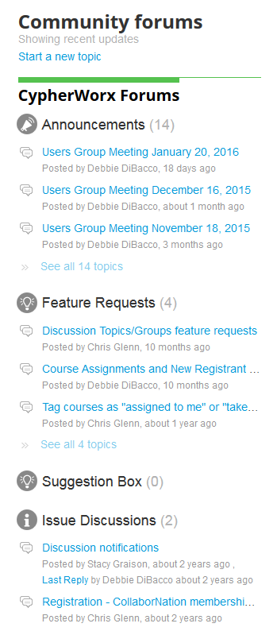
Suggestions
If you have any suggestions, and/or would like to request a new feature that would increase YOUR overall customer experience with our system, then please share them with us.
Any features which are incorporated into our LMS will be announced on next month’s call. By sharing your ideas with us you are assigning us all rights to the features.
In appreciation of your time, submitters whose features are incorporated into our LMS will be sent a $5 Starbucks gift card as a quick “Thank You!”
http://support.cypherworx.com/support/discussions
Click on “Suggestion Box” to add your ideas
in our community forum

Slide 18
Contact Info
Please feel free to reach out to our customer support folks after the webinar if you have more questions.
Debbie DiBacco – ddibacco@cypherworx.com
Chris Glenn – cglenn@cypherworx.com
Brett McIntosh – bmcintosh@cypherworx.com

