Slide 1
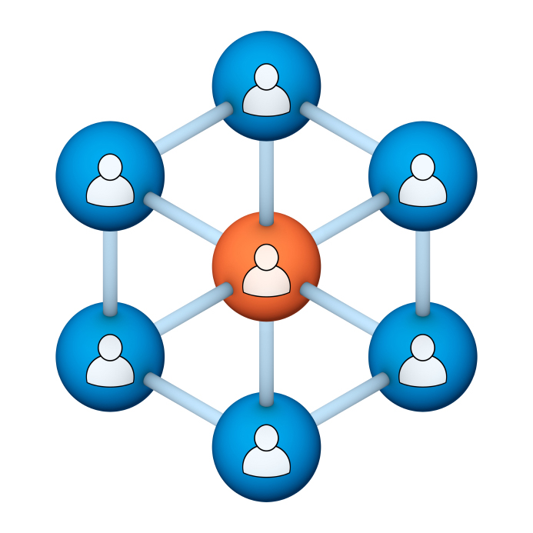
Administrators
Users Group
Meeting
7/18/18

Slide 2
Housekeeping
Right-click on the orange arrow and you’ll see two options: Auto-Hide Control Panel or Show Control Panel.
Clicking on “Show Control Panel” will let you keep the control panel open throughout the presentation.

Slide 3
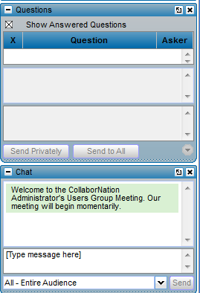
Housekeeping
If you have a question, please type it into the questions area on your “Go To Webinar” control panel.
We want to encourage questions, so please feel free to type them in at any time.

Slide 4
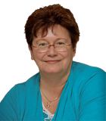
Our Presenters
Mike Maether, VP Programming
CypherWorx, Inc.
Debbie DiBacco, Client Services CypherWorx, Inc.

Slide 5
Agenda
Registration Overview
YouTube Training Videos
Learning Paths
Assessments
Event Updates
Browser/Flash
Support Hub Resources
http://en.wikipedia.org/wiki/Firefighting_in_the_United_States

Slide 6
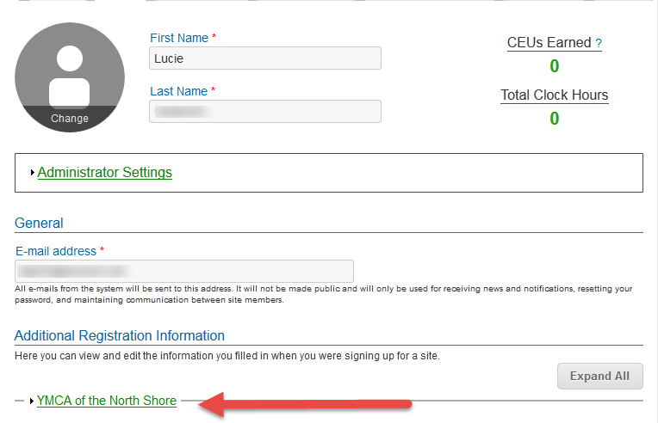
Registration
Importance of the URL:
Specific URLs for each site
Naming convention is: https://collabornation.net/ login/yoursiteinfohere
Without that URL, a customer registers incorrectly (usually into collabornation.net) and without the courses they need.
EXAMPLE: https://collabornation.net/login/ymcanorthshore

Slide 7
YouTube Training Videos
2:44 minute video
CypherWorx Assessment Feature
A quick look at our new Assessment Feature
https://www.youtube.com/watch?v=gi5qzVlPK2Q&t=34s
7:18 minute video
Learning Management System
Details how to take courses, participate in discussions, add events and upload resources. Admins can see how to use the reporting features, course assignment options and our DIY Course Creation tool.
https://www.youtube.com/watch?v=cOrfDxQdEY4
10:41 minute video
CollaborNation Create-a-Course (DIY) Tutorial
Details the step by step process on how to turn your existing material into an online course.
https://www.youtube.com/watch?v=cX4AXHe5Yak

Slide 8
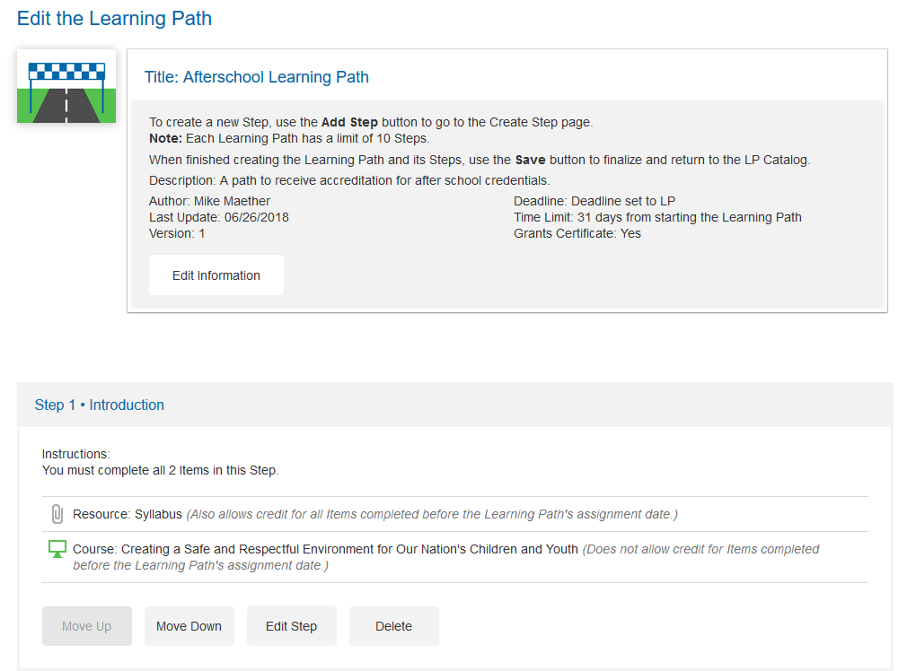
Learning Paths

Slide 9
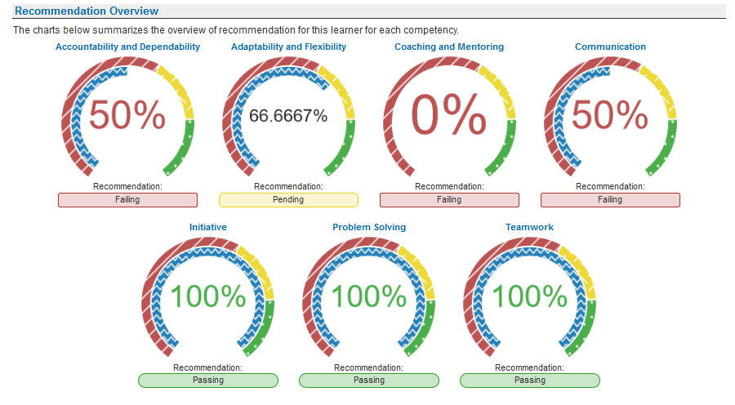
Assessments

Slide 10
Event Updates
Over 50 improvements, including:
The visibility of an event can be changed at any point.
Attendees can be added or removed at all times by the event creator. This is no longer dependent on visibility.
Event creators can now filter attendees based on Reporting Groups.
Unlimited seating events now appear in the course catalog if it's Public. After-Event Reporting can now be applied to these events.
After-Event Reporting and Sign-In sheet now displays at all times.
Event creators can now add themselves to the attendee list if desired.
Updated certificate dropdown.
Updated the language on After-Event Reporting to be more digestible.
Added a visual cue between Public and Private events.
In After-Event Reporting, if a person is set to be Passed they must also submit a score.
Updated tables to no longer be Flash based.
Updated the calendar Events can be seen as a List option.
The Approval Required section will display at all times.
Location is no longer required.
If a person has accepted or declined an event, updating the event will no longer change their status to Pending for reacceptance.

Slide 11
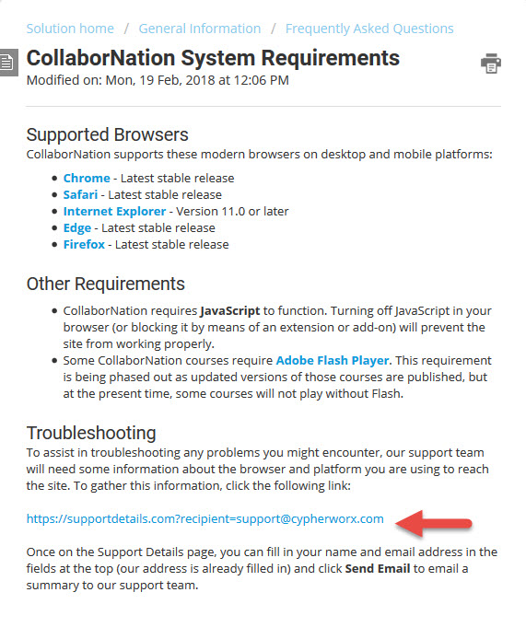
Browser/Flash Info

Slide 12
Support Hub
SUPPORT.CYPHERWORX.COM

Slide 13
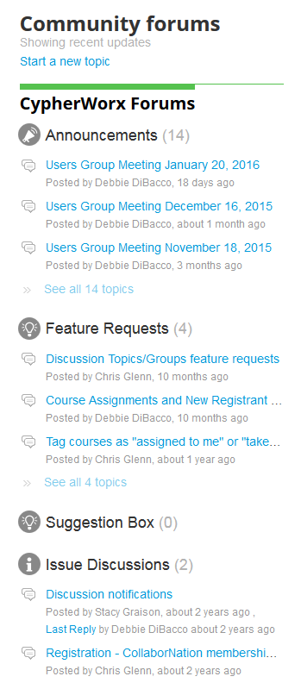
Suggestions
If you have any suggestions, and/or would like to request a new feature that would increase YOUR overall customer experience with our system, then please share them with us.
Any features which are incorporated into our LMS will be announced on next month’s call. By sharing your ideas with us you are assigning us all rights to the features.
In appreciation of your time, submitters whose features are incorporated into our LMS will be sent a $5 Starbucks gift card as a quick “Thank You!”
http://support.cypherworx.com/support/discussions
Click on “Suggestion Box” to add your ideas
in our community forum

Slide 14
Contact Info
Please feel free to reach out to our customer support folks after the webinar if you have more questions.
Debbie DiBacco – ddibacco@cypherworx.com
Chris Glenn – cglenn@cypherworx.com

