Slide 1
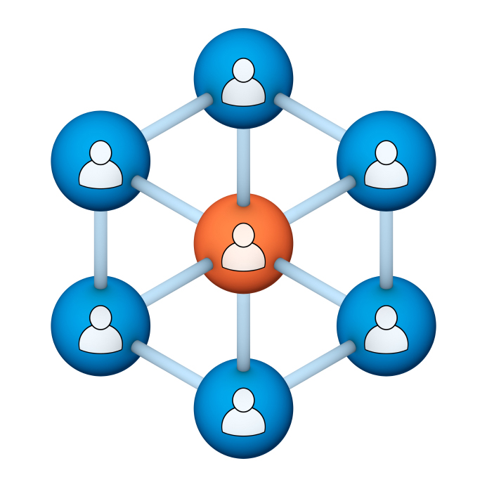
Administrators
Users Group
Meeting
4/17/19
Notes:
Welcome to the April 2019 Administrators Users Group Meeting!

Slide 2
Housekeeping
Using the Zoom navigation bar, click on Chat to send a question or comment:

Slide 3
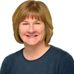
Our Presenter
Chris Glenn, Client Services
CypherWorx, Inc.
Notes:
.

Slide 4
Customer Support
Brett McIntosh – bmcintosh@cypherworx.com
Christopher Schramm – cschramm@cypherworx.com

Slide 5
Agenda
Registration Overview
Training Videos
Admin Course Creation
Browser/Flash
Events feature changes
Adding Learners feature changes
Notifications settings
Support Hub Resources
http://en.wikipedia.org/wiki/Firefighting_in_the_United_States

Slide 6
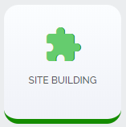
Registration
Importance of the URL/site link:
There are specific URLs for each site, and since the Redesign, different URLs for logging in and registering (new account creation).
Find the unique URLs for your site in Site Building, in the General section after you select the green shield from the menu at the left edge of your screen:

Slide 7
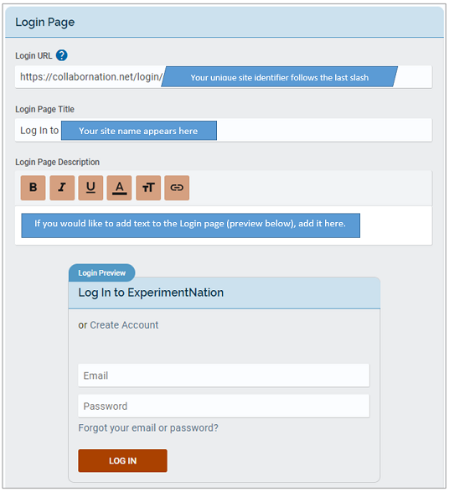
Login URL
After you select
you will see several sections and a “Save Changes” button underneath all of them.
Here is the Login Page section.

Slide 8
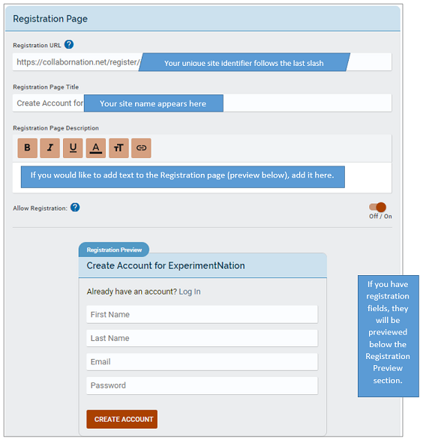
Registration URL
And here is the Registration Page section.
Remember, both the login URL and the registration URL will always begin with:
https://collabornation.net/

Slide 9
Training Videos
25:36 minute video
CollaborNation Site Redesign
A quick look at our site redesign
https://support.cypherworx.com/solution/articles/4000137266-collabornation-site-redesign
48:39 minute video
Admin Users Group Meeting – February 21, 2019
Mike Maether gives a tour of the redesign for Site Administrators
https://www.screencast.com/t/oaoysdg4ef
2:44 minute video
Maximize Employee Performance With Assessments
A quick look at our new Assessment Feature
https://www.youtube.com/watch?v=gi5qzVlPK2Q&t=34s
7:18 minute video
Learning Management System
Details how to take courses, participate in discussions, add events and upload resources. Admins can see how to use the reporting features, course assignment options and our DIY Course Creation tool.
https://www.youtube.com/watch?v=cOrfDxQdEY4
10:41 minute video
CollaborNation Create-a-Course (DIY) Tutorial
Details the step by step process on how to turn your existing material into an online course.
https://www.youtube.com/watch?v=cX4AXHe5Yak

Slide 10
Courses You Create
If you are creating your own courses using a course creation software such as Articulate Storyline or Articulate Rise and need us to load your course for you, we need to have the answers to the following questions.
Course title
Are there prerequisites (if there are, then they'd need to be supplied as well)
Is there an image that will show up when someone takes the course? Is so, I'll need that in jpg form.
What is the Course Availability? (This is how long - in weeks - a client has to take the course).
Course length (how long in hours)
Course Description
What catalog you want the course to go in?
If there is a test, what's the mastery score
If there is a certificate, does it need to populate on "passed" or "completed"
If there is a quiz, please provide me with the answers.
There is also an article in our support hub about using your own courses in your site:
How to create courses and upload them to your site

Slide 11
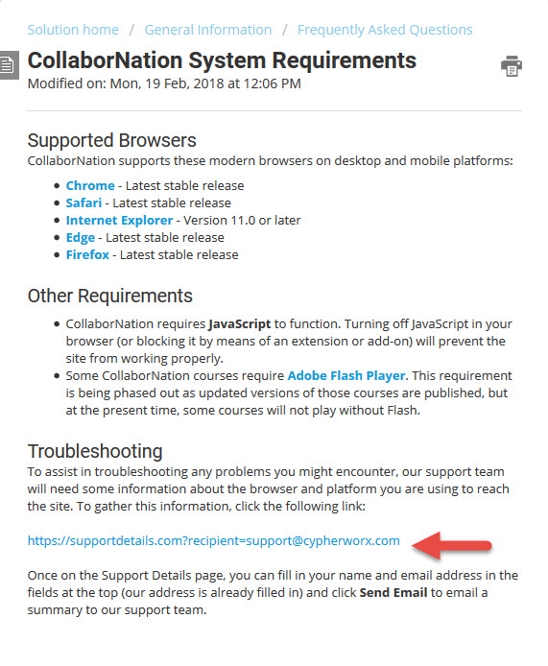
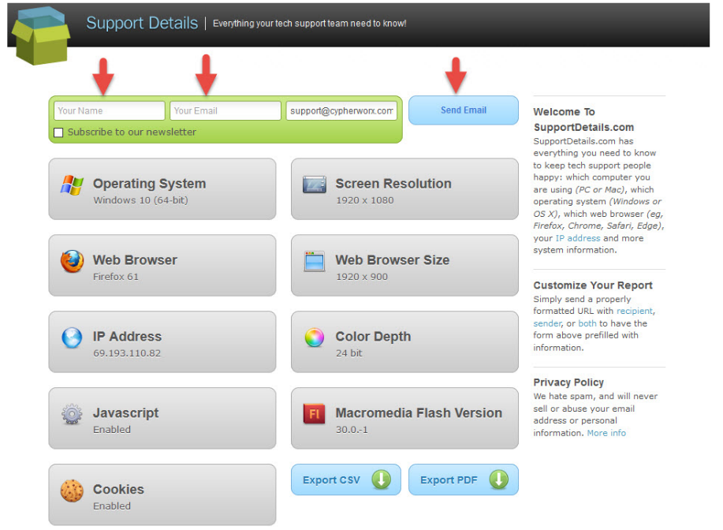
Browser/Flash Info
Visit the Support Hub to see the full article: CollaborNation System Requirements

Slide 12
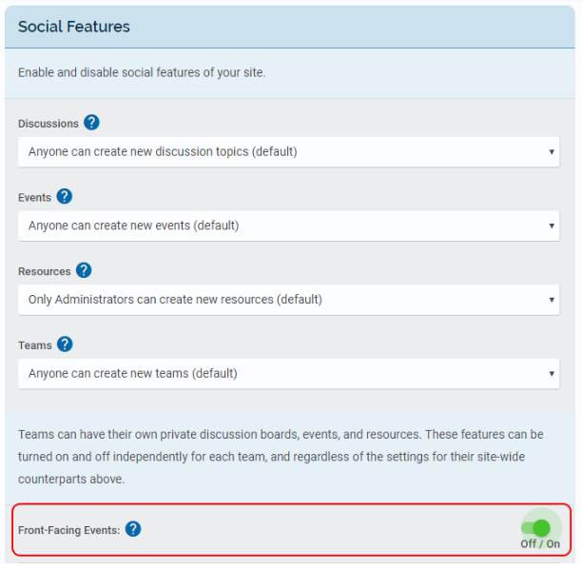
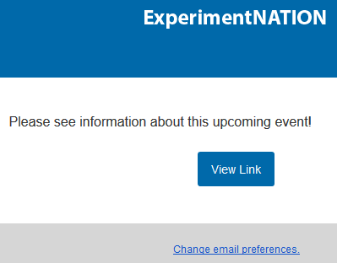
Events: front-facing
You do not need to be logged in to the site to find out about an Event! Creators of Events can simply copy the Event link and email it directly or send the link out to site members using the Notifications feature.
The email will contain a link
for the invitee to view the event.
Sample:
Visit the Support Hub to see the full article: Making Events front-facing

Slide 13
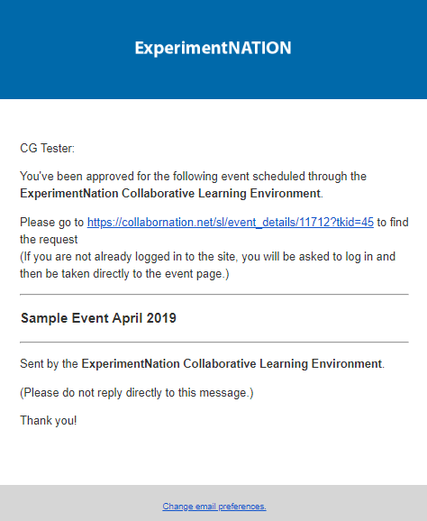
Events
Learners now receive an email confirmation when they register into an event.

Slide 14
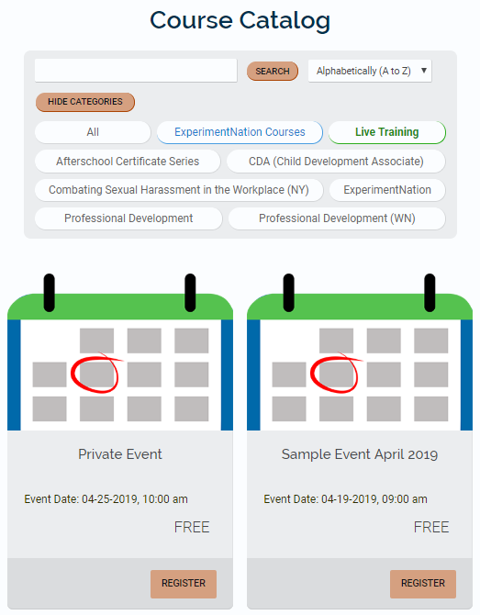
Events
Remember that Public Events can be seen in the Course Catalog in the Live Training category.

Slide 15
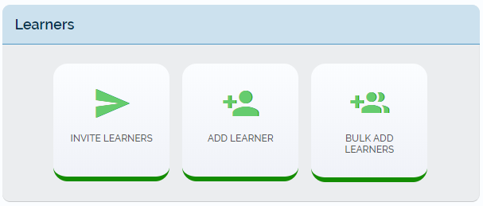
Adding Learners
The Learners section with tools for setting up accounts has been rearranged. You can now send invitations to register and the single form and “add multiples” options are now two separate buttons:

Slide 16
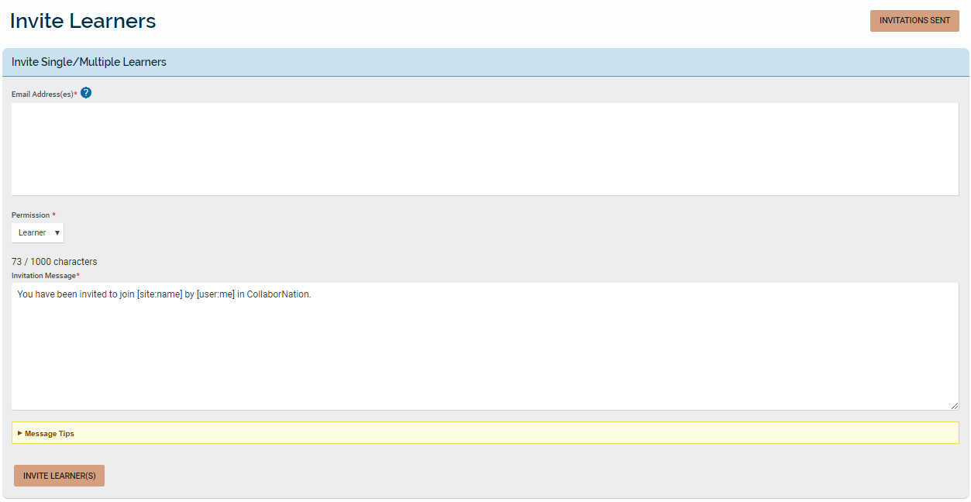
Inviting Learners
You can add one or more email addresses and send a note out to invite people to register into your site. The invitations sent and the results can be seen when you select the INVITATIONS SENT button.

Slide 17
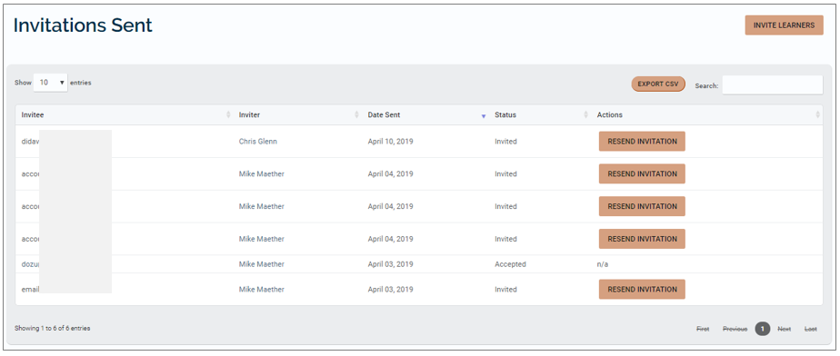
Inviting Learners
View of the Invitations Sent section:

Slide 18
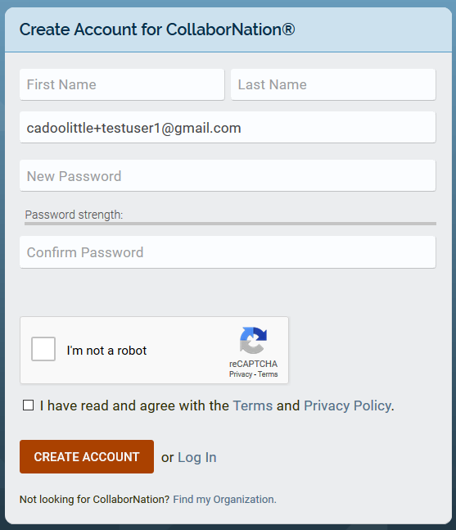
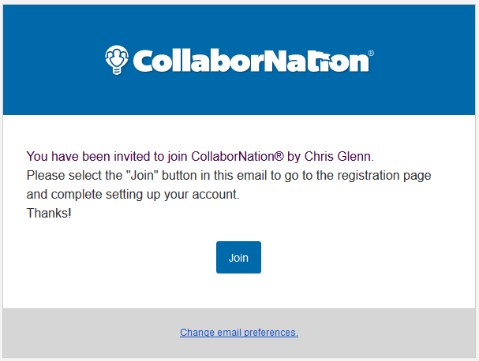
Inviting Learners
An email will be sent from admin@collabornation.net. Selecting the “Join” button will take the invitee to the registration page, where the email field will already be filled in and the rest of the form needs to be completed:

Slide 19
Adding Singly
Admins can create accounts for their learners, either in bulk or one at a time.
If adding singly, you can:
select a permission level (either Learner or Admin),
choose to force a password change at the next sign in or not,
choose to send out an email notification (or not) informing the learner of the new account and how to log in.

Slide 20
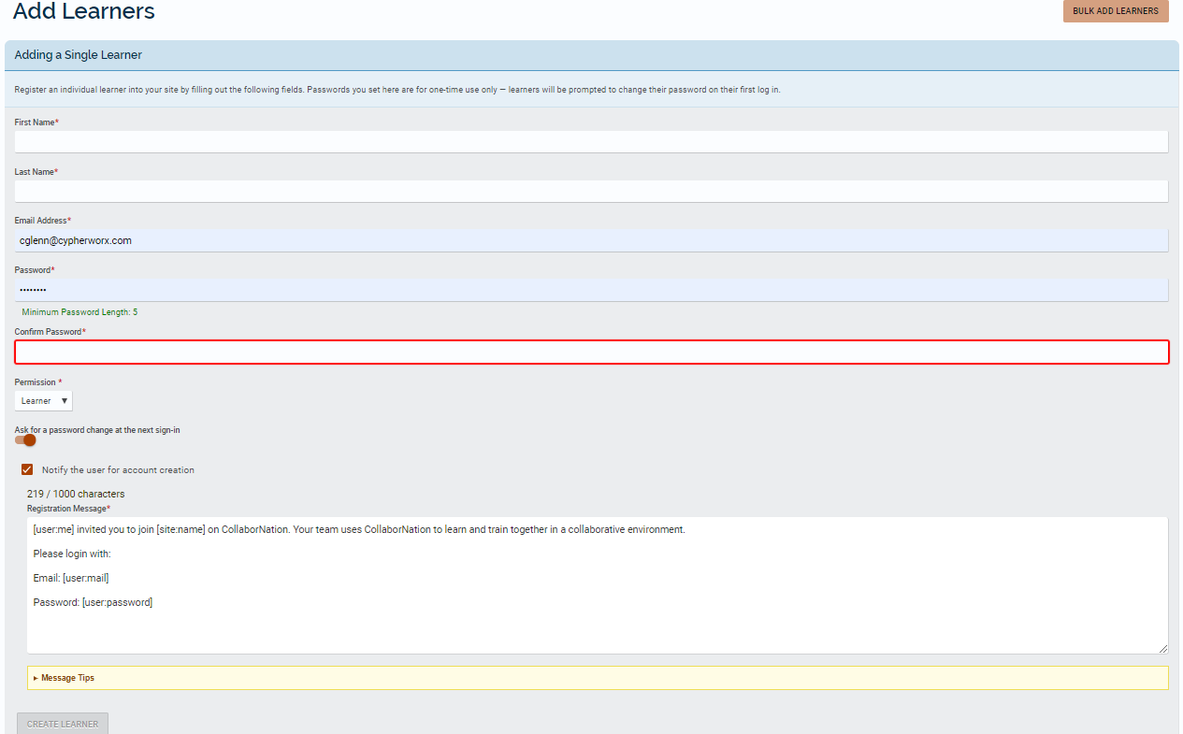
Adding Singly

Slide 21
Adding in bulk
When adding multiple accounts at a time, the “Bulk Add Learners” feature provides a template to download. There is always a preview of the uploaded (filled in) template for you to view in order to proofread before committing to the account creation.
In this feature, you have these options:
choose to force a password change or not the next time the learner signs in,
choose to send out an email notification (or not) informing the learners of their new account and how to log in.

Slide 22
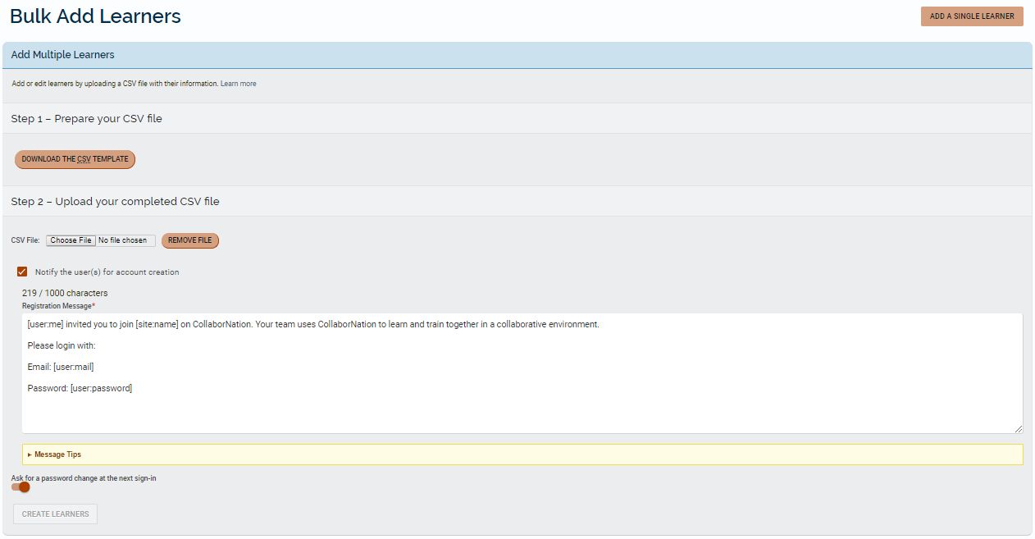
Adding in bulk

Slide 23
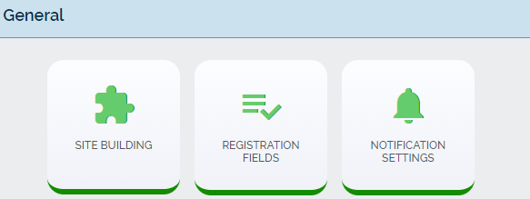
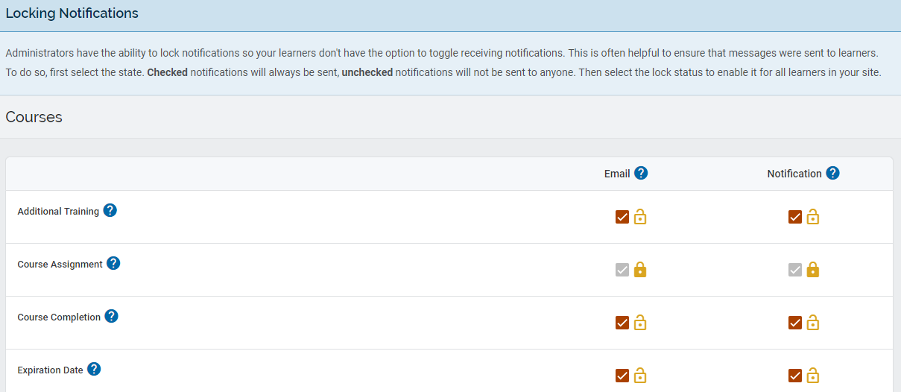
Notifications
Site-wide vs. personal settings:
When you open NOTIFICATION SETTINGS in your Admin Tools and scroll to the bottom of the page, you will see the Locking Notifications section. These settings apply site-wide.

Slide 24
Notifications
The site-wide settings set by a Site Admin correspond to what you and your learners see when you set your personal notification preferences either at the button in your admin tool or at the bell icon at the upper right next to your profile icon.
In your admin tool:
The gear icon when the bell at the upper right of your page is selected:

Slide 25
Notifications
Where the lock icon is “locked” by an admin, changes cannot be made on a personal account level, and the checked boxes will appear grayed out.
But where the lock icon is “unlocked”, each learner can choose to keep on or turn off email or in-site notifications. The changes are saved automatically. Below you can see one of the selections has been turned off.

Slide 26
Review from 3/20/19
Since the Redesign launch in February:
Learning Paths - will now automatically refresh the status of the item upon completion (no need to refresh the browser page).
Course Catalog - admins can now toggle on/off displaying the Course Catalog in their site – setting is in the General section after you select the Site Building button. Admins will still see the Course Catalog and also be able make assignments as always.
Reporting – Event and Assessment descriptions will no longer be displayed in a table column in standard Reporting, but will still display when viewing individually.

Slide 27
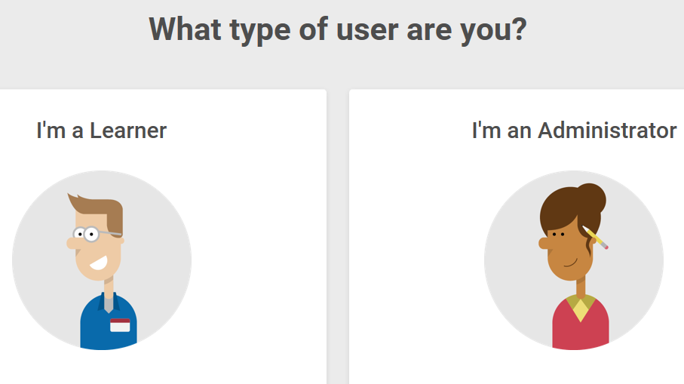
Support Hub
SUPPORT.CYPHERWORX.COM

Slide 28
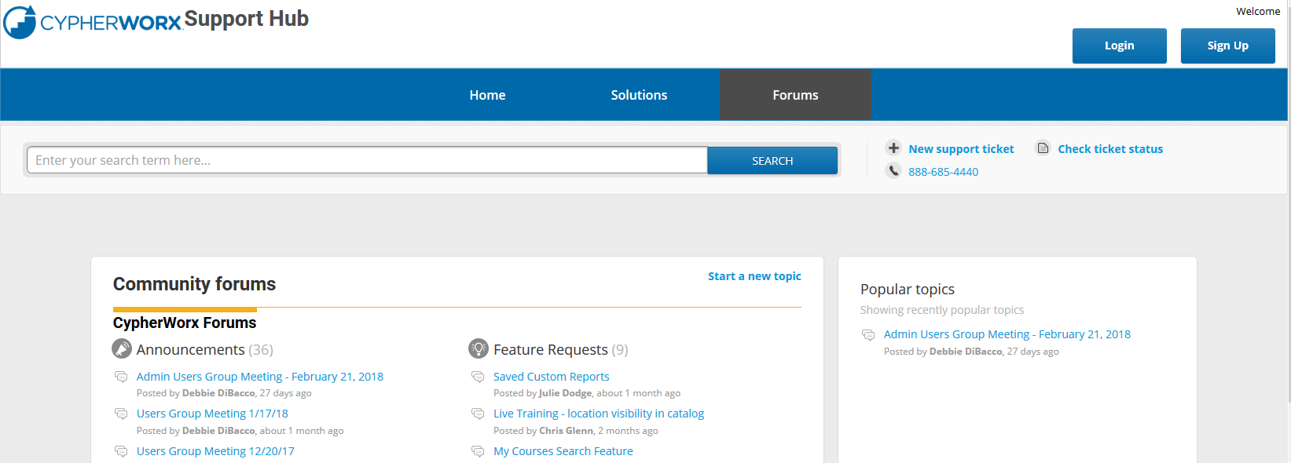
Review Meeting

Slide 29
Contact Info
Please feel free to reach out to our customer support folks after the webinar if you have more questions.
Chris Glenn – cglenn@cypherworx.com
Brett McIntosh – bmcintosh@cypherworx.com
Christopher Schramm – cschramm@cypherworx.com

Slide 30
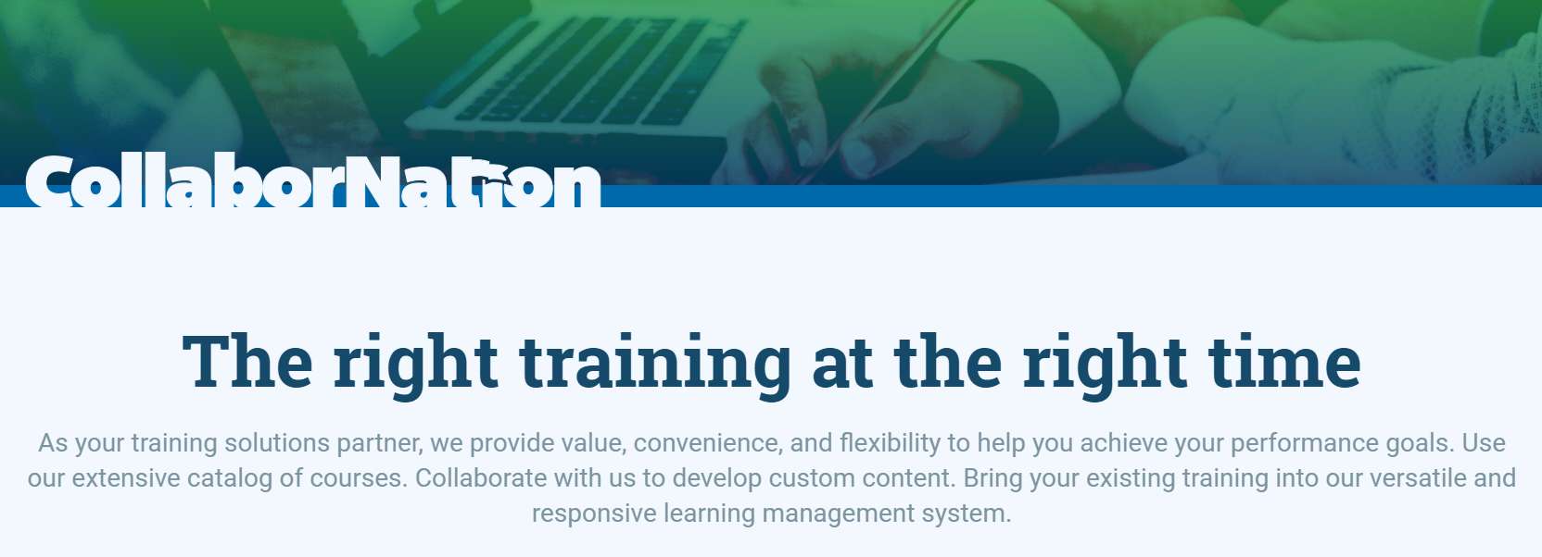
Lastly, thank you for your time today!
If there is ever anything that you would like to review or spend some time going into more detail about, please don’t hesitate to send a note to Chris G. to schedule a one-on-one session or small group session.

